Slide 1
Immediate and Partial Neural Dysfunction After Thyroid and Parathyroid Surgery: the Need for Recognition, Laryngeal Exam and Early Treatment
An American Head and Neck Society
Endocrine Surgery Section Consensus Statement
VK Dhillon, GW Randolph, BC Stack, Jr., B Lindeman, G Bloom, CF Sinclair, G Woodson, JA Brooks, LF Childs, NH Esfandiari, L Evangelista, E Guardani, L Quintanilla-Dieck,, MR Naunheim, ML Shindo, M Singer, N Tolley,
P Angelos, R Kupfer, V Banuchi, W Liddy, RP Tufano

Slide 2
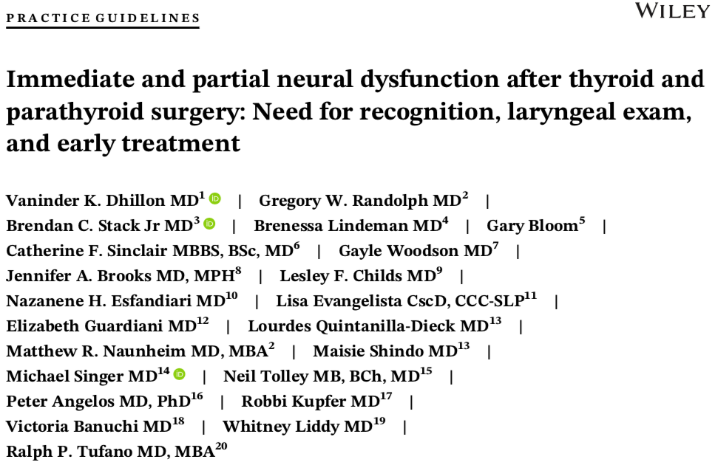

Slide 3
Consensus Development
Consensus Author Panel
National, multidisciplinary effort
Members of AHNS Endocrine Surgery Section, endocrine surgeons, head and neck surgeons, laryngologists, speech language pathologist, endocrinologists, ThyCa member representative
Recommendations
Authors with expertise for respective sections
Evidence based literature-publications from guidelines produced by the AAO, ATA and AHNS-Endocrine Section

Slide 4
Purpose
To define ‘immediate vocal fold paralysis’ (VFP) and ‘partial neural dysfunction’ (PND) as clinically relevant concepts that identify laryngeal dysfunction that occur after thyroid and parathyroid surgery with significant quality of life impact for patients
Identify subgroups of patients and optimize evaluation and treatment for patients with voice, swallowing and breathing issues after thyroid and parathyroid surgery

Slide 5
Background
The reported rates of vocal fold paralysis (VFP) after thyroidectomy are a significant underestimate of its true incidence
Vocal fold paralysis increases the risk for pneumonia, dysphagia, and increased risk for tracheostomy and gastrostomy tube as well as long-term mortality
Laryngeal dysfunction is more complex than vocal fold paralysis.
Encompasses sensory and motor dysfunction that can lead to symptoms of cough, globus sensation, dysphagia

Slide 6
Background
Partial neural dysfunction includes recurrent laryngeal nerve (RLN) and superior laryngeal nerve (SLN) injury
Efferent and afferent pathways involved in partial neural dysfunction include partial RLN dysfunction and partial or complete SLN dysfunction
Significant psychosocial morbidity with VFP that can contribute to frustration, isolation, fear, and altered self-identity for patients
Flexible laryngoscopy and videostroboscopy are important in identification and treatment of both, as well as early referral to Otolaryngology and Speech Language Pathology

Slide 7
Partial Neural Dysfunction
Signs/Symptoms
Motor dysfunction RLN – paresis, loss of tone, change in mucosal wave, paradoxical motion/laryngospasm, medial rotation of the arytenoid SLN (external branch) – change in pitch elevation, fine tuning of voice Pharyngeal plexus – dysphagia, loss of cricopharyngeal tone, globus sensation | Sensory dysfunction RLN – loss of cervical esophageal sensation, dysphagia, cough *SLN (internal branch)- cough, globus sensation
*Internal branch of the SLN (IBSLN) is not typically at direct risk during thyroid or parathyroid surgery except for rare exceptions

Slide 8
Statement #1
The terms transient and permanent vocal fold paralysis do not capture all varying states of laryngeal dysfunction that can occur after thyroid and parathyroid surgery. Laryngeal dysfunction is complex and involves more than just vocal fold motion impairment. A comprehensive evaluation in the immediate post-operative setting is important if there is concern for any neural dysfunction. We therefore introduce the term “immediate” vocal fold paralysis

Slide 9
Vocal Fold Paralysis
Impaired glottic closure caused by unilateral VFP in the immediate postoperative period can lead to significant functional deficits including communication impairment, dyspnea, and dysphagia. Bilateral VFP in the immediate post-operative period can lead to airway compromise and the need for emergent intervention
Dysphonia, dysphagia and dyspnea are symptoms of vocal fold paralysis
The identification of an immediate VFP enables early intervention in the form of patient counseling, voice therapy as well as early medialization procedures, or need for tracheostomy

Slide 10
Statement #2
Early identification, visualization and treatment of immediate post-operative neural dysfunction of the vocal fold, including vocal fold motion impairment, may allow for improved patient outcomes. Vocal fold examination in all of these patients should be performed in the immediate post-operative period which generally occurs within 2 weeks to 2 months

Slide 11
Early Identification of VFP
The following intraoperative scenarios are consistently associated with immediate VFP and should be confirmed and documented by flexible laryngoscopy: 1) known transection or sacrifice of the RLN, or 2) no response to stimulation of the vagus or RLN with the use of nerve monitoring at the end of surgery
Patients with known or suspected VFP, independent of symptoms, should undergo immediate evaluation and intervention even while admitted following thyroid or parathyroid surgery
Direct visualization of immediate VFP assists in 1) identification and documentation of the VFP 2) intervention in a prompt fashion, and 3) counseling of patients with or without symptoms

Slide 12
Statement #3
Laryngeal nerve injury can affect afferent and efferent pathways, resulting in a spectrum of dysfunction. Partial neural dysfunction includes non-voice complaints and therefore may be underdiagnosed. Clinicians should have a high index of suspicion for partial neural dysfunction and involve Otolaryngology-Head and Neck Surgery and Speech Language Pathology colleagues if symptoms persist within 2 weeks to 2 months post-operatively, who may perform a voice and non-voice evaluation, as well as direct visualization of the larynx

Slide 13
Statement #4
A standardized approach in the work up for patients with immediate vocal fold paralysis and partial neural dysfunction should include an objective voice and swallow evaluation through validated questionnaires, direct visualization of the larynx as well as further testing if indicated. Such testing may include videostroboscopy, laryngeal electromyography and a modified barium swallow evaluation

Slide 14
Evaluation

Slide 15
Statement #5
Videostroboscopy provides important information for patients with immediate vocal fold paralysis and partial neural dysfunction. This may apply to those whose voice evaluation and symptom assessment are discordant from preliminary laryngoscopy findings, as well as those with documented neural dysfunction with or without voice complaints, including states of superior laryngeal nerve dysfunction

Slide 16
Videostroboscopy
Videostroboscopy should be employed when subjective complaints are not reconciled by flexible laryngoscopy findings
A comprehensive laryngeal examination is important to assess laryngeal dysfunction over an extended period of time, with the use of task specific exercises
Early recognition of laryngeal dysfunction with appropriate specialists leads to improved patient counseling, and is beneficial and independent of the need for further treatment. This includes close patient follow up

Slide 17
Immediate and Partial Neural Dysfunction After Thyroid and Parathyroid Surgery: the Need for Recognition, Laryngeal Exam and Early Treatment
An American Head and Neck Society
Endocrine Surgery Section Consensus Statement
VK Dhillon, GW Randolph, BC Stack, Jr., B Lindeman, G Bloom, CF Sinclair, G Woodson, JA Brooks, LF Childs, NH Esfandiari, L Evangelista, E Guardani, L Quintanilla-Dieck,, MR Naunheim, ML Shindo, M Singer, N Tolley,
P Angelos, R Kupfer, V Banuchi, W Liddy, RP Tufano

