Slide 1
Salivary and Lacrimal Dysfunction after
Radioactive Iodine for Differentiated Thyroid Cancer:
American Head and Neck Society
Endocrine Surgery and Salivary Gland Sections
Joint Clinical Consensus Statement
MC Singer, F Marchal, P Angelos, V Bernet, L Boucai, S Buchholzer,
B Burkey, D Eisele, E Erkul, F Faure, S Freitag, MB Gillespie,
RM Harrell, D Hartl, M Haymart, J Leffert, S Mandel, BS Miller,
J Morris, EN Pearce, R Rahmati, WR Ryan, B Schaitkin,
M Schlumberger, BC Stack, D Van Nostrand, KK Wong, GW Randolph

Slide 2
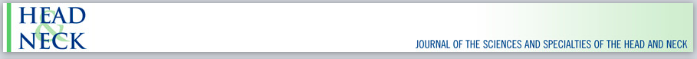
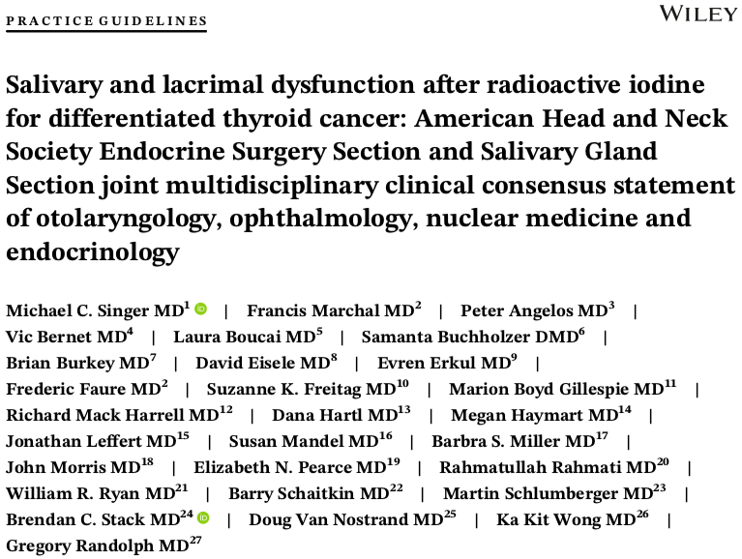

Slide 3
Background
Radioactive iodine (RAI) widely utilized in the management of differentiated thyroid cancer
Efforts to move towards more selective usage
Critical to consider the potential side effects and risks of RAI – including salivary and lacrimal dysfunction
Need for greater awareness of these complications and their optimal prevention and treatment

Slide 4
Methods
Multidisciplinary writing group convened by the AHNS Endocrine Surgery and Salivary Gland Sections
Included experts from Endocrinology, Nuclear Medicine, Ophthalmology, Endocrine Surgery, Otolaryngology
Literature search of RAI complications
Recommendations based on literature and expert opinion
Endorsed by AHNS QOC and council

Slide 5
Incidence
Incidence of acute sialadenitis ranges from 10-41%
  Parotid glands in 59‐81%; both glands are typically affected
  Submandibular glands in 16‐46%
Xerostomia appears 3-12 months after RAI treatment
  Incidence between 15-54%,
Dysgeusia from 13-27% - can be permanent
Ocular symptoms, including dryness, pruritus, epiphora, incidence between 2.5-25%
Prevalence decreases with time

Slide 6
Incidence
Risk of developing a secondary primary malignancy
  Divergent results from cancer epidemiologic investigations
  Given concentration of RAI in salivary gland tissue, these glands are potentially particularly at risk
Appears to be correlation between RAI dosing and younger age and risk of secondary primary malignancy
Marti JL, et al. Increased risk of second primary malignancy in pediatric and young adult patients treated with radioactive iodine for differentiated thyroid cancer. Thyroid 2015; 25:1159–1172.
Clement SC, et al. Intermediate and long‐term adverse effects of radioiodine therapy for differentiated thyroid carcinoma‐‐a systematic review. Cancer Treat Rev 2015; 41:925-934.

Slide 7
Recommendation 1
Given the potential for salivary and lacrimal side effects as well as secondary primary malignancy, patients in whom RAI therapy is being considered should receive pretreatment education regarding the prevalence and nature of these complications
  Xerostomia, sialadenitis, dry eyes, epiphora, nasal symptoms and, in rare instances, secondary primary malignancy should be discussed
Strong recommendation, moderate‐quality evidence

Slide 8
Recommendation 2
Physicians should be aware that secondary primary malignancies can be associated, rarely, with the use of RAI and relates to RAI activity and patient age
  Given this small but possible risk of a secondary malignancy, including of the salivary glands, kidneys and bone marrow, judicious, evidence‐based use of RAI is warranted
  In addition, these risks should be considered when determining optimal follow‐up
Weak recommendation, low‐quality evidence

Slide 9
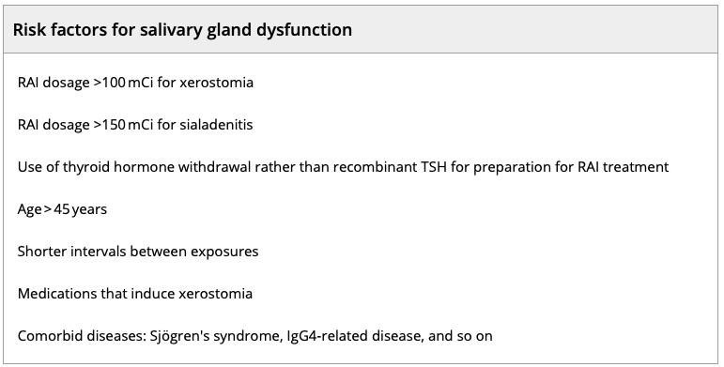
Risk Factors

Slide 10
Recommendation 3a
Given the association between administered activity of RAI, particularly >100 mCi, and frequency/severity of side effects, minimum effective, individualized RAI activity should be utilized
  Thyroid remnant ablation with 30 mCi of RAI has significantly less risk of inducing complications
  In patients with thyroid cancer, whose tumors are considered iodine-refractory, unless efforts at redifferentiation are attempted, RAI use should be avoided
Strong recommendation, moderate‐quality evidence

Slide 11
Recommendation 3b
The use of recombinant TSH rather than thyroid hormone withdrawal to prepare for RAI therapy appears to reduce both the risk of salivary and lacrimal gland complications
  This should be considered when determining the optimal protocol for patient RAI preparation
Weak recommendation, low‐quality evidence

Slide 12
Recommendation 3c
Other factors such as age, interval between RAI treatments, factors relating to salivary gland uptake, preexisting salivary gland disease, and xerostomic medication impact the risk of RAI related complications
  These should be considered when determining the risk-benefit calculation of RAI treatment for individual patients
Strong recommendation, low‐quality evidence

Slide 13
Prevention
In addition to aggressive hydration, range of interventions often recommended - medications, supplements, sialagogues, and massage
Sialagogues appear to have a protective effect
  Significant debate about when to initiate and frequency
Van Nostrand, et al. Radiopharmacokinetics of radioiodine in the parotid glands after the administration of lemon juice. Thyroid 2010; 20:1113–1119.
Nakada K, et al. Does lemon candy decrease salivary gland damage after radioiodine therapy for thyroid cancer? J Nucl Med 2005; 46:261-266.

Slide 14
Recommendation 4a
The use of lemon candies/juice and massage as RAI protectants should be considered
  The exact optimal time to start, frequency, duration, and particular sialagogue and method of massage to use remains unclear
Weak recommendation, moderate‐quality evidence

Slide 15
Recommendation 4b
There is insufficient data to recommend the use of other interventions, including the use of amifostine, vitamin E, selenium, or vitamin C as RAI protectants
Weak recommendation, low‐quality evidence

Slide 16
Treatment
For xerostomia management consists of conservative interventions with adequate hydration, tobacco avoidance and appropriate oral hygiene
Treatment of acute sialadenitis consists of nonsteroidal anti-inflammatory medications or oral corticosteroid
  If there is persistent painful swelling, erythema or pus seen at the papilla, a broad-spectrum antibiotic should be prescribed
  Sialagogues are contraindicated in the acute phase as they can worsen the symptoms

Slide 17
Treatment
Chronic sialadenitis typified by repeated episodes of salivary gland swelling and pain
  Salivary stimulants for hypofunctional tissue
Sialendoscopy offers a minimally invasive approach to diagnose and manage chronic sialadenitis
  Can manage ductal strictures which result secondary to RAI exposure

Slide 18
Recommendation 5
In patients experiencing symptoms after RAI exposure timely referral, to an otolaryngologist for salivary gland and an ophthalmologist for nasolacrimal gland dysfunction, is recommended
Strong recommendation, low‐quality evidence

Slide 19
Recommendation 6
Sialendoscopy should be considered in patients with RAI induced salivary gland sialadenitis that has not responded to conservative or medical management or that is recurrent or chronic in nature
Strong recommendation, low‐quality evidence

Slide 20
Salivary and Lacrimal Dysfunction after
Radioactive Iodine for Differentiated Thyroid Cancer:
American Head and Neck Society
Endocrine Surgery and Salivary Gland Sections
Joint Clinical Consensus Statement
MC Singer, F Marchal, P Angelos, V Bernet, L Boucai, S Buchholzer,
B Burkey, D Eisele, E Erkul, F Faure, S Freitag, MB Gillespie,
RM Harrell, D Hartl, M Haymart, J Leffert, S Mandel, BS Miller,
J Morris, EN Pearce, R Rahmati, WR Ryan, B Schaitkin,
M Schlumberger, BC Stack, D Van Nostrand, KK Wong, GW Randolph

