Slide 1
HPV-Related Oropharyngeal Cancer: What you need to know about diagnosis, treatment and management
Carole Fakhry, MD MPH
Michael Moore, MD FACS
Cheri Ann Nathan, MD FACS

Slide 2
Overview
Trends in epidemiology of HPV-related oropharyngeal cancer (HPV + OPC)
Presentation and approach to diagnosis
Treatment options for HPV + OPC
Indications for HPV vaccination and the status of implementation

Slide 3
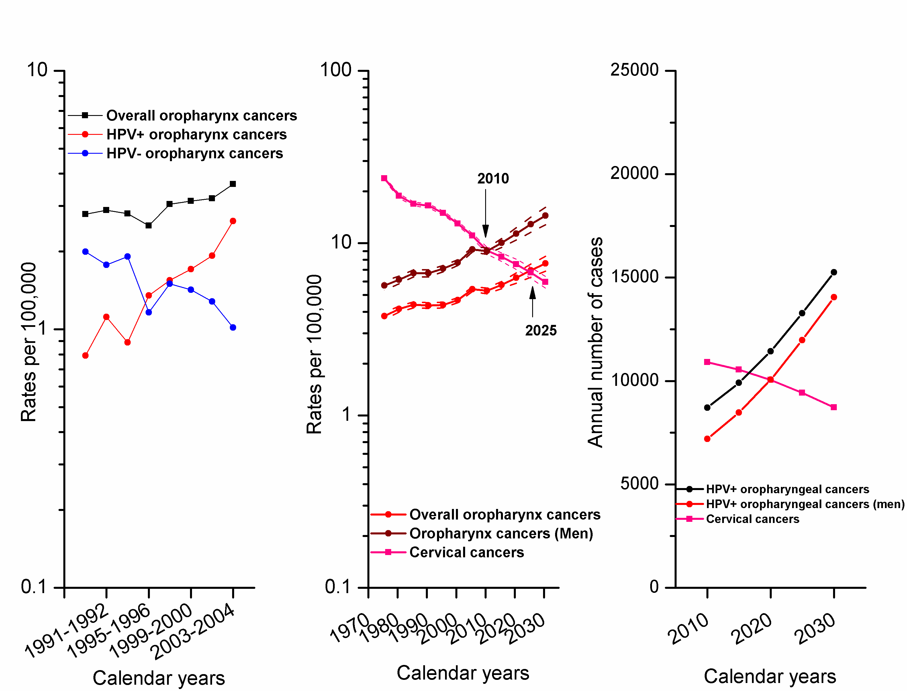
OPC incidence projected to surpass cervical cancer incidence in US
Notes:
Panel A shows incidence rates for all oropharyngeal cancers, HPV-positive oropharyngeal cancers, and HPV-negative oropharyngeal cancers during 1988-2004 in Hawaii, Iowa, and Los Angeles. Observed prevalence of HPV infection in oropharyngeal tumors included in the study (n=272) was reweighted to all cases of oropharyngeal cancers diagnosed during 1988-2004 using the inverse of the probability of selection into the study as weights. The probability of selection into the study was estimated specific for age group, gender, race, registry, and calendar period (in 2-year groups). These reweighted prevalence estimates were used to derive incidence rates for HPV-positive and HPV-negative oropharyngeal cancers in the three registries combined. Panel B shows the observed and projected incidence rates for oropharyngeal cancers (among both men and women), oropharyngeal cancers among men, and cervical cancers among women. Observed incidence rates during 1973-2007 from 9 registries within the SEER program were used in age-period-cohort models to project expected incidence through the year 2030. Panel C shows the projected number of cases of HPV-positive oropharyngeal cancers (among men and women), HPV-positive oropharyngeal cancers among men, and cervical cancers among women through the year 2030. Projected incidence rates shown in Panel B were applied to the 2008 U.S. population projections to calculate the annual number of cases. The annual number of HPV-positive oropharyngeal cancer cases was calculated assuming 70% prevalence of HPV infection in oropharyngeal cancers.

Slide 4
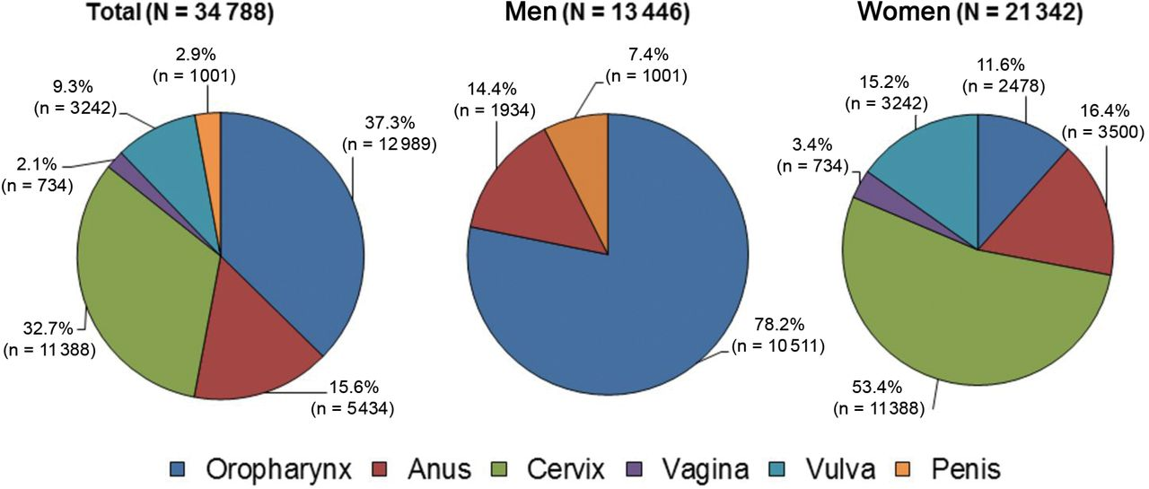
Number of new HPV + OPC overall and by sex, in the United States, 2009.
Jemal A et al. JNCI J Natl Cancer Inst 2013;105:175-201
© The Author 2013. Published by Oxford University Press.
Notes:
Number of new human papillomavirus (HPV)–associated cancers overall, and by sex, in the United States, 2009. Source: National Program of Cancer Registries and Surveillance, Epidemiology, and End Results areas reported by the North American Association of Central Cancer Registries as meeting high-quality incidence data standards for the specified time period. Note that the number of cancer cases underestimates the actual number of cases occurring because of incomplete coverage of population-based registries in 2009 (93%). HPV-associated cancers are defined as cancers at specific anatomic sites and with specific cellular types in which HPV DNA frequently is found. Some of these cancers may not necessarily be HPV-positive because no testing was conducted. Virtually all cervical cancers are due to HPV infection, along with 90% of anal cancers, more than 60% of certain subsites of oropharyngeal cancers, and approximately 40% of vagina, vulva, and penile cancers.

Slide 5
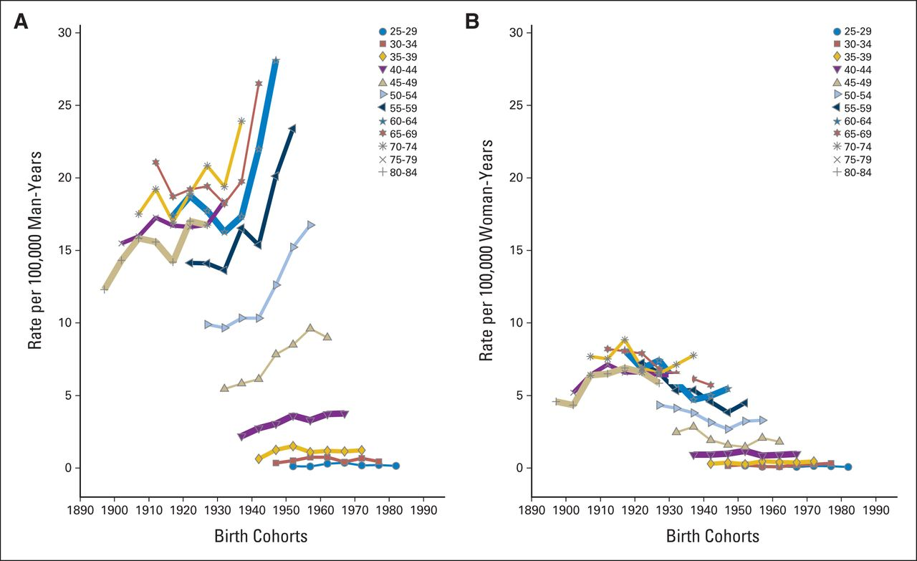
Increased incidence rates OPC primarily among men and younger age-cohorts
Notes:
Shown are incidence rates for oropharyngeal cancers among (A) men and (B) women, stratified by cohort year of birth (in 10-year overlapping groups) and age (in 5-years groups). Data were derived from nine cancer registries covered by the National Cancer Institute's SEER program (1973 to 2011). Oropharyngeal cancers include the base of tongue, lingual tonsil, soft palate, uvula, tonsil, oropharynx, and Waldeyer's ring.

Slide 6
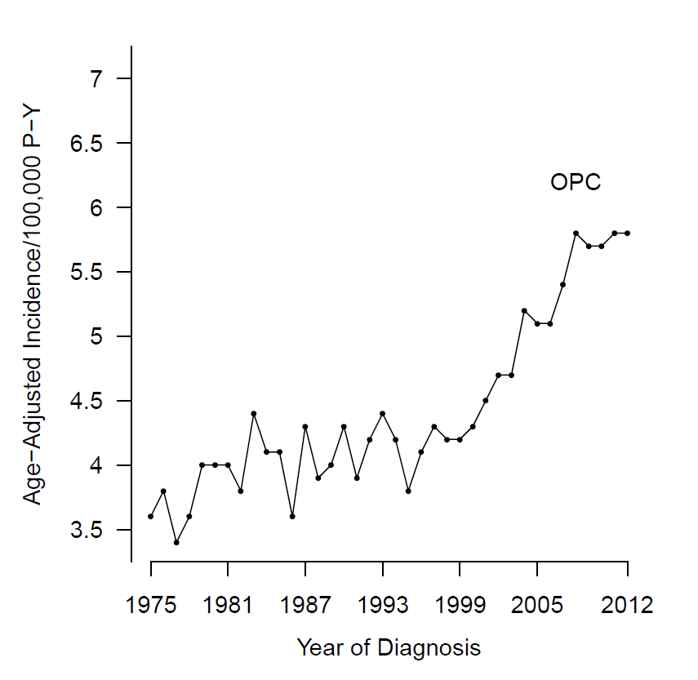
Incidence of OPC in the US: SEER (1975-2012)
 | Percent change
Overall | 62.6
Sex
Male | 81.8
Female | -1.6
Race
White | 87.7
Black | -18.3
Other | 5.9
Age
30-39 | 68.5
40-49 | 73.1
50-59 | 81.2
60+ | 51.3
P<0.001
Patel et al. Cancer 2016

Slide 7
HPV Virology
HPV infects basal keratinocytes in skin and mucus membranes
Estimated that 43-62% of genital swabs would harbor HPV
Many people will clear infection
Expression of L1 and L2 capsids lead to viral proliferation but not carcinogenesis
HPV DNA incorporation leads to expression of E6 and E7 oncogenetic proteins → necessary for carcinogenesis

Slide 8
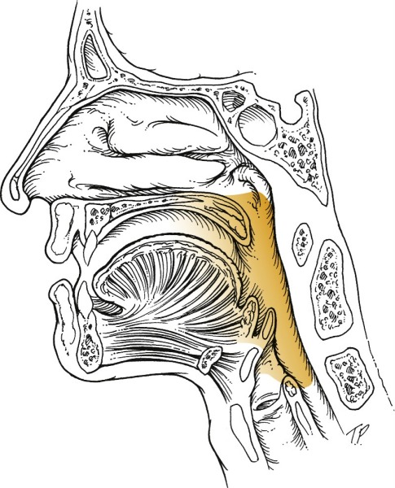
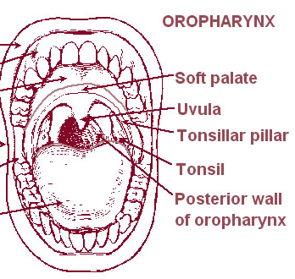
Where does HPV + OPC occur? Palatine tonsils and base of tongue
Base of tongue

Slide 9
Case presentation
50 year old man notices a lump while shaving. No other symptoms; feels great (golfs, runs, full time job, kids etc). Non-smoker. Maybe recent URI
PCP gives 2 rounds of antibiotics
After antibiotics obtains CT scan which shows enlarged lymph node
Neck mass in adult needs evaluation!

Slide 10
Diagnosis
Referral to otolaryngology/ head and neck surgeon
History, examination.
Biopsy (neck and primary)
HPV detection (in situ hybridization or p16 immunohistochemistry)
Staging

Slide 11
Distinct clinical profile
Oropharynx: palatine and lingual tonsils
Unknown primary site
Smaller primary tumor (earlier T stage)
Nodal disease at presentation
Fakhry et al JNCI 2008
Fakhry et al JCO 2008

Slide 12
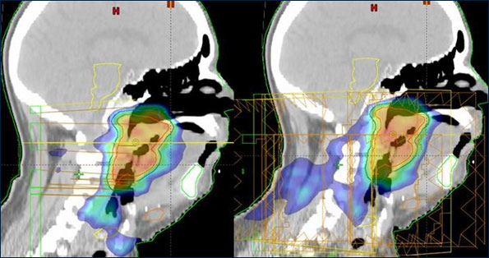
Oropharyngeal cancer: management
Non surgical
Radiation
Chemoradiation
Surgical
Open
Transoral
-Standard
-Robotic resection
-Laser resection

Slide 13
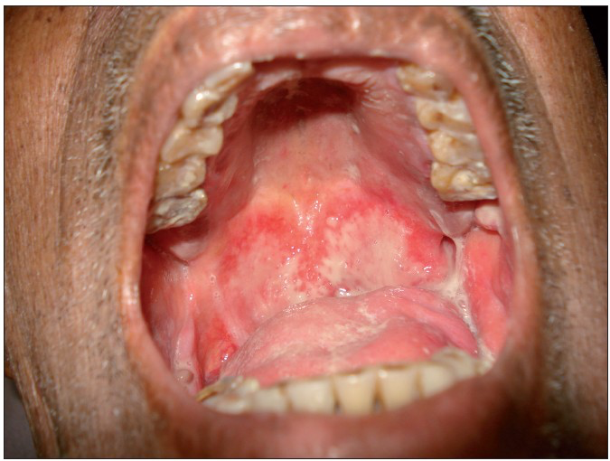
Side effects of non-surgical therapy
Taste disturbance (88%)
Nausea/vomiting (36%)
Dry mouth (29-38% )
Esophageal stricture (5% )
G-tube dependence longer than 1 year (9% )
Patients treated with radiation demonstrated more dental problems and dry mouth and decreased Quality of Life
jpalliativecare.com, Irune, et al, 2014, Kocak-Uzel, et al, 2014, Nutting, et al, 2011, McBride, et al, 2014, Broglie, et al, Laryngoscope, 2013
Notes:
Not sure if need??

Slide 14
Cost of HPV-related OPSCC
12,989 new cases annually
Chesson, et al, 2012 (2004-2007 data)
Mean lifetime cost per new case is $43,200, with societal cost of $306 million
Incidence has more than doubled since then!!

Slide 15
Oral HPV transmission
Oral HPV is not casually transmitted (i.e., by sharing drinks, kiss on the cheek)
Partners have likely already shared any infections
With new partners, discuss protection methods (e.g., condoms, barrier protection)
Exposure does not mean cancer

Slide 16
Partner’s level of risk…
Rate of oral HPV infection among partners is same as that among general population (no increased risk)
Partners of patients with HPV-associated HNSCC may have slightly higher rates of HPV-associated cancers (anal, penile, oropharyngeal) but these cancers remain rare
Chances of developing these cancers remain low overall

Slide 17
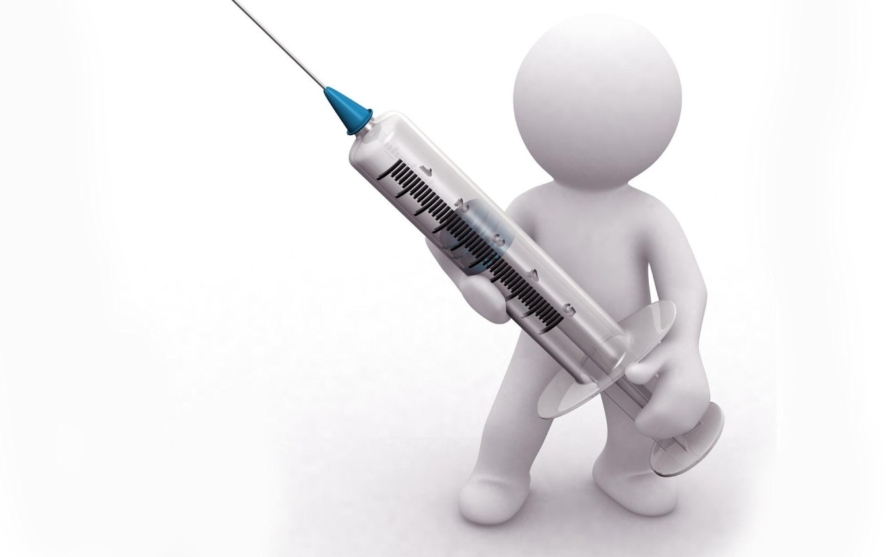
Goals of vaccination
Shown to effectively prevent anogenital HPV infection, premalignancy and cancer
Impart immunity to strains of HPV prior to exposure
Decrease burden of infection/exposure/ HPV-related cancer on a population level

Slide 18
HPV vaccination
ACIP recommendations
Routine immunization of 11-12 yo males and females
Catch-up vaccination of
Up to 21 yo males
Up to 26 yo females
Immunosuppressed males and females through 26 yo
Gay and bisexual men through 26yo
Before sexual debut
The present vaccines
Quadrivalent (Gardasil®, Merck)
HPV6, 11, 16 and 18
HPV16 is responsible for ~95% of HPV-OPSCC
Nonavalent (Gardasil®, Merck)
HPV6, 11, 16, 18, 31, 33, 45, 52, and 58
Bivalent (Cervarix™, GSK)
HPV 16 and 18
All are safe and effective
3 doses over 6 months
Those who can complete the course before age 15 can use a 2 dose regimen between 6 to 12 months apart
http://www.cdc.gov/vaccines/vpd-vac/hpv/vac-faqs.htm
Notes:
Males- initial 2009, updated 2011.
Females. 2007
Can start as early/ approved for 9yo although recommendations are for these ages.

Slide 19
Vaccine Efficacy
Rates of HPV infection targeted by vaccine fell from 11.5% in 2003-2006 to 5.1% in 2007-2010
Effectiveness of getting at least one shot was 82%
From the 79 million doses of Gardisil distributed since 2006, <0.1% have had a reported serious adverse event
Markowitz, et al, J Infectious Dis, 2013

Slide 20
HPV Vaccine Efficacy
7,466 women given either HPV 16/18 vaccine or Hep A Vaccine
93.3% Vaccine efficacy
→ Due to long latent period before cancer development, direct study to prove efficacy in preventing OPC is unlikely
Herrero et al, PLOS ONE 2013

Slide 21
Vaccine Implementation
Center for Disease Control
In 2015, only 63% of girls 13-17 had received one dose and 42% had received all 3 doses
50% of boys have received 1 dose and 28% have received all 3 doses
Primary reason is that it is not recommended by their doctors!!

Slide 22
Summary
HPV Vaccine is recommended for girls and boys
Goal is to immunize prior to infection
Vaccine has proven efficacious
Utilization is poor but improving
Education is needed
Children and young adults
Parents
Pediatricians and other practitioners

