Slide 1
Surgical Management of the Recurrent Laryngeal Nerve in Thyroidectomy
C. Fundakowski, N. Hales, N. Agrawal, M. Barcynski, P. Camacho, D. Hartl, E. Kandil, W. Liddy, T. McKenzie, J. Morris, J. Ridge, R. Schneider, J. Serpell, C. Sinclair, S. Snyder, D. Terris, R. Tuttle, CW. Wu, R. Wong, M. Zafereo, G. Randolph

Slide 2
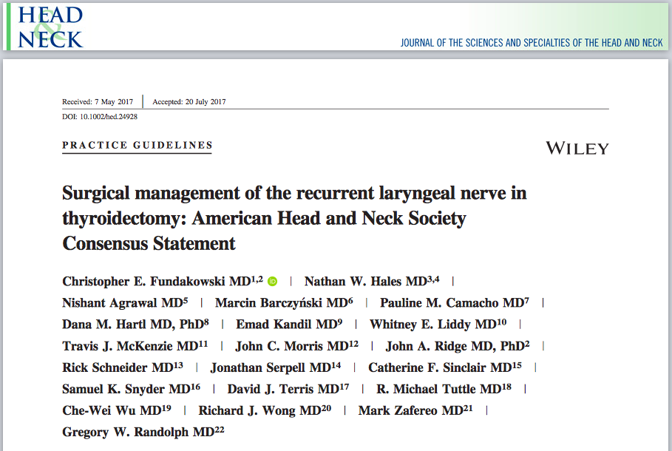

Slide 3
Consensus Development
Consensus Author Panel
  International, multidisciplinary effort
  Members of AHNS Endocrine Surgery Section, endocrinologists, endocrine surgeons, head & neck surgeons
Recommendations
  Authors with expertise for respective sections
  Evidence based literature - thyroid surgical publications & recent AAO-HNS, AHNS & ATA guidelines

Slide 4
Surgical Management of the Recurrent Laryngeal Nerve in Thyroidectomy
Intention: To help guide surgeons in clinical decision making for intraoperative RLN management, particularly in the setting of thyroid cancer
Statement includes discussion of:
  Details of RLN embryology & anatomy
  Surgical approaches to RLN
  Advances in RLN monitoring
  Management of RLN invaded by malignancy
  Concept of staged surgery
  Implications for radioactive iodine

Slide 5
Background
Post-thyroidectomy voice complaints - 30-87%
Rates of RLN injury reported to be - 3-5%
True incidence significantly underestimates - closer to 10%
Risk factors for RLN injury during thyroidectomy:
  Revision procedures
  Malignancy, Graves’ disease
  Recurrent or substernal goiter
  Hematoma exploration
  Surgeon volume

Slide 6
Background
Unilateral
  Dyspnea
  Dysphonia (hoarseness, vocal fatigue, breathy voice)
  Dysphagia with potential aspiration.
Bilateral
  Stridor
  Respiratory distress
  Airway compromise due to obstruction

Slide 7
Recommendation 2.1
Comprehensive understanding of the embryology and anatomy of the RLN, larynx, and neck base is essential for optimal management of the RLN during thyroidectomy

Slide 8
RLN Embryology
Thyroid - fusion of the medial thyroid anlage (derived from the primitive pharynx) & the lateral thyroid anlage (derived from the neural crest)
  Tubercle of Zuckerkandl - a posterior lateral projection from the thyroid, represents this site of fusion
Superior parathyroid gland - originates from the 4th branchial pouch
RLN - arises from the vagus nerve
  Carries motor, sensory, parasympathetic fibers

Slide 9
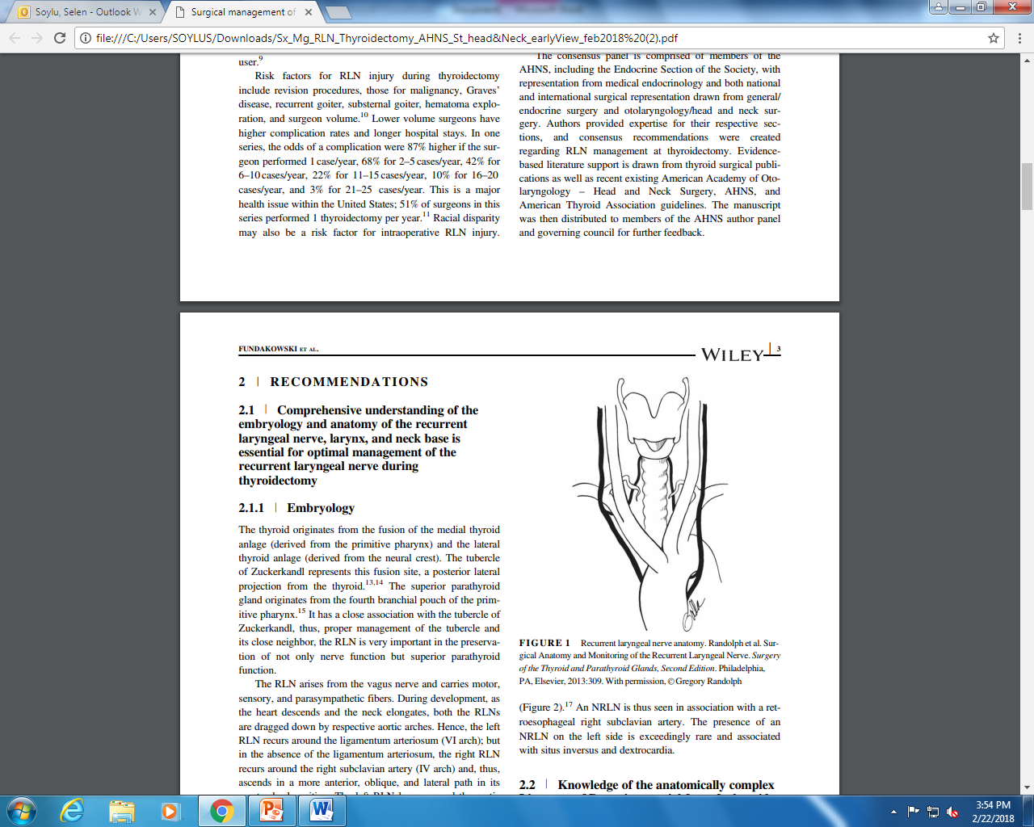
Anatomy of the RLN
Right RLN
  Loops around right subclavian artery
  Ascends in more anterior, oblique and lateral path
Left RLN
  Loops around aortic arch
  Ascends more vertically & deeper in left tracheoesophageal groove.
Both nerves
  Cross inferior thyroid artery
  Enter larynx below cricothyroid joint just under inferior constrictor muscles

Slide 10
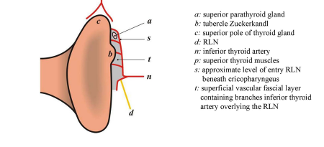
Anatomy of the RLN

Slide 11
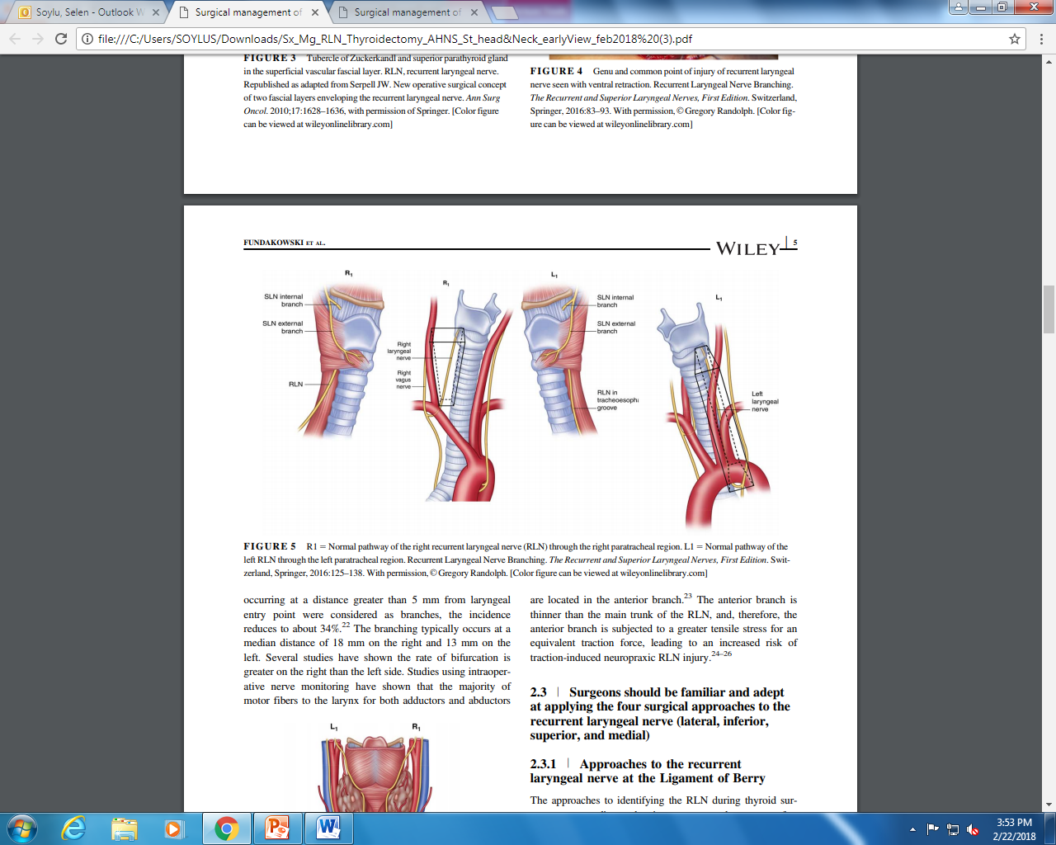
Anatomy of the RLN

Slide 12
Non-recurrent Laryngeal Nerve
Direct medial course from vagus nerve
  Usually at level of inferior thyroid artery
  Ascends in tracheoesophageal groove
Usually occur on right side
Estimated incidence 0.5-1%

Slide 13
Recommendation 2.2
Knowledge of the anatomically complex Ligament of Berry is essential for safe thyroid and parathyroid surgery

Slide 14
Ligament of Berry
Ligament of Berry is the most common site of RLN injury
“I have noticed in operations of this kind, which I have seen performed by others upon the living, and in a number of excisions, which I have myself performed on the dead body, that most of the difficulty in the separation of the tumor has occurred in the region of these ligaments. . .. This difficulty, I believe, to be a very frequent source of that accident, which so commonly occurs in removal of goiter, I mean division of the recurrent laryngeal nerve.”
-Sir James Berry, 1887

Slide 15
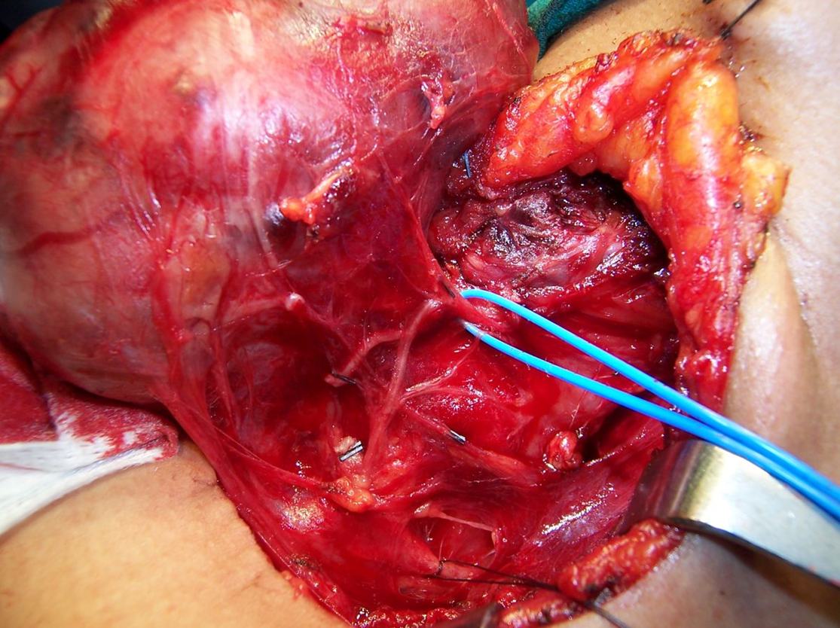
Ligament of Berry - Anatomy
At the distal 2 cm of its extra-laryngeal course the RLN is intimately related to the Ligament of Berry.

Slide 16
Recommendation 2.3
Surgeons should be familiar and adept at applying the four surgical approaches to the recurrent laryngeal nerve (lateral, inferior, superior, and medial)

Slide 17
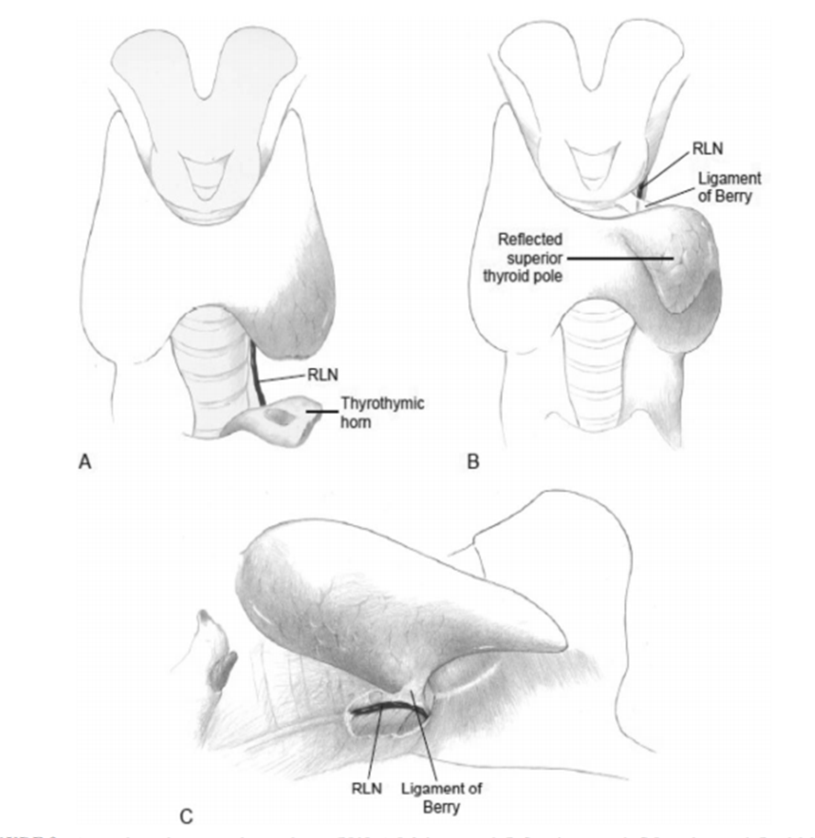
Approaches to RLN
Inferior approach - more useful in revision cases
Superior approach - for large goiters

Slide 18
Approaches to RLN
Lateral approach - most common approach
Medial approach - may be useful in large goiters & in cases with small incisions

Slide 19
Recommendation 2.4
Instruments/technology/intraoperative nerve monitoring - loss of signal

Slide 20
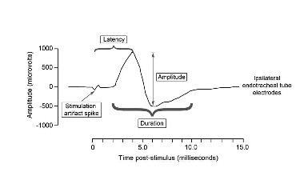
Recommendation 2.4
Physiology of IONM -electromyographic (EMG) data from thyroarytenoid/vocalis muscle
Current IONM options:
  Intermittent IONM (I-IONM)
    Handheld probe
  Continuous IONM (C-IONM)
    Temporary implantable vagus electrode

Slide 21
Recommendation 2.5
Intraoperative neural monitoring can provide more information than sight alone during thyroidectomy

Slide 22
Value of IONM
IONM provides:
1) Neural mapping information before nerve visualization
2) Prognostic information about nerve function
3) Information about site of nerve injury
4) Improved management of SLN
5) Information regarding possible duration of subsequent vocal cord paralysis

Slide 23
Value of IONM
Intermittent IONM allows early detection & elucidation of mechanism of RLN injury
  Learn and plan better intraoperative and postoperative management
Continuous IONM (C-IONM) permits real time monitoring of vagal & RLN functional integrity
  May identify EMG signals associated with early-impending injury
  Surgeon alerted to stop a maneuver causing stretching or compression of RLN
  Better recovery of nerve function

Slide 24
Recommendation 2.6
Optimal management of the recurrent laryngeal nerve that is adherent to or invaded by cancer requires knowledge of preoperative glottic function through preoperative laryngeal examination as well as intraoperative monitoring electromyography signal

Slide 25
RLN Invasion
Superficial epineural invasion:
  Shave or partial nerve sheath excision can allow for macroscopically clean margins with a functionally intact RLN
More extensive invasion:
  Preoperative VCP: RLN resection recommended
  Functional status determined by:
1) Preoperative laryngeal exam
2) Intraoperative EMG signal

Slide 26
RLN Invasion
Invaded functioning RLN:
  Attempt neural preservation
  No survival benefit with complete resection VS small remnant & adjuvant Rx
  Complete resection considered in selected cases of expected improvement in disease-free or overall survival

Slide 27
Recommendation 2.7
In cases of loss of signal without electromyography recovery, the surgeon should consider staging the contralateral procedure to limit risk of bilateral cord paralysis and tracheotomy

Slide 28
Recommendation 2.7
Possible false positive LOS or concern for complete cancer resection should be weighed against risk of bilateral VCP
Completion surgery performed:
1) When vocal fold mobility recovers postoperatively
2) Based on multidisciplinary discussion & patient counseling

Slide 29
Recommendation 2.8
Management of the recurrent laryngeal nerve and Ligament of Berry intraoperatively have substantial implications for postoperative radioactive iodine thyroid bed scintillographic uptake and, therefore, significant implications for endocrinologists

Slide 30
Postoperative Radioactive Iodine
Even with meticulous total thyroidectomy high resolution postoperative RAI scan can detect small foci of uptake
Identifiable areas of uptake often seen on SPECT-CT after total thyroidectomy commonly occur in areas closely related to the RLN

Slide 31
Conclusion
RLN & EBSLN injury is often preventable with a thorough understanding of:
  The embryology & anatomy of the RLN, Ligament of Berry & tubercle of Zuckerkandl
  Surgical experience
  An understanding of IONM
Safe & thorough thyroidectomy can be reliably performed with proper technique and knowledge
Multidisciplinary (endocrinology & surgery) approach can provide the highest surgical/oncological outcomes

Slide 32
Surgical Management of the Recurrent Laryngeal Nerve in Thyroidectomy
C. Fundakowski, N. Hales, N. Agrawal, M. Barcynski, P. Camacho, D. Hartl, E. Kandil, W. Liddy, T. McKenzie, J. Morris, J. Ridge, R. Schneider, J. Serpell, C. Sinclair, S. Snyder, D. Terris, R. Tuttle, CW. Wu, R. Wong, M. Zafereo, G. Randolph

