Slide 1
Perioperative Pain Management and Opioid-Reduction
In Head and Neck Endocrine Surgery:
An American Head and Neck Society
Endocrine Surgery Section Consensus Statement
JK Ferrell, ML Shindo, BC Stack, Jr., P Angelos, G Bloom, AY Chen, L Davies, JC Irish, T Kroeker, SD McCammon,
C Meltzer, LA Orloff, A Panwar, JJ Shin, CF Sinclair,
MC Singer, T Wang, GW Randolph

Slide 2
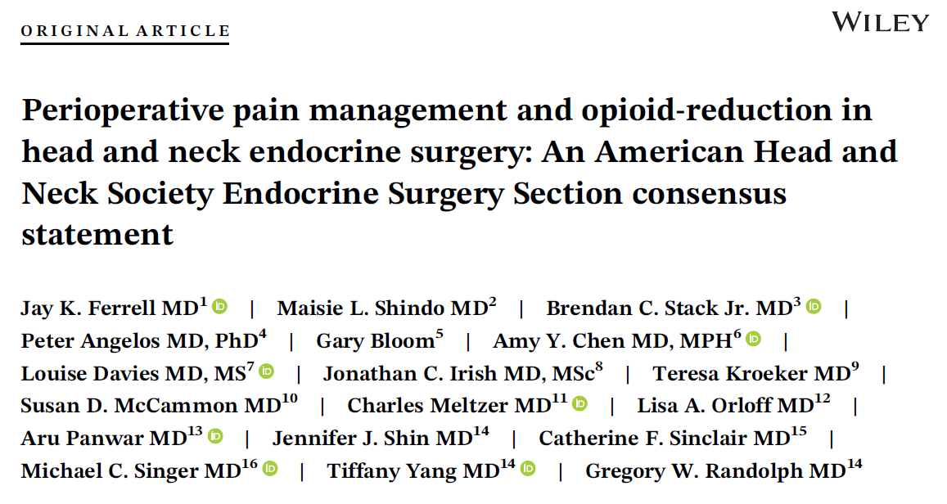

Slide 3
Background
Opioid addiction continues to be a public health crisis
Between 1999 and 2018, nearly 450,000 people died as a result of opioid misuse
Crisis is multifactorial however overprescribing of opioids is a major contributing factor
Secondary addiction can occur after short duration of use such as after outpatient surgery
Despite growing literature, evidence-based guidelines to assist surgeons with proper outpatient opioid prescribing or alternative pain management approaches are lacking

Slide 4
Purpose
AHNS Endocrine Section convened an expert panel to critically evaluate current literature and provide better consensus on best practices for perioperative pain management for head and neck endocrine procedures

Slide 5
Methods
Expert panel: 18 panelists including members of the AHNS, 1 member of ThyCa, and MPH/evidence-based medicine experts
Extensive review of relevant literature published between Jan 2000- April 2020
Consensus statements developed on literature review and best available evidence
Modified Delphi method used to determine level of consensus for each statement

Slide 6
Focus of Consensus Statements
Perioperative multimodality pain management strategies
Postoperative opioid prescribing
Pain management in patients with chronic pain
Preoperative pain risk assessment and patient counseling
Supportive pain management programs and technology

Slide 7
Results of Modified Delphi
Finalized survey distributed to expert panel included 13 total statements
Consensus was demonstrated for 12 statements
Only statement 1c did not reach full consensus

Slide 8
Multimodal Perioperative Pain Management
Statement 1a: Multimodality, non-opioid medication regimens can be used successfully as first-line pain management in head and neck endocrine surgery (consensus)
Employing synergistic combinations of non-opioid meds (acetaminophen, NSAIDs, gabapentin)
Statement 1b: Preoperative non-opioid pain medications can mitigate postoperative pain and reduce patients' overall opioid requirements (consensus)

Slide 9
Multimodal Perioperative Pain Management
Statement 1c: In addition to proper surgical technique, intraoperative strategies—including selective use of regional anesthesia and non-opioid general anesthetic agents—may be beneficial in reducing the need for postoperative opioids after thyroid and parathyroid surgery (non-consensus)
3 members of panel not in agreement citing lack of strong evidence on cost versus benefit of regional cervical nerve block

Slide 10
Multimodal Perioperative Pain Management
Statement 1d: Non-opioid medications and adjunctive strategies can effectively manage pain after head and neck endocrine procedures and reduce postoperative opioid requirements (consensus)

Slide 11
Postoperative Prescribing of Opioids
Statement 2a: Head and neck endocrine surgeons should utilize opioid medications judiciously and only if first line non-opioid medications are insufficient or medically contraindicated
If needed, <75 MME* provides adequate pain control in most opioid-naïve patients
Significant proportion of patients may be managed with even less or no opioids
Statement 2b: Non-opioid medications and adjunctive strategies can effectively manage pain after head and neck endocrine procedures and reduce postoperative opioid requirements
*MME- morphine milligram equivalents; 75 MME = 10 tabs of oxycodone 5mg or 15 tabs of hydrocodone 5mg

Slide 12
Postoperative Prescribing of Opioids
Statement 2c: Establishing perioperative processes that address patients' pain management enhances and supports efforts to reduce postoperative opioid prescribing
Statement 2d: Evidence-based institutional process initiatives and protocols support surgeons in evaluating and improving their perioperative pain management practices

Slide 13
Chronic Pain and Postoperative Pain Management
Statement 3: Successful postoperative pain management in patients with underlying chronic pain conditions may be enhanced through collaboration with pain medicine specialists and the judicious use of opioid medications after thyroid and parathyroid surgery (consensus)
For many patients with chronic pain conditions, maintaining their baseline regimen will be sufficient
If major adjustments are needed, surgeons should consult with hospital pain service and/or patients’ pain management provider

Slide 14
Preoperative Pain Assessment and Patient Education
Statement 4a: Surgeons should proactively assess for patient specific factors and underlying conditions which could impact pain experiences and portend higher pain management requirements (consensus)
Ex: Age < 45yrs, prior opioid use, history of alcohol abuse, medications (anxiolytics, SSRIs, ACE inhibitors)
Statement 4b: Preoperative education that clearly defines pain expectations and the benefits of multimodality pain management reinforces efforts to curtail postoperative opioid prescribing (consensus)

Slide 15
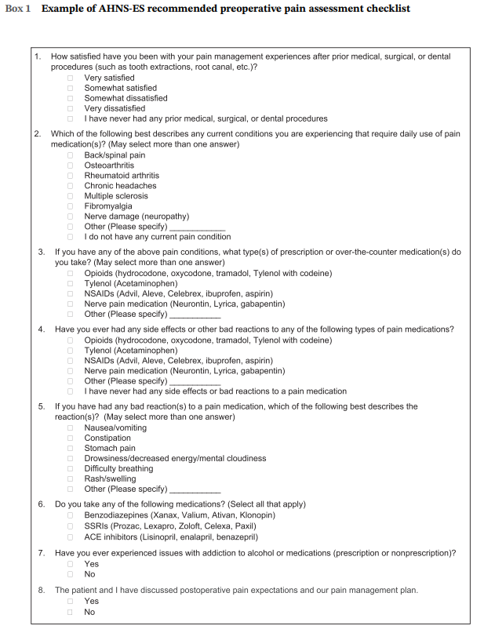
Preoperative Pain Assessment and Patient Education
Statement 4c: Surgeon performed pain management education should be strongly encouraged and, whenever possible, integrated into the preoperative workflow (consensus)

Slide 16
Supportive Pain Management Programs and Technology
Statement 5: When available, participation in statewide prescription drug monitoring programs may curtail excessive or unnecessary prescribing of postoperative opioids (consensus)
States are increasing use and enforcement of prescription drug monitoring programs (PDMPs)
Evidence on the efficacy of PDMPs is mixed but studies have suggested less community diversion and lower mortality rates
Additional technologies such as EMR add-ons and electronic patient pain assessments are becoming more available

Slide 17
Summary and Conclusions
Successful, comprehensive perioperative pain management spans the continuum of the operative encounter
Surgeons should proactively assess for patient-specific pain risk factors and counsel on perioperative pain management expectations
Multimodality pain control is foundational to reducing unnecessary use of opioid medications postoperatively
Surgeons capitalize on continuing educational opportunities and emerging technologies to improve pain management outcomes
Further studies and evidence-based guidelines for perioperative pain management are clearly warranted

Slide 18
Perioperative Pain Management and Opioid-Reduction
In Head and Neck Endocrine Surgery:
An American Head and Neck Society
Endocrine Surgery Section Consensus Statement
JK Ferrell, ML Shindo, BC Stack, Jr., P Angelos, G Bloom, AY Chen, L Davies, JC Irish, T Kroeker, SD McCammon,
C Meltzer, LA Orloff, A Panwar, JJ Shin, CF Sinclair,
MC Singer, T Yang, GW Randolph

