Slide 1





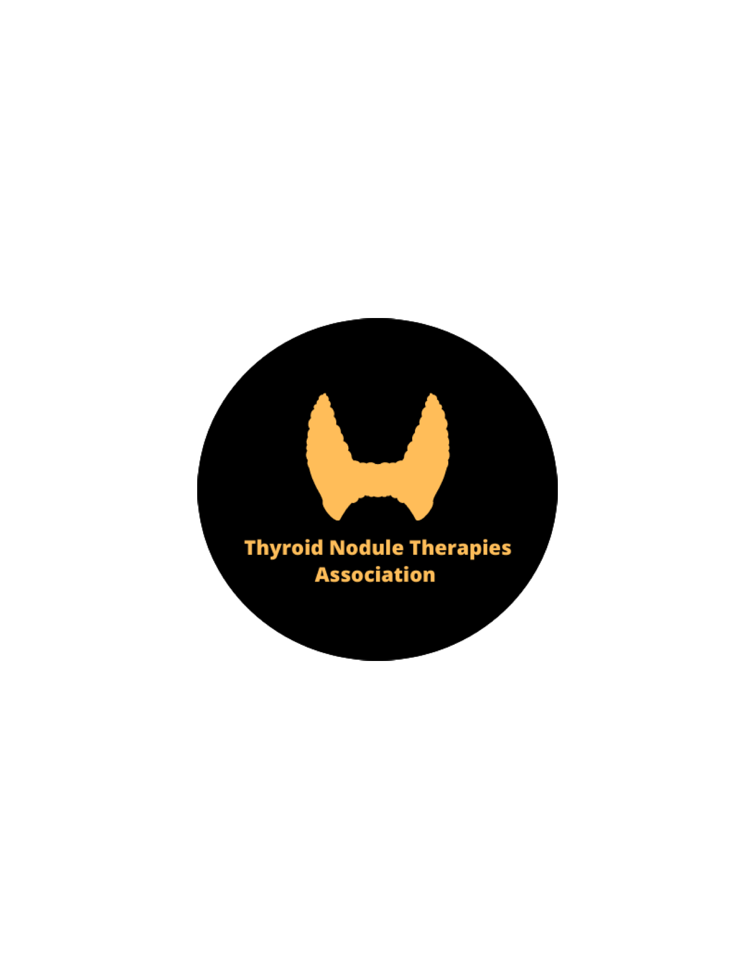


Radiofrequency Ablation and Related Ultrasound-Guided Ablation Technologies for Treatment of Benign and Malignant Thyroid Disease: An International Multidisciplinary Consensus Statement of the American Head and Neck Society Endocrine Surgery Section with the Asia Pacific Society of Thyroid Surgery, Associazione Medici Endocrinologi, British Association of Endocrine and Thyroid Surgeons, European Thyroid Association, Italian Society of Endocrine Surgery Units, Korean Society of Thyroid Radiology, Latin American Thyroid Society, and Thyroid Nodules Therapies Association

Slide 2

Author Panel
Lisa A Orloff, Julia E Noel, Brendan C Stack, Jr., Marika D Russell, Peter Angelos, Jung Hwan Baek, Kevin Brumund, Feng-Yu Chiang, Mary Beth Cunnane, Louise Davies, Andrea Frasoldati, Laszlo Hegedüs, Ayaka J Iwata, Emad Kandil, Jennifer Kuo, Celestino Lombardi, Mark Lupo, Ana Luiza Maia, Bryan McIver, Dong Gyu Na, Roberto Novizio, Enrico Papini, Kepal N Patel, Leonardo Rangel, Jonathon O Russell, Jennifer Shin, Maisie Shindo, David Shonka, Amanda S Karcioglu, Catherine Sinclair, Michael Singer, Stefano Spiezia, Jose Higino Steck, David Steward, Kyung Tae, Neil Tolley, Roberto Valcavi, Ralph P Tufano, R Michael Tuttle, Erivelto Volpi, Che Wei Wu, Gregory W Randolph

Slide 3
Overview
Introduction
Methods
  Author panel selection
  Proposed statement development
  Modified delphi method
Background
  Principles of thermal ablation
  Radiofrequency ablation (RFA)
  Laser ablation (LTA)
  Microwave ablation (MWA)
  High Intensity focused Ultrasound (HIFU)
  Alcohol (ethanol) ablation (EA)

Slide 4
Overview
Pre-procedural evaluation
  Benign thyroid nodules
  Cytologically indeterminate thyroid nodules
  Malignant disease
  Ultrasound evaluation and considerations
  Voice and laryngeal assessment
  Informed consent
  General assessment of procedural fitness
  Management of anticoagulation

Slide 5
Best Practice Recommendations: Pre-procedural Evaluation
Recommendation 1: US-guided ablation procedures may be used as a first-line alternative to surgery for patients with benign thyroid nodules contributing to compressive and/or cosmetic symptoms.
Recommendation 2: Though less efficacious than surgery or RAI in normalizing thyroid function, thermal ablation procedures can be a safe therapeutic alternative in patients with an autonomously functional thyroid nodule and contraindications to first-line techniques.

Slide 6
Best Practice Recommendations: Pre-procedural Evaluation
Recommendation 3a: US-guided ablation procedures may be considered in patients with suitable primary papillary microcarcinoma who are unfit for surgery or decline surgery or active surveillance.
Recommendation 3b: US-guided ablation procedures may be considered in patients with suitable recurrent papillary thyroid carcinoma who are unfit for surgery or decline surgery or active surveillance.
Recommendation 3c: Pre-procedural biochemical and imaging assessment aid in determining curative vs. palliative treatment intent for treatment of recurrent papillary thyroid carcinoma.

Slide 7
Best Practice Recommendations: Pre-procedural Evaluation
Recommendation 4a: Subjective voice assessment should be undertaken prior to performance of US-guided ablation procedures in any candidate.
Recommendation 4b: Patients with voice impairment or relevant prior surgical history warrant a laryngeal evaluation and assessment of vocal fold mobility.
Recommendation 4c*: Laryngeal exam should be performed prior to ablation on the contralateral side after ipsilateral ablation.
*Indicates statement did not reach consensus among author voting panel. 7 of 39 voting authors voted “neutral” or “disagree.”

Slide 8
Best Practice Recommendations: Pre-procedural Evaluation
Recommendation 5a: Prior to pursuing US-guided ablation procedures, complete radiographic, biochemical, medical, and symptomatic evaluation should be performed and may be facilitated by completion of a checklist.
Recommendation 5b: Prior to pursuing US-guided ablation procedures, discussion should be held with the patient regarding expected outcome(s) and potential risks.

Slide 9
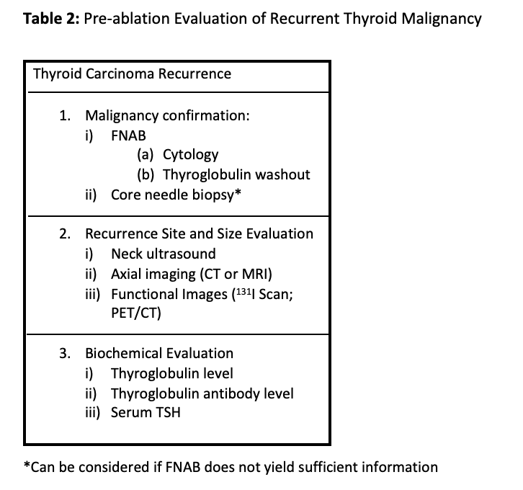

Slide 10
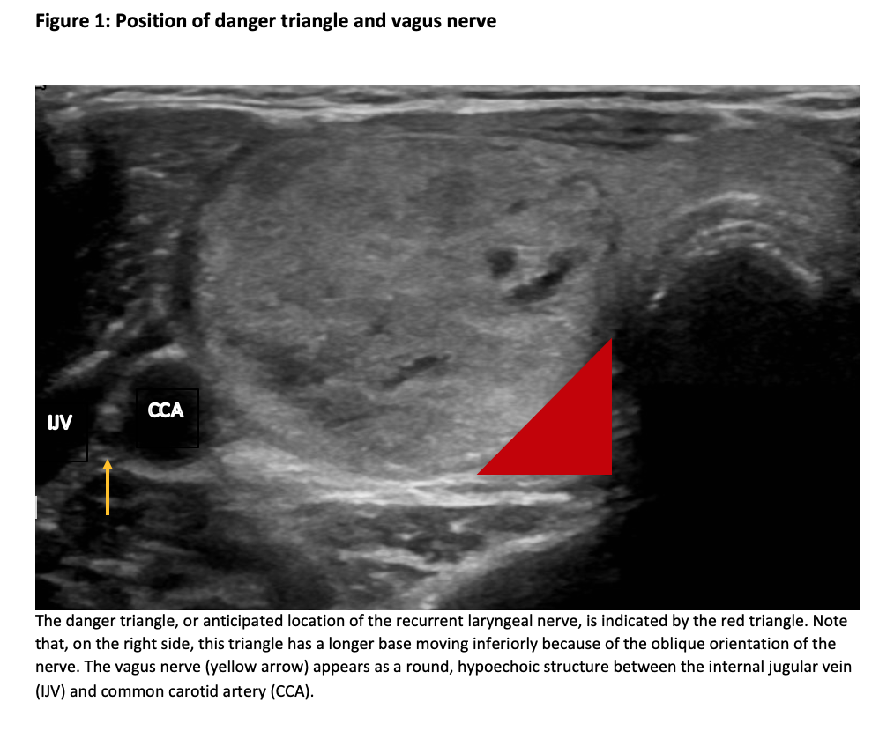

Slide 11
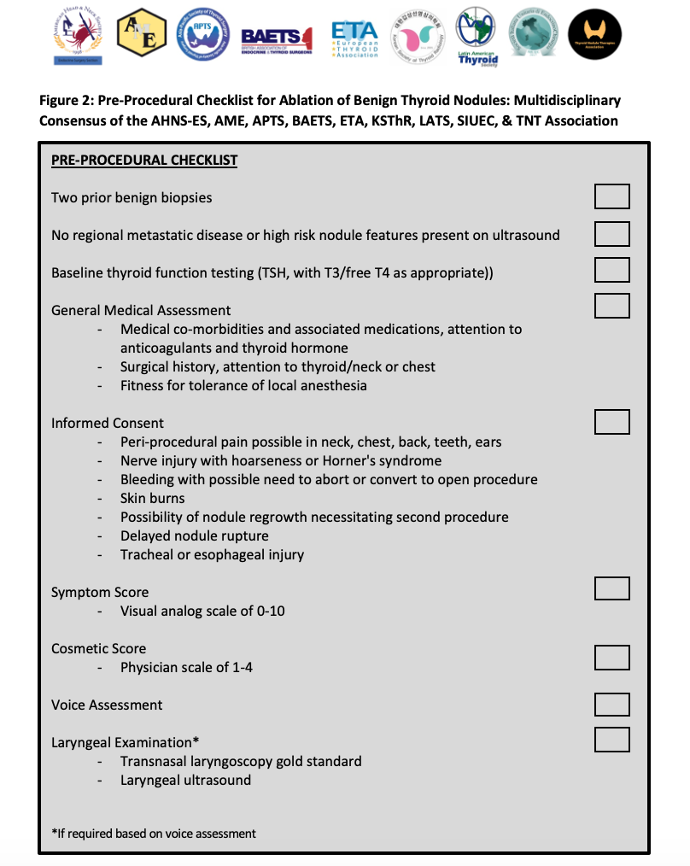

Slide 12
Overview
Technique
  RFA
  Technique/equipment considerations
  LTA
  MWA
  HIFU
  EA

Slide 13
Best Practice Recommendations: Technique
Recommendation 6**: When patient co-morbidities and disposition permit, performance of US-guided ablation procedures under local anesthesia allows for monitoring of peri-procedural complications.
Recommendation 7: Hydrodissection creates distance between the target lesion and vital structures, thereby minimizing patient discomfort and reducing unintended thermal spread.
**Indicates statement was borderline for meeting consensus among author voting panel. 3 of 39 voting authors voted “neutral” or “disagree.”

Slide 14
Best Practice Recommendations: Technique
Recommendation 8a: In performance of RFA, utilization of the moving shot technique via the trans-isthmic approach and delivery of energy only when the needle tip is visualized by US is paramount to effective ablation.
Recommendation 8b. The moving shot technique via the trans-isthmic approach minimizes inadvertent thermal injury to surrounding critical structures.
Recommendation 9: Continuous patient vital sign monitoring is not universally required for all ablation techniques; however established guidelines for procedural sedation in adults should be followed if sedation is administered.

Slide 15
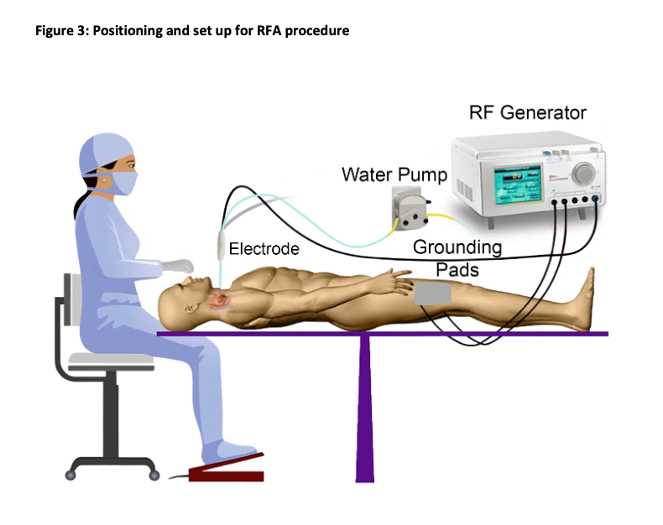

Slide 16
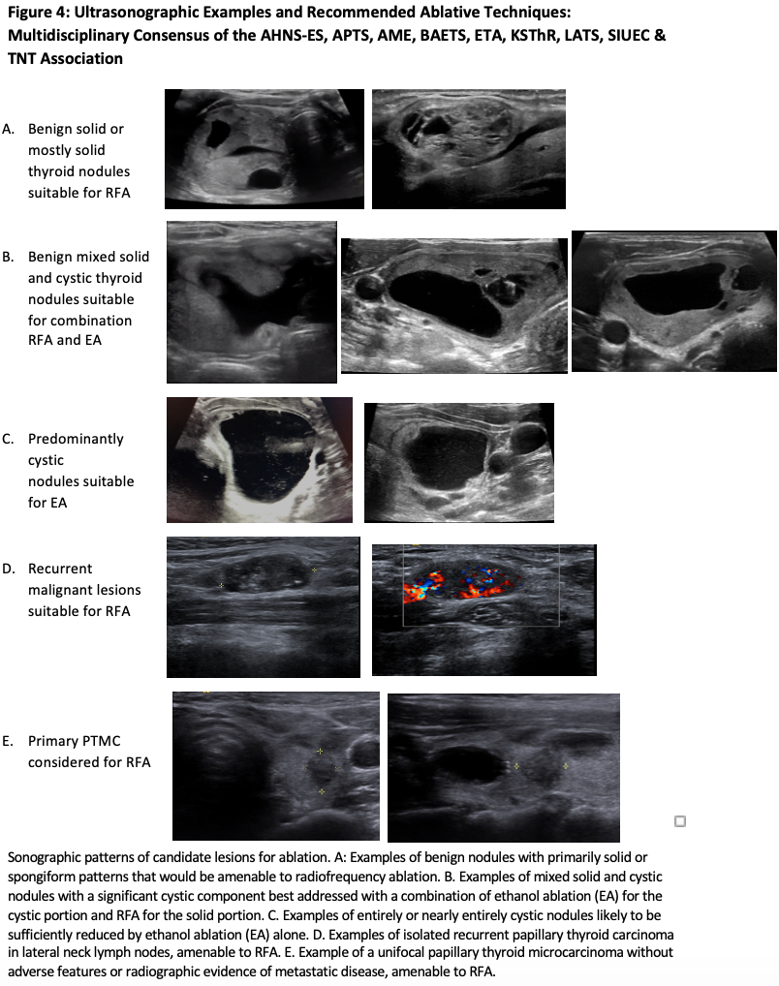

Slide 17
Overview
Post-procedural considerations
  Acute post-procedure management
  Extended follow-up

Slide 18
Best Practice Recommendations: Post-procedural Considerations
Recommendation 10: Immediate clinical and ultrasonographic assessment of acute complications following thermal ablation is required.
Recommendation 11a: Subjective voice assessment should be undertaken by the treating physician following ablation in any candidate.
Recommendation 11b: Changes in voice compared with the pre-operative status reported by the patient or detected by the physician require laryngeal evaluation with assessment of vocal fold mobility.

Slide 19
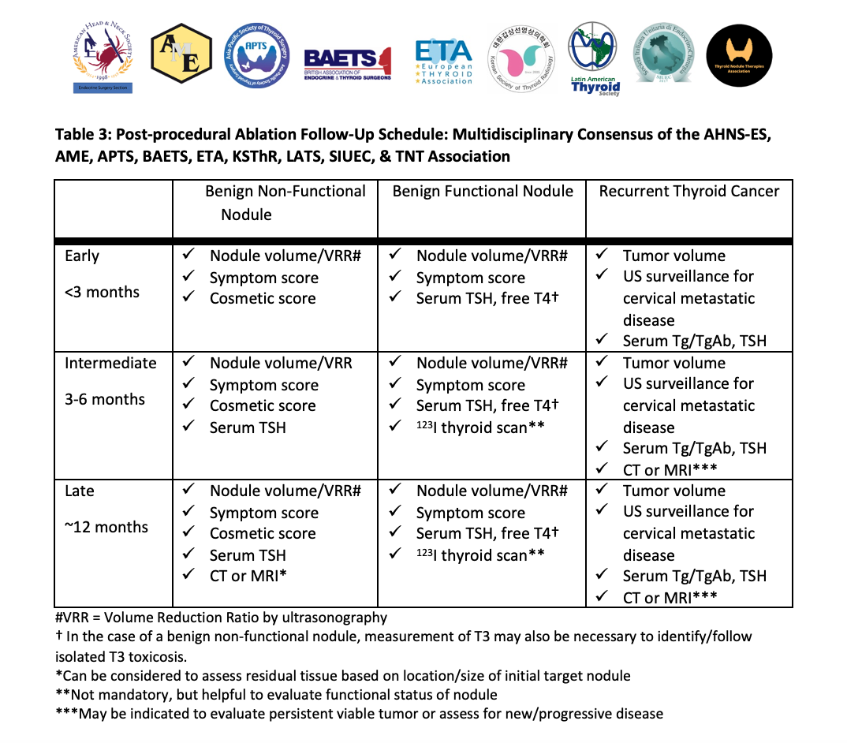

Slide 20
Overview
Efficacy/Outcomes
  Measures of success
    Benign disease
    Malignant disease
  Effectiveness of ablation by technique
    RFA
    MWA
    HIFU
    EA
    Summary and implications of efficacy data

Slide 21
Best Practice Recommendations: Efficacy and Outcomes
Recommendation 12: Careful documentation of both objective and subjective metrics before treatment and during the follow-up period is important to establish treatment effectiveness and to set realistic expectations.
Recommendation 13a: Following thermal ablation for benign nodules, primary objective measures of efficacy include ultrasonographic measurement of volume reduction and preservation or normalization of thyroid function
Recommendation 13b: Patient-reported outcomes, including validated symptom, cosmetic, and quality of life instruments may be used to determine efficacy.

Slide 22
Best Practice Recommendations: Efficacy and Outcomes
Recommendation 13c: Repeat ablation of a benign nodule can be considered for remnant nodular tissue contributing to unresolved symptomatic or cosmetic concerns.
Recommendation 13d: Retreatment for persistent hyperthyroidism may be performed.

Slide 23
Best Practice Recommendations: Efficacy and Outcomes
Recommendation 14: Following thermal ablation for recurrent malignancy, ultrasonographic determination of tumor volume, assessment of locoregional disease status, and serum Tg/TgAb are performed to evaluate treatment response.
Recommendation 15: In the setting of primary malignancy, sonographic volume reduction or complete resolution of the malignant lesion, along with long-term assessment of disease progression, are necessary to determine oncologic effect.

Slide 24
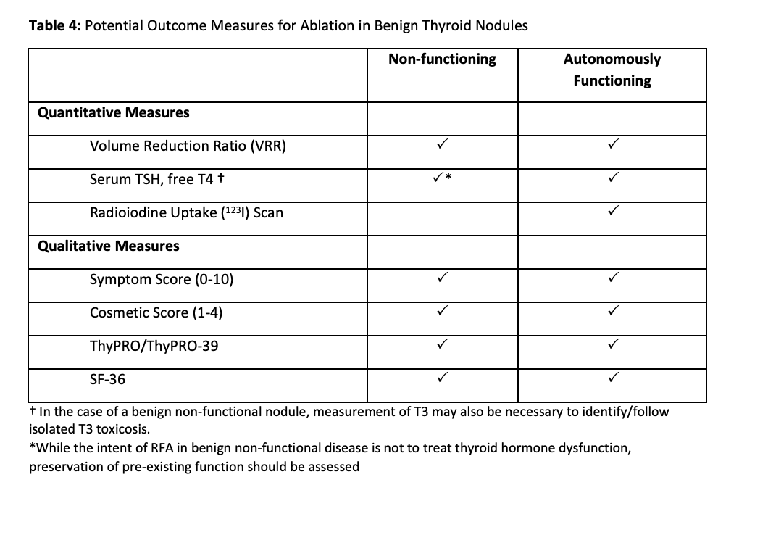

Slide 25
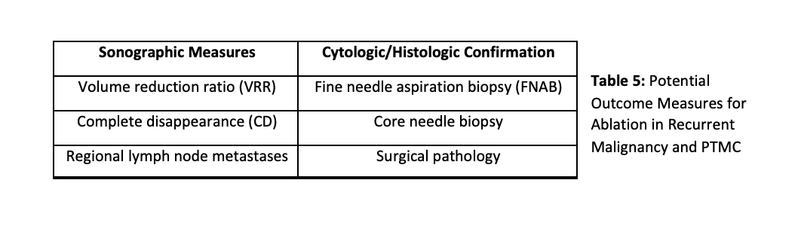

Slide 26
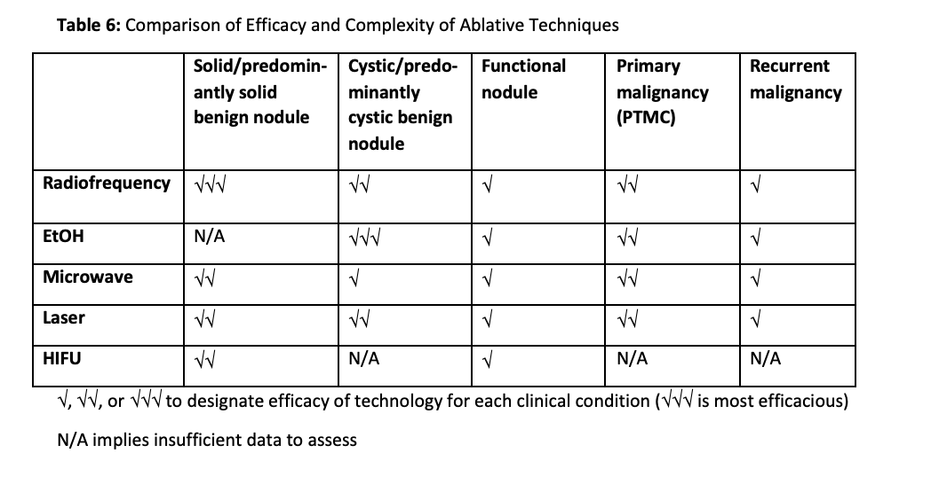

Slide 27
Overview
Potential complications
Implementation
Summary and future directions

Slide 28
Best Practice Recommendations: Complications
Recommendation 16: Assiduous recording of complications resulting from thermal ablation is recommended in order to accurately inform practitioners and patients about the safety of these procedures.

Slide 29
Best Practice Recommendations: Implementation
Recommendation 17a: Prior to performing any US-guided thermal ablation procedure, advanced training in and facility with US of the thyroid and neck are essential.
Recommendation 17b. Proficiency with US-guided fine needle aspiration biopsies of thyroid nodules is recommended for performance of US-guided ablation procedures.

Slide 30
Best Practice Recommendations: Implementation
Recommendation 17c. The provider should receive specific instruction on the chosen ablation technique, with the opportunity to practice on a phantom model and observe cases.
Recommendation 17d: Optimal practice involves one’s initial cases being supervised by a physician experienced in US-guided ablation procedures.
Recommendation 18: Physicians performing US-guided thyroid ablation who do not provide longitudinal patient care should communicate and facilitate long-term follow-up with a care team specializing in management of nodular thyroid disease.

