Slide 1
Trends in Diagnosis of Noninvasive Follicular Thyroid Neoplasm With Papillarylike Nuclear Features and Total Thyroidectomies for Patients With Papillary Thyroid Neoplasms
Lisa Caulley, MD, MPH; Antoine Eskander,MD, ScM; Weining Yang, MD; Edel Auh, BS;
Lydia Cairncross, MBChB, MMED; Nancy L. Cho, MD; Bahar Golbon, BHSc; Subramania Iyer,MS, MCh;
Jeffrey C. Liu, MD; Paul J. Lee, MD, PhD; Brenessa Lindeman, MD, MEHP; Charles Meltzer, MD;
Nicole Molin, MD; Alessandra Moore, MD; Julia Noel, MD; Halie Nozolino, BS; Jesse Pasternak, MD, MPH;
Brendon Price, PhD, MBBCh; TimRamsay, PhD; Lars Rolighed, MD, PhD; Mirabelle Sajisevi, MD;
Arun Sharma, MD, MS; Catherine Sinclair, MD; Meredith Sorensen, MD; Kyung Tae,MD, PhD;
Alice L. Tang, MD; Gabriel Tsao, MD; Michelle Williams, MD; SeanWrenn, MD; Monica H. Xing, BA;
Mark Zafereo, MD; Brendan C. Stack Jr, MD; Greg Randolph, MD; Louise Davies, MD,MS

Slide 3
Background
The incidence of thyroid cancer has increased over the past 3 decades
Rise in thyroid cancer is postulated to be in part attributable to the detection of small, localized papillary thyroid carcinomas (PTCs), particularly early-stage PTCs that have increased without improvements in thyroid cancer–related morbidity or mortality rates
Strategies have been developed to try to mitigate overtreatment
American Thyroid Association (ATA) 2015 guidelines recommending consideration of lobectomy for qualifying low-risk thyroid neoplasms up to 4 cm in size
Noninvasive encapsulated follicular variant PTC was reclassified as noninvasive follicular thyroid neoplasm with papillarylike nuclear features (NIFTP) to reflect key histopathologic features of PTC but a lack of aggressiveness

Slide 4
Objective
To determine:
How the new NIFTP classification has changed diagnostic rates of PTC
Whether there is variation in use of the new diagnostic category across different locations
Whether extent of surgery for PTC has changed with the new ATA guideline recommendations

Slide 5
Methods
Multicenter, multinational retrospective analysis of patients who underwent thyroid-directed surgery
18 contributing centers from 6 countries (US, Canada, Denmark, South Korea, South Africa, and India)
Eligible cases included adult patients (18 years and older at the time of surgery) who had undergone thyroid-directed surgery for any thyroid pathology in calendar years 2015 and 2019
Each institution submitted the first consecutive 100 or highest number available (if <100) of pathology records
Centers were also invited to submit the first 100 or highest number available of cases for 2016, 2017, and 2018 (if available)

Slide 6
Methods
A standardized case report form was developed, piloted, refined and distributed to all participating institutions
Data elements extracted:
Age
Sex
Year of surgery
Fine-needle aspiration (FNA) cytology result
Whether molecular testing was performed
Type of surgery performed
Greatest dimension of the nodule or tumor
Final pathology

Slide 7
Methods
Data sources:
Individual patient clinical records
Operative reports
Pathology reports

Slide 8
Methods
Primary Outcomes
Frequency of NIFTP diagnosed in patients who underwent thyroidectomy in 2019
Secondary Outcomes
Proportion of PTC diagnosed among all thyroidectomies in 2015 and 2019
Proportion of total thyroidectomies performed in patients diagnosed with PTC in 2015 and 2019
Factors contributing to extent of primary surgery over the 2 study periods
For sites that provided data for 2016 through 2018
Proportion of NIFTP diagnosed among all thyroidectomies
Proportion of PTC diagnosed among all thyroidectomies
Total thyroidectomies performed in patients diagnosed with PTC

Slide 9
Methods
Statistical Analysis
Demographics were summarized by year
Continuous variable comparisons were evaluated using a Mann–Whitney U-test
Categorical comparisons between patients were made using Chi-squared test
Logistic regression analysis to evaluate patients who differed by year surgery but were similar with respect to other characteristics

Slide 10
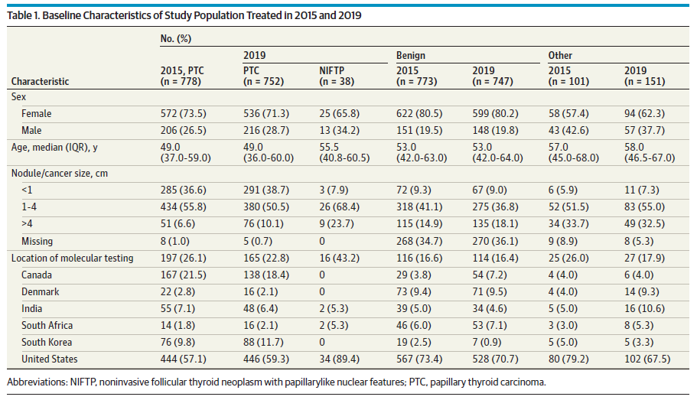
Results

Slide 11
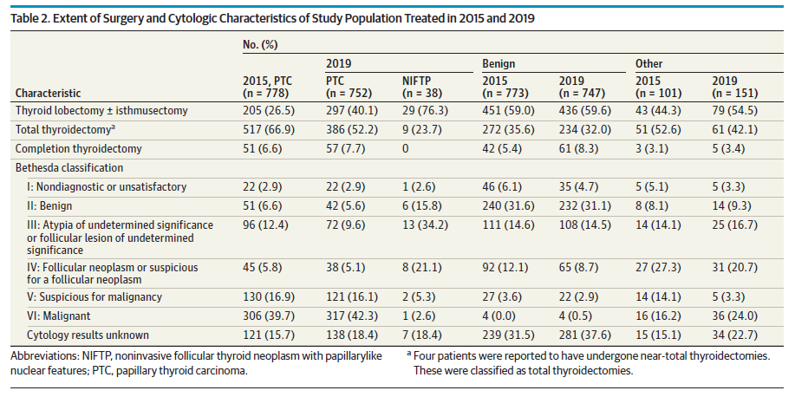
Results

Slide 12
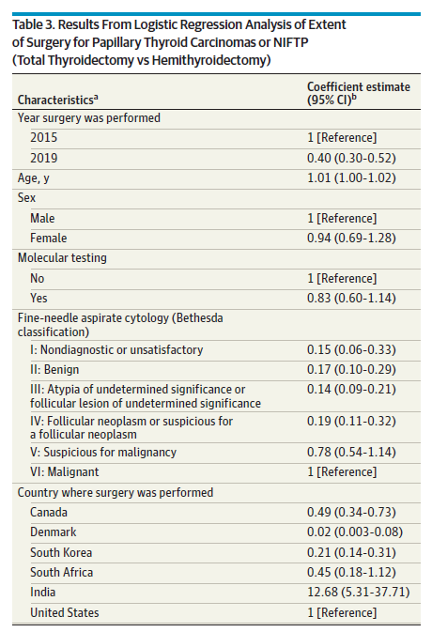
Results

Slide 13
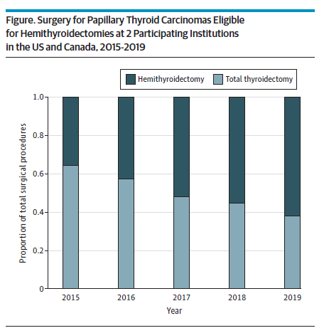
Results

Slide 14
Discussion
In this multi-institutional analysis of a cohort of PTC specimens, in 2019 the diagnosis of NIFTP was observed in only 4.7% of papillary thyroid neoplasms
Uniform low rates of application of the NIFTP diagnosis across participating countries
Approximately 40% of eligible PTCs were treated with hemithyroidectomy in 2019
More than 50% of PTCs eligible for deescalated management with hemithyroidectomy continued to be treated with total thyroidectomy in 2019

Slide 15
Discussion
Strengths of this study:
Provides contemporary information on trends
Inclusion of international sites
Straightforward design
Use of standardized data collection approaches across institutions
Study limited by:
Lack of information about reasons for selection of surgical approach
Population limited surgical thyroid disease

Slide 16
Summary and Conclusion
This is the first study of the American Head & Neck Society Endocrine Surgery Section Collaborative, a global network of endocrine surgeons
The 2 approaches studied to assess progress in efforts to prevent or mitigate overtreatment of early-stage PTC have shown mixed success so far
Reclassification of selected PTCs to NIFTP has only been applied to a small patient population in this multicenter, multinational analysis
Fewer patients eligible for hemithyroidectomy underwent total thyroidectomy, in keeping with current recommendations

Slide 17
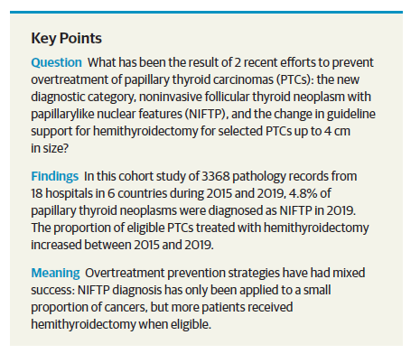
Summary and Conclusion

