Slide 1
AHNS Guideline Development: Townhall for the Recon Section
October, 2023

Slide 2
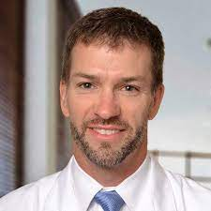
AHNS Reconstructive Head & Neck Surgery
Jeremy Richmon
Matthew Old

Slide 3
AAES
Total membership = ~600
# clinical practice guidelines (2009 – 2020)= 4

Slide 4
AAES: recent guidelines
2022: The American Association of Endocrine Surgeons Guidelines for the Definitive Surgical Management of Secondary and Tertiary Renal Hyperparathyroidism
2020: The American Association of Endocrine Surgeons Guidelines for the Definitive Surgical Management of Thyroid Disease in Adults
2016: The American Association of Endocrine Surgeons Guidelines for Definitive Management of Primary Hyperparathyroidism
2009: AACE/AAES Medical Guidelines for the Management of Adrenal Incidentalomas

Slide 5
American Association of Oral and Maxillofacial Surgeons (AAOMS)
Total membership = ~11,000
# clinical practice guidelines: none (yet)….
# position papers (2013– 2023): 15
AHNS 1st CPG Oral Cancer

Slide 6
AHNS
Total membership = ~1,800
# clinical practice guidelines: 0

Slide 7
Summary
Society | Membership | # Clinical Practice Guidelines
AAO-HNS | ~12,000 | 28
ASCO | ~45,000 | 109
ASTRO | ~10,000 | 33
ATA | ~1,700 | 10
AAES | ~600 | 4
AAOMS | ~11,000 | 0
AHNS | ~1,800 | 0

Slide 8
Clinical Guideline Development: past the wild west …
Past
Lack clear definitions/terminology, rules
No journal input
Multiple units in AHNS involved
Turn around issues
No CSS/CPG !!

Slide 9
AHNS Reconstructive Head & Neck Surgery
Jeremy Richmon
Matthew Old

Slide 10
AHNS Whitepaper 2024
The AHNS Sections
Welcome submissions
Clear process
Simple process
Quick turnaround- we serve you
We 3 are available anytime if ?s
This is FULLY approved by AHNS at
multiple levels
Need your leadership to successfully deploy
AHNS Future

Slide 11
AHNS White paper landscape -1&2 allow current expression - 3&4 aspirational ~ 2yrs -Vetted by ~ 15 EBM experts and JAMAOTO and Head and Neck Ed staff
Categories: | I.) Narrative Review endorsed by AHNS | II.) Position Paper endorsed by AHNS | III.) Clinical Consensus Statement (current state) endorsed by AHNS | IV.) Clinical Practice Guidelines (future state) endorsed by AHNS
1.) Objective | To present an up-to-date review for clinicians on a topic of general common interest from the perspective if internationally recognized experts in these disciplines. Focus should be an update on the current understanding of the physiology of the disease or condition, diagnostic and treatment issues. | To present key opinions on central focused topics within the field in a scholarly, thoughtful, and well-referenced. Approach should be systematic and utilize evidence-based methodology. Discussion of controversies/ opposing views of diagnosis/treatment. | To quantitatively assess whether there is a formal agreement regarding proposed statements about diagnosis, management, complications, and/or treatment¹. More applicable to situations where published evidence is limited or lacking as compared to a CPG and yet there are opportunities to reduce uncertainty and improve care. | To provide recommendations for action or avoidance of action to support evidence-based practice arising from a strong, high level of evidence data². The CPG is quality driven, evidence based, efficient in process, transparent in its methodology, with rigorous COI processes, actionable and multidisciplinary

Slide 12
AHNS White paper landscape: 4 Categories 1- Narrative Review endorsed by AHNS 2- Position Paper endorsed by AHNS 3- Clinical Consensus Statement endorsed by AHNS 4- Clinical Practice Guidelines endorsed by AHNS - 1 & 2 allow current expression - 3 & 4 aspirational - Vetted by ~15 EBM experts and JAMAOTO & Head & Neck Editorial staff

Slide 13
AHNS White paper landscape: 4 Categories 1- Narrative Review endorsed by AHNS 2- Position Paper endorsed by AHNS 3- Clinical Consensus Statement endorsed by AHNS 4- Clinical Practice Guidelines endorsed by AHNS

Slide 14
AHNS White paper landscape: #1 Narrative Review endorsed by AHNS
Objectives
- To present an up-to-date review for clinicians on a topic of general interest
- Focus should be an update on the current understanding of the physiology of the disease or condition, diagnostic and treatment issues
Basic format and content
- Basic format: Narrative review with no key points
- Key Content: General topic overview. No statements or recommendations

Slide 15
AHNS White paper landscape: #1 Narrative Review endorsed by AHNS
Level of Evidence: varies
Implications: results provide a timely overview of related literature on a topic fully endorsed AHNS publication.
Duration & team size:
- 6 to 8 months
~ 5 or less members

Slide 16
AHNS White paper landscape: #1 Narrative Review endorsed by AHNS
AHNS Submission and vetting process (will be discussed in depth later)
Notification of AGAB with 1 page outline & an author list
AGAB reviews & determines the appropriateness in 1 month (+ pre-submission inquiry with Editor of JAMA Oto/Head and Neck to confirm appropriateness of the topic)
send approval back to the section
submit the scientific content to AGAB
→ approval notification of to the section in 2 weeks

Slide 17
AHNS White paper landscape: #1 Narrative Review endorsed by AHNS
Other societies engagement: Encouraged.
AHNS authors are in lead author positions and are proportional to the # of societies involved (e.g.; three sponsor organizations, at least 1/3 of authors are AHNS members).
Budget: None
Length and format details
2000-3500 words
50-75 references
<5 Tables and or figures
No Key points
In accordance with the respective journal author guidelines

Slide 18
AHNS White paper landscape: 4 Categories 1- Narrative Review endorsed by AHNS 2- Position Paper endorsed by AHNS 3- Clinical Consensus Statement endorsed by AHNS 4- Clinical Practice Guidelines endorsed by AHNS

Slide 19
AHNS White paper landscape: #2 Position Paper endorsed by AHNS
Objectives
- To present key opinions on central focused topics within the field in a scholarly, thoughtful, and well-referenced.
- Approach should be systematic and utilize evidence-based methodology.
- Discussion of controversies/opposing views of diagnosis/treatment.
Basic format and content
- Basic format: Narrative or systematic review with no key points
- Key Content: Statements of "Opinion"

Slide 20
AHNS White paper landscape: #2 Position Paper endorsed by AHNS
Level of Evidence: Low-level, limited, or potentially contradictory data (Typically)
Implications: The results can represent the leading opinions of either the AHNS or the service/section of the AHNS that is fully endorsed AHNS publication.
Duration & team size:
- 6 to 8 months
- 8-10 members

Slide 21
AHNS White paper landscape: #2 Position Paper endorsed by AHNS
AHNS Submission and vetting process (will be discussed in depth later)
Notification of AGAB with 1 page outline & an author list
AGAB reviews & determines the appropriateness in 1 month (+ pre-submission inquiry with Editor of JAMA Oto/Head and Neck to confirm appropriateness of the topic)
send approval back to the section
submit the scientific content to AGAB
→ approval notification of to the section in 2 weeks
Other societies engagement: Encouraged.
AHNS authors are in lead author positions and are proportional to the # of societies involved (e.g.; three sponsor organizations, at least 1/3 of authors are AHNS members).
Budget: None

Slide 22
AHNS White paper landscape: #2 Position Paper endorsed by AHNS
Length and format details
3500 words
50-75 references
<5 Tables and or figures
No Key points
In accordance with the respective journal author guidelines

Slide 23
AHNS White paper landscape: 4 Categories 1- Narrative Review endorsed by AHNS 2- Position Paper endorsed by AHNS 3- Clinical Consensus Statement endorsed by AHNS 4- Clinical Practice Guidelines endorsed by AHNS

Slide 24
AHNS White paper landscape: #3 Clinical Consensus Statement endorsed by AHNS
Objectives
- To quantitatively assess whether there is a formal agreement regarding proposed statements about diagnosis, management, complications, and/or treatment.
- More applicable to situations where published evidence is limited or lacking as compared to a Clinical Practice Guidelines and yet there are opportunities to reduce uncertainty and improve care.

Slide 25
AHNS White paper landscape: #3 Clinical Consensus Statement endorsed by AHNS
Basic format and content
- Basic format:
- Expert opinion + formal systematic literature review + Statements of consensus
-Modified Delphi method recommended to provide strength of author panel consensus
- Levels of evidence should be described (from the American College of Physicians and can be supplemented with Oxford Centre for Evidence-Based Medicine: Levels of Evidence (CEBM))
- The review of the literature should be systematic and conducted with the support of a medical librarian and an evidence synthesis should adhere to Guidelines for systematic reviews.
- Dates of systematic review and database accession and all parameters should be stated.
- Literature search and articulation of recommendations should adhere to a standardized format (PICO: population, intervention, comparator, outcomes)
- Key Content: Agreed statements based on currently available evidence

Slide 26
AHNS White paper landscape: #3 Clinical Consensus Statement endorsed by AHNS
Level of Evidence: Mid-level Data (Typically)
Implications: The results represent the quantified and endorsed consensus opinion of the AHNS through approved panel authors.
Duration & team size:
- 6 to 8 months
- 8-10 members

Slide 27
AHNS White paper landscape: #3 Clinical Consensus Statement endorsed by AHNS
AHNS Submission and vetting process (will be discussed in depth later)
1- Submission of Clinical Consensus Statement Application Form to AGAB
- AGAB provides scientific review in accordance with guideline methodology science
- The EC considers global strategy and prioritizes the projects
2- Submission of application form with paper outline and authorship for:
a. determination the AHNS White papers guidelines are observed
b. Clinical Consensus Statement is prioritized with other submissions given resources required
c. Journal selection and notification/collaboration
pre-submission inquiry with Editor of JAMA Oto/Head and Neck to confirm appropriateness of the topic
Other societies engagement: Encouraged.
AHNS authors are in lead author positions and are proportional to the # of societies involved (e.g.; three sponsor organizations, at least 1/3 of authors are AHNS members).
Budget: Yes

Slide 28
AHNS White paper landscape: #3 Clinical Consensus Statement endorsed by AHNS
Length and format details
Special Communication
5000 words
75-100 references
5-10 Tables and or figures
In accordance with the respective journal author guidelines

Slide 29
AHNS White paper landscape: 4 Categories 1- Narrative Review endorsed by AHNS 2- Position Paper endorsed by AHNS 3- Clinical Consensus Statement endorsed by AHNS 4- Clinical Practice Guidelines endorsed by AHNS

Slide 30
AHNS White paper landscape: #4 Clinical Practice Guidelines (CPG) endorsed by AHNS
Objectives
- To provide recommendations for action or avoidance of action to support evidence-based practice arising from a strong, high level of evidence data.
- The CPG is quality driven, evidence based, efficient in process, transparent in its methodology, with rigorous COI processes, actionable and multidisciplinary

Slide 31
AHNS White paper landscape: #4 Clinical Practice Guidelines endorsed by AHNS
- Basic format:
- Follows the Guidelines International Network (G-I-N) standards for development.
- The reporting methodology should be disclosed
- Conflicts of interest need to be managed transparently
- Literature review should be systematic,
- The recommendations should be clearly articulated with accompanying ratings for the levels of evidence and strength of recommendations.
- Literature should be monitored, and guidelines updated when indicated by availability of new evidence.
- Formal recommendations denoted by 1- strength of literature support and 2- strength of recommendation which incorporate the benefit, harms and alternatives.
- Levels of evidence should be described by the Guideline Grading System
- Key action statements can be drafted with the use of BRIDGE-Wiz, Yale Center for Medical Informatics.

Slide 32
AHNS White paper landscape: #4 Clinical Practice Guidelines endorsed by AHNS
- Key Content:
Recommendations for Action. Key Action statements with profile constructs including:
-Aggregate evidence quality
-Level of confidence in evidence
-Benefit
-Risks, harms, costs
-Benefit-harm assessment
-Value judgements
-Intentional vagueness
-Role pf patient preferences
-Exceptions
-Policy level
-Differences of opinion

Slide 33
AHNS White paper landscape: #4 Clinical Practice Guidelines endorsed by AHNS
Level of Evidence: High and Mid-level Data (Typically)
Implications: The results represent the systematized and endorsed recommendation for action from the AHNS and jointly participating societies through approved panelists.
Duration & team size:
- 12 to 18 months
- 15-20 members

Slide 34
AHNS White paper landscape: #4 Clinical Practice Guidelines endorsed by AHNS
AHNS Submission and vetting process (will be discussed in depth later)
1- Submission of CPG Application Form to AGAB
- AGAB provides scientific review in accordance with guideline methodology science
- The EC considers global strategy and prioritizes the projects
2- Submission of application form with paper outline and authorship for:
a. determination the AHNS White papers guidelines are observed
b. CPG is prioritized with other submissions given resources required
c. Journal selection and notification/collaboration
pre-submission inquiry with Editor of JAMA Oto/Head and Neck to confirm appropriateness of the topic.
Other societies engagement: Encouraged.
AHNS authors are in lead author positions and are proportional to the # of societies involved (e.g.; three sponsor organizations, at least 1/3 of authors are AHNS members).
Budget: Yes
Expect no more than 1 CPG/year (or fewer) initially as budgetary issues are discussed.

Slide 35
AHNS White paper landscape: #4 Clinical Practice Guidelines endorsed by AHNS
Length and format details
Special Communication CPG
>5000 words
> 100 references
>5-10 Tables and or figures
In accordance with the respective journal author guidelines

Slide 36
AHNS Guideline Advisory Board (AGAB)
Organizational Chart and Process Flow
First meeting 4/22

Slide 37
AGAB Advisory Board – Organizational Chart
Gregory Farwell Gregory Randolph
Patient Care Division Chair, EC Liason Administration Division Chair, EC Liason
AGAB Leadership
Jennifer Shin, Stacey Ishman, Seth Schwartz Methology Leads, Baran Sumer Administrative Lead
Education Division Chair
Christine Gourin/Babek Givi
New Methodologic Expertise AHNS Volunteers
Steven Chang, John Cramer, Antoine Eskander, Matthew Geltzeiler, Babak Givi, Zhen Gooi, Cirian Lane, Rosemary Martino Leandro Matos, Aru Panwar, Karthik Rajasekaran, Alvaro Sanbria Kerstin, Stenson, Varun Vendra, Mary Xu, Mark Zafareo
Roger Chow, Methodologist
Existing Guideline Service Members
Ernest Gomez, Miriam O’Leary, Ofer Azoulay, Raymond Chai, John de Almeida, Nicole Fowler, Tiffany Glazer, Greg Kempl, Salem Noureldine, Samip Patel, Guy Petruzzelli, Scott Roof, Michael Sim
AHNS BSC Admin
Ochun Farlice, Christina Kasendorf

Slide 38
AGAB Process Flow – Narrative Reviews & Position Papers
AHNS Sections
NR or PS Submission:
- One page -
Title
Author panel
Outline
Comes from the Sectional
leadership with their approval
Back to the AHNS Sections
After AHHS approval THEN submitted for separate independent journal
PEER REVIEW (JAMAOTO, Head and Neck)

Slide 39
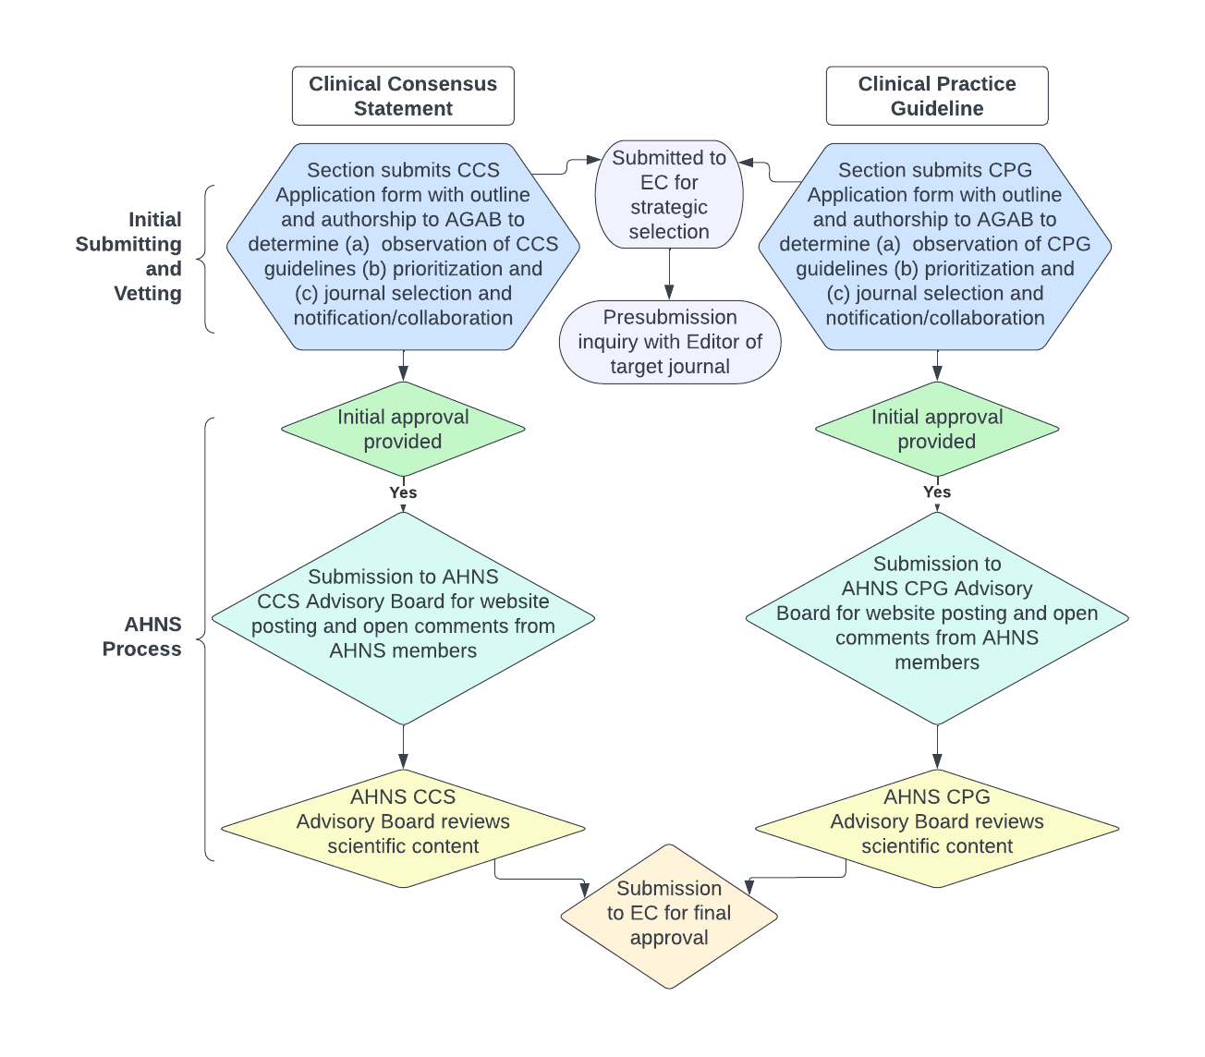
AGAB Process Flow – CCS and CPG N=1 paper/2 yrs
AHNS Sections
CCS/CPG AGAB Subgroup
with Section input

Slide 40
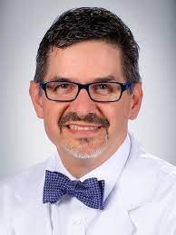
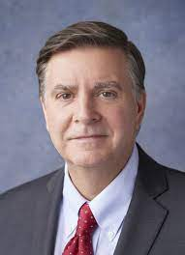
Deliverables and Timeline for AHNS first CPG/CSS
A single centralized body for all white per activity -- AGAB
AGAB with appropriate manpower/woman power and budget (for CSS/CPG)
Expected increase volume of AHNS Narrative Reviews and Position Papers and first true AHNS CPG within the 2yrs
=============================================
AHNS guidelines Townhall October to January.
Preliminary deadline for submission from sections of CPG/CSS applications April. Topic selected for first AHNS CPG announces at COSM May 2024
We are off to the races !!!
We are here for you 24/7, 365
Baran Sumer Greg Farwell Greg Randolph
Baran.Sumer@UTSouthwestern.edu; Greg.Farwell@Pennmedicine.upenn.edu; Gregory_Randolph@meei.Harvard.edu

Slide 41
AHNS Reconstructive Head & Neck Surgery
Jeremy Richmon
Matthew Old
Thanks and now …Q and A

