Slide 1

Welcome To The
2025 AHNS Business Meeting
2025 AHNS Business Meeting

Slide 2
AHNS Foundation Update
2025 AHNS Business Meeting
  Foundation Goal – increase the corpus by $1 million by 2027 to support AHNS 2.0 initiatives
    Launched 40 in 4 campaign - 40 donors to pledge participation in 5 in 5 over next four years
    Ten New/continuing 5 in 5 donors: Drs. Barab Devrin, Bill Lydiatt, Susan McCammon*, Maie St. John, Kerstin Stenson, James Rocco, Eben Rosenthal, Will Ryan and Bevan Yeuh. Mark Zafereo**.
      * Susan McCammon gave a lump sum donation! ** Mark Zafereo completed one round of 5 in 5 donations and is on his second! Special thanks to past 5 in 5 donors: Drs. Carol Bradford, Robert Ferris, Doug Girod, Dennis Kraus, Randall Weber, Mark Zafereo.
    Centurian Club total donation $5K can be applied as first 5 in 5 donation: To encouraging new donors to join Centurion Club and advance to 5 in 5 as their career advances
    Recognition of transformative leaders of the AHNS: Developing a tribute giving campaign
    Current corpus = $5,039,849.16
  Examination of AHNSF and AHNS investment strategies
    Examining proposals to maximize growth and minimize risk and portfolio management expenses
  2024 Awards
    In 2024, the AHNS Foundation supported grants and awards in the amount of $138,717. We look forward to supporting our 2025 AHNS awardees.
  Website Update
    Update website to be more informational and accessible. Including donor and grant recipient testimonials. Member testimonials will also be featured – Why do you support the Foundation? Or How did an award supported by the Foundation advance your career?

Slide 3
Secretary’s Report
2025 AHNS Business Meeting - May
Formal approval of Council and Executive Committee e-mail/zoom votes: Total of 10 approved votes from October 28, 2024 to May 5, 2025.
AHNS Executive Committee approved Greg Farwell as 2026 Proferred Chair for the International Conference (replaced Carole Fakhry who stepped down) | 5/5/2025
AHNS Executive Committee approved the new resident/fellowship symposium chairs. TJ Ow and Marisa Buchakjian | 4/10/2025
AHNS Executive Committee Agreed with the following ATC's recommendations:Yale - No accreditation at this time Thomas Jefferson - Approved for five year accreditation for two fellows and an increase from one to two fellows per year | 3/20/2025
AHNS Executive Committee approved accrediting for the Mayo Clinic Rochester | 01/16/20205
AHNS Executive Committee approved accrediting USC as a new program for two years | 12/19/2024
AHNS Executive Committee approved increasing the non member faculty reimbursement for COSM to up to 12 non members, comped registration only | 12/5/2024
AHNS Executive Committee approved supporting the Thyroid Disease CARE Act | 11/21/2024
AHNS Executive Committee voted to move forward with contract negotiations with Wolters Kluwer for a new journal | 11/21/2024
AHNS Executive Committee approved Ellie Maghami as the new DEI Division Vice Chair | 11/21/2024
The Endocrine Section and Patient Care Division approved endorsing the ATA Management Guidelines for Adult Patients with Differentiated Thyroid Cancer | 10/28/2024

Slide 4
Secretary’s Report
2025 AHNS Business Meeting – May
Continuing as Section Liaison to all Six Sections/Quarterly Updates
See membership reports under the DEI Division for an update
on AHNS membership
Heads Up!
If there is anything you wish to highlight or promote regarding your Service, Section or society projects, please email JJ Jackman at jj@ahns.info. We are always looking for blog submissions for
Heads Up and once posted, they are automatically tweeted and
posted on our Facebook page, Instagram and Linked In.

Slide 5
Secretary’s Report
2025 AHNS Business Meeting - May
COSM Update:
COSM 2027
April 7-11, 2027
9: AAFPRS, ABEA, AHNS, ALA, ANS, AOS, ARS, ASPO, TRIO
Sheraton Grand Seattle
Seattle, Washington
COSM 2028
May 3-7, 2028
9: AAFPRS, ABEA, AHNS, ALA, ANS, AOS, ARS, ASPO, TRIO
Hyatt regency Chicago
Chicago, IL
  SLC New Chair – Dr. Bradley Kesser
Development and communication of new, streamlined policies and procedures addressing approval processes for services and sections
Identification of AHNS funded projects to help the Foundation develop more opportunities for giving
The next Council meeting will be during the AAO-HNSF in Indianapolis (October 10, 2025).

Slide 6
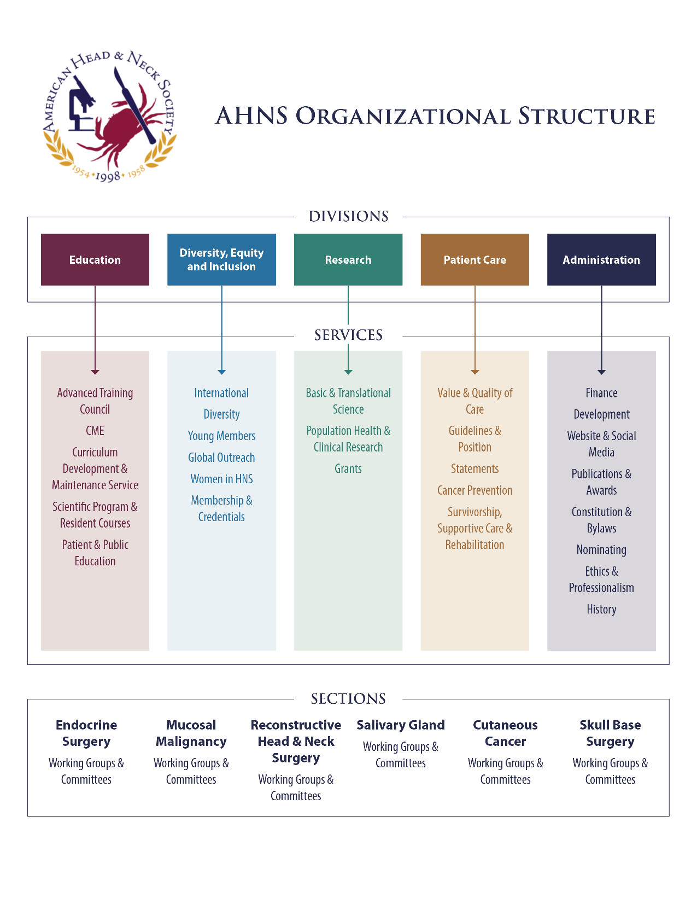
Secretary’s Report
2025 AHNS Business Meeting - May

Slide 7
On a final note, I’d like to thank the AHNS Council for supporting me in my six years as the AHNS Secretary. I have seen tremendous growth and enthusiasm in this Society and I look forward to its future. It has truly been an honor!
2025 AHNS Business Meeting - May

Slide 8
President’s Report
AHNS Business Meeting
May 2025
Created and appointed task forces to work on the mission of the Society:
  Artificial Intelligence Task Force – Chairs – Chris Holsinger and Andres Bur
  Oral Surgery Task Force (see program survey results on next slide) – Chair – Neal Futran
  Revenue Opportunities Task Force – Chair – Mark Zafereo
  Quality and Value Task Force – Chair – Matt Old
  Behavorial Health Task Force – Chair – Aru Panwar
Developed 2025 Meeting Theme “Mind, Machine, and Medicine: Mobilizing Behavioral Health, AI, and Education to Advance Head and Neck Care."
Keynote lecturers at meeting: David Rubin, Curtis Langlotz, Brett Haskell
Helped finalize new AHNS Journal and Call for Editor Position
Fostered partnerships with other associations regarding important initiatives, including the ACS CSSP, the ATA, ABO-HNS, IFHNOS, IFOS and IAOO
IFOS Order of Merit and 2026 Meeting Colloboration
Appointed Joe Scharpf as the AHNS Representative to the ACS OHNS Advisory council and the CSSP Representative
Appointed Beth Cottrill to also serve as a CSSP Representative
Appointed Nikki Schmitt and Steven Chinn to be the IFHNOS HNCIG Representatives
AHNS Service Award (Announcement at Council Meeting)

Slide 9
Oral Surgeons in the AHNS Fellowship match
Survey of accredited fellowship directors:
Does your program have the ability to train an oral surgeon with an MD/DDS degree? | If the circumstances were right, good candidate, no better option available, would you rank an oral surgeon to match at your fellowship? | If you would match an oral surgeon, would you recommend:
Yes - 11 | Yes - 7 | Two years - 8
No - 21 | No - 25 | It would depend on the candidate - 14

Slide 10
2025 AHNS SERVICE AWARD
AHNS Guidelines and Position Statements Service
Baran Sumer and Ted Gomez
AHNS Website and Social Media Service
Baran Sumer and Caitlin McMullen

Slide 11

Treasurer Report
Maie St. John, MD, PhD

Slide 12
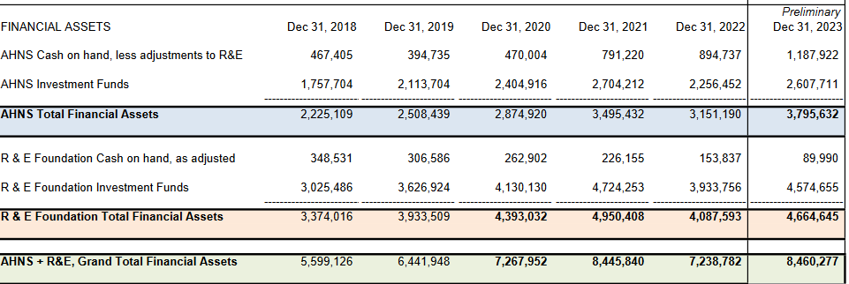
Financial Assets
+17% vs 2022

Slide 13
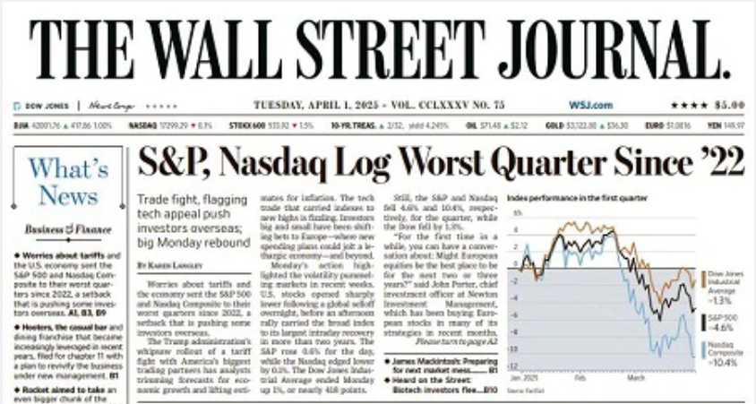
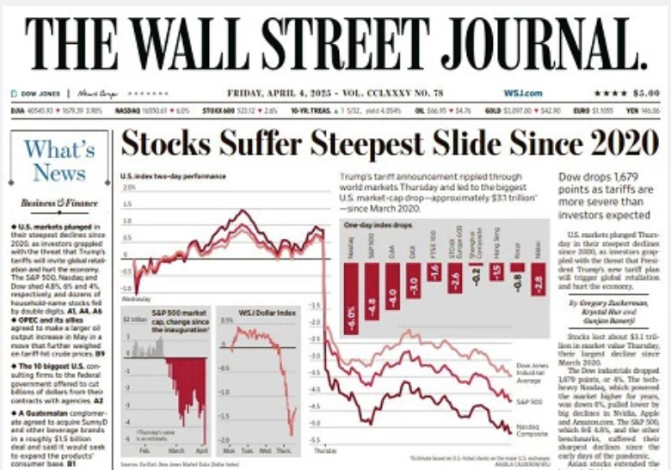

Slide 14
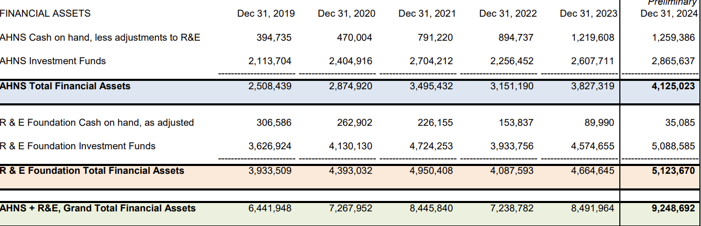
Financial Assets
+9% vs 2023

Slide 15
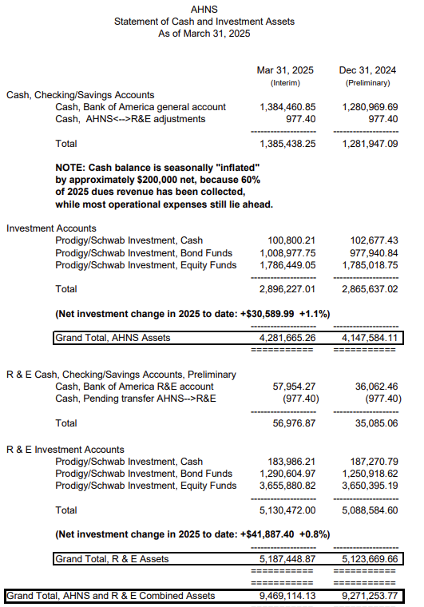
Increases in Q1 2025, despite market decline
S&P 500 ↓4.6%
Russel 3000 ↓4.7%
Dow ↓1.3%

Slide 16
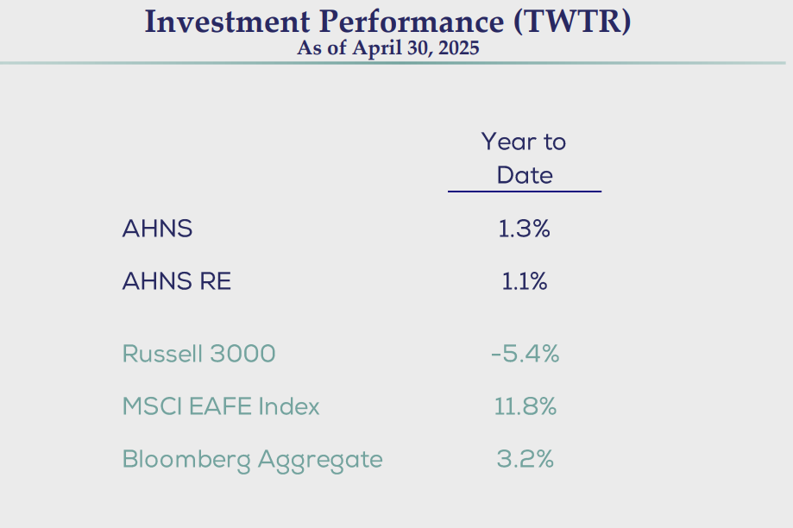
Notes:
Inception Date: 1/31/2007

Slide 17
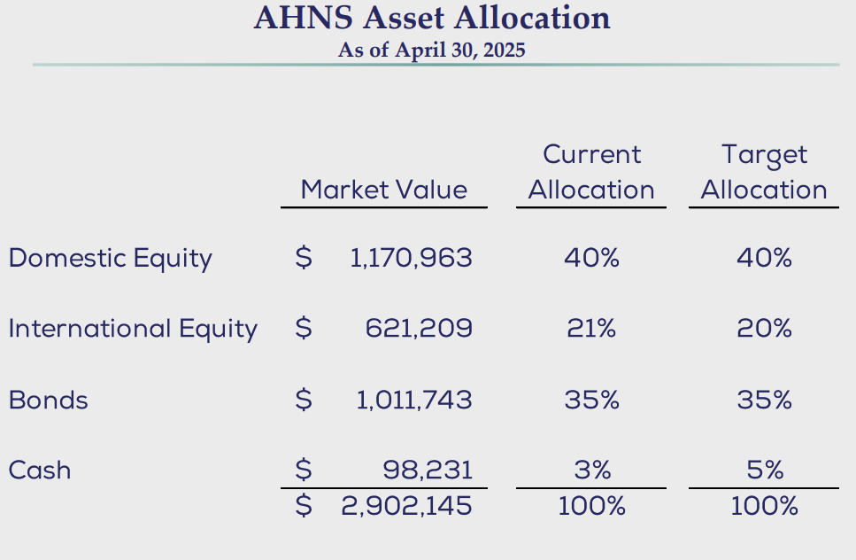

Slide 18
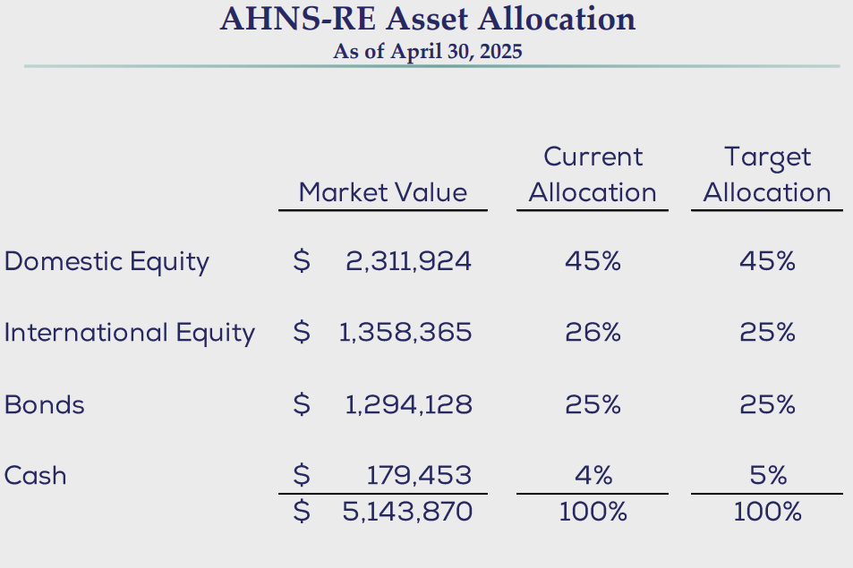

Slide 19

AHNS : R&E
Philosophies about AHNS and R&E Funding
AHNS: immediate operational expenses
  Annual expenses to run society
  Recommend up to 1.5 years cash on hand
R&E: investments in future of society
  Transitioning from “accumulation” to using endowed funds
  More aggressive growth in R&E investments
  Mission-based budgets: research & educational support

Slide 20
Requests for Funding: Process
Requests for funding should be submitted in the form of a written proposal.
Proposal must include detailed budget (Budget Justification).
Proposal should include metrics and plans surrounding ROI.
Requests that span more than one time funding will need to include annual updates/ deliverables on the investment.
  Include proposed models of permanence/sustainability.

Slide 22
2025 – 2026 AHNS Leadership Slate
President: Bevan Yueh, MD 2025-2026
President Elect: Eben Rosenthal, MD 2025-2026
Vice President: *Susan McCammon, MD 2025-2026
Secretary: *Matt Old, MD 2025-2028
Treasurer: *Maie St. John, MD 2025-2028
Education Division Chair: Babak Givi, MD 2024-2027
Education Division Vice-Chair: Mike Moore, MD 2024-2027
Research Division Chair: Stephen Lai, MD 2024-2027
Research Division Vice-Chair: Nicole Schmitt, MD 2024-2027
Patient Care Division Chair: *Carole Fahkry, MD 2025-2028
Patient Care Division Vice-Chair: *Trevor Hackman, MD 2025-2028
Administration Division Chair: Cecelia Schmalbach, MD 2024-2027
Administration Division Vice-Chair: Lisa Shnayder, MD 2024-2027
DEI Division Chair: *Melonie Nance, MD 2025-2028
DEI Division Vice-Chair: *Ellie Maghami, MD 2025-2028
Foundation Chair: James Rocco, MD, PhD 2023-2026
Nominating Service: *Jeremy Richmon, MD 2025-2026
*Claudio Cernea, MD 2025-2026
Finance Service: *Dinesh Chhetri, MD 2025-2028
*Rodney Taylor, MD 2025-2028
*Indicates who will be voted upon at the business meeting
2025 AHNS Business Meeting

Slide 23

2025 AHNS Program Service
Update at AHNS Council & Business Meeting
Program Chair:
Susan McCammon, MD
Program Co-Chairs:
Aru Panwar, MD
Andrew Shuman, MD
May 13-15, 2025::New Orleans, LA
Notes:
ZOOM LINK: https://us06web.zoom.us/j/84485651429?pwd=NamfGtHasfHqhnVHV97YkBYUdTcuAE.1
Meeting ID: 844 8565 1429
Passcode: 256755

Slide 24
AHNS 2025 Meeting Statistics
Meeting registrants: 533 (as of May 13, 2025)
Abstracts received: 900
Oral abstracts selected: 37
Poster abstracts selected: 336

Slide 25
Program Innovations & Features
Program Theme: Mind, Machine, and Medicine: Mobilizing Behavioral Health, AI, and Education to Advance Head & Neck Care
Program Design: Active participation with AHNS Sections
Pre-Meeting Courses (6):
  Head & Neck Surgery Symposium for Residents
  Thyroid, Parathyroid, and Neck Ultrasound Course
  Innovation and Entrepreneurial Symposium
  Head & Neck Microvascular Reconstructive Course
  Drawn to Uncertainty: Workshop for Medical Educators
Keynote Lectures (3):
  Brett Haskell: Psychology of Sustainable Success
  David Rubin: Mental Health and Role of Head & Neck Surgeons
  Curtis Langlotz: AI in Medicine

Slide 26
Program Innovations & Features
Reflections on 20 Years After Hurricane Katrina: Practice of Medicine in Resource Limited Settings
Women’s Panel focused on Leadership & Career Pathways
Expanded Access to Scientific Sessions (7):
  ‘Expert Introduction’ to define research landscape for each session
  Recognition to top presentation in each session
Expanded Access to Posters

Slide 27
Special Thanks
William Lydiatt, MD and the AHNS Council
AHNS Section and Service Members and Leaders
Program Service Reviewers, Session Moderators, and Poster Tour Leaders
Invited Lecturers
Faculty, residents and students contributing to science and discourse
BSC Team:
Christina Kasendorf
Rebecca Cranor
Carrie Ahern
Colleen Elkins
Dan Berlant
Lorena Gonzalez
Erin Schwarz
Ochun Farlice
JJ Jackman
The city of New Orleans

Slide 28


Slide 29
ADMINISTRATION DIVISION
2025 AHNS Business Meeting
Notes:
Minimize overlap with tumor boards

Slide 30
2025 AHNS Business Meeting
Workflow question
Currently the bylaws read as follows:
“The Secretary shall forward the proposed amendment to the Constitution & Bylaws Service for review and comment. The Constitution & Bylaws Service will consider the proposed amendments and draft appropriate language to reflect the change. Any revisions to the Constitution or Bylaws will be reported to the Council and voted upon at the Council meetings. A two-thirds vote of the Council is necessary before the changes are announced to membership. The proposed changes will be announced at the Society business sessions. A two-thirds vote of Active Fellows is necessary for the changes to take effect.”
The bylaws committee has noticed that for any changes to occur, the council approves them, then sends to bylaws committee which finalizes language, and it gets voted on a full year later.
Question: Do we correctly understand the workflow? If so, do we want to develop a system that allows for more rapid changes if necessary?

Slide 31
2025 AHNS Business Meeting
  AHNS Development Service Report
  2025 Meeting Fundraising
  Goal = $153,000 Funds Raised = $153,000 % to goal = 100%
  NON-Meeting Fundraising
  TORS fellow course Sponsor: Intuitive Support: $30,000
  NOTE: Intuitive reduced the course from 40 to 20 fellows citing the lack of adoption in early career practice. TORS fellows training under revision with goal of broader industry support, more simulation, decreased cadaveric training.
  Industry supported webinars Sponsor: Coherus Biosciences
  Topic: Nasopharyngeal Cancer Support: $30,000 each
  8/28/2024 (clinician focused) and 4/23/2025 (patient/survivor focused)
  2026 Meeting Fundraising
  Development Service members meeting with industry at COSM and ASCO
  Note: International Meeting fundraising includes marketing and educational grant support, 2023 mtg = 93% marketing income, 7% educational grant income; 2016 mtg = 81% marketing, 19% ed grants

Slide 32
History Service
Alexandra Kejner, Melonie Nance
2025 AHNS Business Meeting
COSM events
First annual History Trivia Event
  Sponsored event with historical trivia first night of COSM
  Plan for submitting as an official event for upcoming AHNS meeting
History facts initiative
  During COSM, slides between presentations featuring historical facts and resources
Website Development
  AHNS history section including living timeline, past presidents, landmark papers timeline with linked full text
Webinar proposals
“What history has taught us”
  Live panel featuring influential figures in HNS surgery
  ENT through the ages
    Historical perspectives of head and neck procedures (ancient Rome, etc)
Plans for AHNS international meeting
  Historians in medicine panel
  Trivia night 2.0
  Invited speaker (Dr. Lindsey Fitzharris – the facemaker about Dr. Gilles)
  History facts in the AHNS meeting app
Future plans
  Consider history corner in journal
  Journal club issue dedicated to historical topics

Slide 33
Publications and Awards Service
2025 AHNS Business Meeting
Tony Eskander, MD, Sc,M.– Chair
Louise Davies, MD, MS – Vice-Chair
Robert Maxwell Byers Award - Abdullah A Memon - Medical College of Wisconsin - Cancer-Testis Antigens as Novel Precision Immuno-oncologic Targets in HPV-negative Head and Neck Cancer
Best Prevention and Early Detection Papers - 1st Place - Robin Baudouin - Foch Hospital - Versailles/Paris-Saclay University - Machine Learning to Differentiate Mucosal Lesions from Laryngeal Immobility Using Voice Recordings
Best Prevention and Early Detection Papers - 2nd Place - Helena Kim - Northwestern University Feinberg School of Medicine - Associations of Food Environment with Oropharyngeal Cancer Prognosis among Younger Adults in the United States
Best Resident Clinical Paper - Traeden D Wilson, MD – Loma Linda University Healthcare- The Epigenetic link between Psychosocial Stress and Survival of Oral Squamous Cell Carcinoma
Randal Weber, MD Award for Quality, Safety and Value in Head and Neck Oncology - Nana-Hawwa Abdul-Rahman, MS - University of Pittsburgh School of Medicine -Improving Prediction of Postoperative Pulmonary Complications Following Oncologic Head and Neck Surgery with Microvascular Free Flap Reconstruction
Best Resident Basic Science Research Paper - Tolani Olonisakin, MD, PhD - Johns Hopkins Hospital - scRNA-seq and genomics analyses reveal key mechanisms of inverted papilloma-associated sinonasal squamous cell carcinoma malignant transformation
-2024 / 15 submissions; 2025 / 23 submissions
**Visual Abstracts
**Upcoming International Meeting
- increase members (double)
- engagement of section chairs
**Increase engagement with NEW JOURNAL
**Modify Bylaws with New Journal
**Increased Social Media Presence
Reviewers
Tony Eskander
Louise Davies
Raymond Chai
Evan Graboyes
Linda Yin
Nagashree Seetharamu
Tam Ramsey
Carly Barbon
Huang
Thomas Gal

Slide 34
AHNS Website and Social Media Service
Baran Sumer, Caitlin McMullen
2025 AHNS Business Meeting
Website overhaul: reorganized and updated for COSM, further improvements coming
Mission statement to clarified audience and goals - approved
Systematic Guidelines and Workflow established for creating content and the publishing - approved
Promotion of Annual Meeting program and HNC awareness month by engaging sections for content
Future Plans:
Professionalism guidelines for content creation underway
Connect and coordinate with individual services/sections for content development and submission and introduce new website design

Slide 35
EDUCATION DIVISION
2025 AHNS Business Meeting
Notes:
Minimize overlap with tumor boards

Slide 36
Advanced Training Council
2025 AHNS Business Meeting
2 new Head and Neck Fellowships approved – USC, Mayo Rochester
3 new accreditation applications declined: UNLV, Yale, Sarasota Memorial Hospital
1 new fellowship application to be site visited or reviewed – Rutgers University
3 programs re-reaccredited this year - Ohio, MEEI, Jefferson
1 re-accreditation application pending approval
9 new Program Directors approved – University of Southern California, University of Michigan, University of California, San Francisco. Moffitt Cancer Center, University of California-Davis, Johns Hopkins, University of Pennsylvania, Henry Ford Hospital, University of Pittsburgh
ATC Subdomain being built

Slide 37
Advanced Training Council
2025 AHNS Business Meeting
Rutgers University
MEEI Endocrine
Roswell Park Cancer Institute
Indiana University School of Medicine
Emory University - Endocrine
Loma Linda University
Nebraska Methodist Hospital
NYU-Langone
Sarah Cannon
University of Utah
University of Arkansas
UNC Chapel Hill
Site visits being scheduled for 2025-2026

Slide 38


AHNS CME Service Business Meeting Report
May 2025

Slide 39
Update from Dr. Katherine Fedder
  Supporting the 2025 COSM meeting accreditation
    Attending Planning Meetings
    Reviewed disclosures for abstract reviewers, abstract presenters & faculty
    Will summarize evaluation results after the meeting
  Supporting the 2026 International meeting
    Attending Planning Meetings
    Mitigating planner financial relationships
  ACCME reaccreditation application submitted in March 2025; interview in June/July 2025 with ACCME surveyors; decision will be received in December 2025

Slide 40
Curriculum Development & Maintenance Service
2025 AHNS Business Meeting
AHNS Curriculum 3.0 – revisions made in Summer 2024
Monthly Virtual Tumor Boards presented by the AHNS Sections
Partnering with DosedDaily
Creation of Monthly Assignments and Self-Assessment Checklist for Fellows:
AHNS curriculum readings
Virtual Tumor Board
Cases from ESSENTIAL CASES in HEAD AND NECK ONCOLOGY
DosedDaily questions

Slide 41
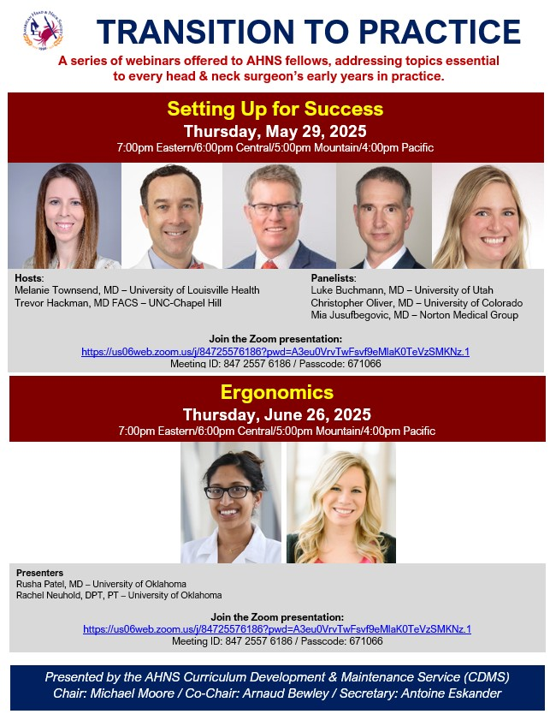
Curriculum Development & Maintenance Service
2025 AHNS Business Meeting
New for AHNS Fellows:
Transition to Practice – webinars designed to help fellows prepare for their careers beyond fellowship

Slide 42

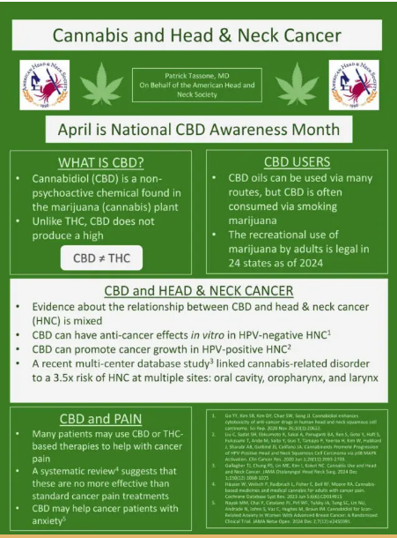
Patient & Public Education
2025 AHNS Business Meeting
Series of social media posts for April/Head & Neck Cancer Awareness Month
Task group to organize the Patient information on the AHNS Website
General ongoing collaboration with HNCA, including on the upcoming October 2025 Survivorship Symposium in Los Angeles
Recent webinars:
  US vs HPV webinar
  Nasopharyneal Cancer Webinar

Slide 43
DIVERSITY, EQUITY AND INCLUSION DIVISION
2025 AHNS Business Meeting
Notes:
Minimize overlap with tumor boards

Slide 44
Diversity Service
2024-2025
2025 AHNS Business Meeting
The AHNS Myers’ Family Summer Travel Fellowship in Otolaryngology
  2025: Hailie C. Hayes, MD Candidate, Class of 2027 - Medical College of Georgia at Augusta University, Mentor - Dr. Pratyusha Yalamanchi - University of Michigan
  2024: Gabrianna Andrews, DO Candidate, Class of 2026 - Rowan-Virtua School of Osteopathic Medicine, please attend the award ceremony to engage with the scholar!
  2018 First Recipient Update: Frantzlee LaCrete, MD, MPH – University of Nebraska College of Medicine - Current Resident at The University of Kansas Class of 2027
AHNS Research & Education Foundation’s Dr. Eddie Méndez Fellowship Award
  2023-2025 Inaugural Recipient: (2 year cycle), Julian Jackson, Julian A. Jackson, MD Candidate Class of 2025 - Sidney Kimmel Medical College Mentor – Dr. Joseph Curry
    "The Synergistic Roles of Gasdermin E and Ninjurin-1 in Raptinal-Induced Immunogenic Cell Death in Head and Neck Cancers.“
    He will present his update during the Awards Ceremony on May 14, 2025, 7-8 AM
Honoring Dr. Giovana R Thomas
  AHNS co-sponsored inaugural University of Miami Endowed Lectureship with Triological Society
  service trying to identify additional mechanism for honoring the service of Dr. Thomas while also providing mid-career diverse HNS national platform that will aid in his/her promotion
Notes:
44

Slide 45
Global Outreach Service
2025 AHNS Business Meeting
Current initiatives:
Webinar: “10 Things I Have Learned in Global Service”
  July, 2025
Ethiopian Head and Neck Fellowship
  We continue to see alternative sources of funding to support trainees
Service members continue to support microvascular training of Ukrainian surgeons

Slide 46
International Advisory Service - AHNS
2025 AHNS Business Meeting
-
Chair: Erivelto Volpi
Vice Chairs: Wojtek Mydlarz and Vincent Vander Poorten
Upcoming Plans:
- The IAS newsletter: two annual issues, including content from all AHNS Sections.
The first one appeared in December 2024 (https://www.ahns.info/american-head-and-neck-society-international-advisory-service-ahns-ias-newsletter/)
Collaborating with the EHNS - discussing the possibility of AHNS/IAS collaboration/participation in the EU-ROBOT.
Just had an AHNS delegation at ECHNO Amsterdam in March 2025 https://www.echno2025.com/
- Co-Branded Webinars and Virtual Tumor Board
  Quarterly Zoom/webinars with global, regional, and sister societies.

Slide 47
International Advisory Service - AHNS
2025 AHNS Business Meeting
  Promote IAS meetings during U.S. or international events
  During international conferences, the IAS will facilitate networking and collaboration among participants to foster friendships and mentoring opportunities, catalyzing future collaborations.

Slide 48
Membership and Credentials Service
2025 AHNS Business Meeting
Three membership application cycles per year
AHNS 2025 Membership Dues Report (as of April 18) Total Members Invoiced: 1,688
  Total Dues Billed: $489,625
  Total Collected: $353,375
  Collection Rate: 66%
  Outstanding Dues: $113,125
  Final 2024 rate improved to 81% after follow-ups and grace periods
Active Members: 73% collection rate; Majority of revenue
New Membership Category and Modifications to Active Member Category: Aim to engage radiation/medical oncologists& scientists in AHNS leadership (Need to discuss optimal category definitions)

Slide 49
Membership and Credentials Service
2025 AHNS Business Meeting
Membership Growth
  Total dues-paying members increased from 1,467 (2024) to 1,560 in 2025 (+6.3%)
  Total reported members (including retired) rose from 1,827 to 1,918 (+5%)
Demographic Reporting
  Date of Birth reported for 96% of members (up from 95% in 2024)
  Gender reported by 97%; 66% male, 27% female, 7% chose not to disclose
  Race/Ethnicity reporting improved to 78% (up from 52% in 2024 dues-paying members)
    42.6% White, 21.3% Asian, 6.5% Hispanic/Latino, 2.4% Black/African American
Age Distribution
  Largest age groups:
  29% born 1981–1990
  19% born 1971–1980
  15% born 1991–2000, driven by Medical Student membership
92% of dues-paying members are between ages 34 and 73

Slide 50
Women’s Service
Shirley Y. Su and Karen Choi
2025 AHNS Business Meeting
Panel: Wednesday May 14th at 4pm, Reception 6pm
Panel: “Exploring Leadership and Alternative Career Pathways to Academic Medicine”
  Speakers: Dr. Cherie-Ann Nathan (Team Building), Dr. Bert O’Malley (Executive Leadership), Dr. Bevan Yueh (Medical School), Dr. Dennis Kraus (Business/Industry)
Margaret Butler Award (Drs. Amy Lassig & Larissa Sweeney)
  Congratulations to Dr. Maie St John
    2024 Carol Bradford, 2023 Anna Pou, 2022 Amy Chen, 2021 Lisa Orloff, 2020 Cherie Ann Nathan, 2019 Marion Couch
Pay Equity Research
  Dr. Katelyn Stephan Manuscript: “Gender Based Salary Differences Among Academic Otolaryngologists” submitted to Laryngoscope.

Slide 51
AHNS Young Members Service
Chair: Andrés Bur, MD
Vice Chair: Arvind Badhey, MD
2025 AHNS Business Meeting
AHNS Young Members Corner Podcast
Features interviews with leaders and innovators in head and neck surgery on topics of interest to young head and neck surgeons
11 episodes now available through Spotify and Apple featuring:
  #11 Melina Windon, Janice Farlow, Eric Gantwerker – Artificial intelligence in surgical education
  #10 Anne Kane, Kelly Malloy, Brittny Tillman, Kevin Emerick – Building a cutaneous practice
  #8 Brian Cervenka, Alessa Colaianni, Kelly Malloy – Personal challenges in head and neck careers
  #7 Andy Shuman, Alessa Colaianni – Introducing the AHNS peer support system
  #6 Bill Lydiatt – Clinical Decision making
Practice building:
  Young Members Slack Channel for early career discussions/mentoring
  Sponsored an AHNS Fellow Tumor Board with CDMS: “Navigating fellowship, early career development & your first real job”
  Coding and billing resources
  Qualitative study on transitioning from training to practice led by Dr. Karen Choi
  Well-attended networking events at AHNS meetings in Montreal, Chicago, New Orleans

Slide 52
PATIENT CARE DIVISION
2025 AHNS Business Meeting
Notes:
Minimize overlap with tumor boards

Slide 53
AHNS GUIDELINES ADVISORY BOARD (AGAB)
2025 AHNS Business Meeting – COSM
Review of Progress over the last year
Budget for the CCS and CPG approved by the Executive Council
CPG on Oral Cavity Malignancies approved and is moving forward after CPG leadership meeting in August with Miriam Lango as Chair
Eight narrative reviews or position papers submitted and approved by AGAB and pre-submission inquiries sent to journals in the past year
Formulated COI management policy for CPG for approval by Executive Committee

Slide 54
Cancer Prevention Service
2025 AHNS Business Meeting
“Clinical Management Update of Oral Leukoplakia: A Review From the American Head and Neck Society Cancer Prevention Service” published in Head and Neck in February 2025. Collaboration with mucosal service, led by Jimmy Gates
Head and neck self-exam website – Launched April 2024, focusing on promotion to partner groups, has had stable web traffic
Tobacco cessation – AGAB submission under preparation for manuscript on perioperative tobacco cessation treatment
Head and neck cancer awareness week – Five $1000 grants selected by service members for April’s oral head and neck cancer awareness week
AHNS journal club – Second annual CPS themed journal club published April 2025
HPV Patient-facing slide deck – Video content complete, to be reviewed by service at COSM 2025 followed by submission to executive council
Collaboration with Patient + Public Education Service to create infographic on oral cancer prevention in support of awareness week

Slide 55
Survivorship, supportive care, rehabilitation service
2025 AHNS Business Meeting
August webinar: Thriving as a Laryngectomee: Finding Joy and Embracing Hobbies (77 attended, 188 registered, 227 web views)
November webinar: Holiday Cooking Demonstration (35 attended, 169 registered, 118 web views)
February webinar: Healing from Within: Managing Fatigue and Sleep Challenges in Head and Neck Cancer (86 attended, 268 registered, 184 web views)
March webinar: Moving Forward: The Power of Exercise in Head and Neck Cancer Recovery (101 attended, 291 registered, 142 web views)
Apr webinar: Nasopharyngeal Cancer: The Journey of Treatment Through Survivorship (374 registered)
May webinar: Hope & Healing: Addressing Emotional Needs During the Head & Neck Cancer Journey ( attended, 230 registered, web views)
June webinar: Putting Patients First: Navigating Clinical Trials for Head & Neck Cancer
2025 Survivorship Symposium planning – Los Angeles
  Theme: Stronger Together: Thriving Through Resilience
Reviewing survivorship information and patient pages on AHNS website as part of reorganization

Slide 56
VQoC Service Update
2025 AHNS Business Meeting
Working Group structure with 3 areas of focus
  Timely initiation of PORT (Graboyes)
    Descriptive study of ongoing QI approaches that AHNS VQoC service members have pursued at their institutions to improve timely PORT in the past few years (navigation, epic work flows, etc)
    Finalizing QI work led by Dr. Divi for eventual publication
    Exploring position statement on risk adjusted benchmarks
  Patient Reported Outcomes in HN Oncology (Mifsud, Tam, Puram)
    Partnered with HNCA to get patient input to finalize survey and then disseminate through HNCA listservs
    Working on suggestions for integration of PROs into clinical practice
  MultiD Tumor Boards (Mifsud, Hackman)
    Finalized survey to send to AHNS members
Integration across AHNS
  CoC quality metric (working w/ HN leadership on new metric for HPV testing)
  AHNS VQoC Task Force (working w/ Matt Old and team on process/structure for quality component within Team/Center of Excellence paradigm)

Slide 57
RESEARCH DIVISION
2025 AHNS Business Meeting
Notes:
Minimize overlap with tumor boards

Slide 58
Research Division
Council Meeting Report
2025 AHNS Business Meeting
Chair: Stephen Y. Lai
Vice-Chair: Nicole Schmitt
Staff: Loren Hamilton
May 13, 2025

Slide 59
Research Division
2025 AHNS Business Meeting
Basic & Translational Science Service
Population Health & Clinical Research Service
Grants Service
Survey Task Force/Service

Slide 60
Basic & Translational Science Service
2025 AHNS Business Meeting
Infographics
Clinical Trials Overview (“Dealer’s Choice”) – Dr. Buckajian
Neoadjuvant Therapy in HNSCC – Drs. Kansara & Basu
Refined infographic on biomarkers, strategy, design, and recent trials.
Immunotherapy for Mucosal HNSCC –
Webinar-based infographic
Thyroid Cancer – Dr. Li
Webinars
Completed
From the Bench to the Bedside: Using Preclinical Models to Advance the Management of Head and Neck Cancer – Drs. S. Thomas, C. Thomas & Saddawi
Upcoming
Research Ethics – Drs. Curry & Liu
Genomics in HNSCC – Drs. Finegersh, Curry & Brenner
Developing
Non-Invasive Diagnostics Panel – Drs. Brenner, Wu & Buckajian
Point-of-Entry Clinical Trials – Drs. Liu & Carey
Additional Initiatives
Membership Proposal Development
Developing a proposal for a viable membership category for PhD, non-MD/DO researchers into AHNS
Jeffrey Liu
Sufi Thomas
Staff: Loren Hamilton

Slide 61
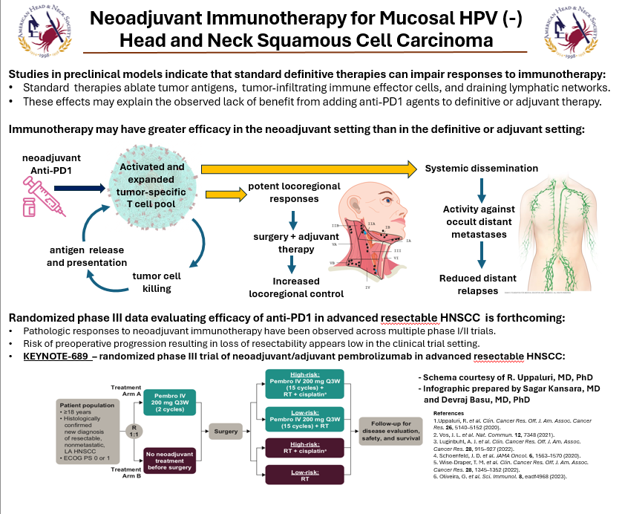
Basic & Translational Science Service
2025 AHNS Business Meeting
Infographic

Slide 62

Basic & Translational Science Service
2025 AHNS Business Meeting
Looking for cell lines in HN?
Have a question about processing genomics data?
Look no further than the online repository of supportive experts on the
AHNS Virtual Repository of Scientific Resources
Scan the QR code to access the repository
(AHNS login required)
Sponsored by the AHNS Basic & Translational Science Service

Slide 63
Population Health & Clinical Research Service
2025 AHNS Business Meeting
Infographics:
Completed:
  Mental Health in Head and Neck Cancer
  Smoking Cessation
  Neoadjuvant Therapy for Mucosal HNSCC
  Artificial Intelligence and Head and Neck Cancer
  World Oral Health Day
  National Cannabis Awareness Month
  World No Tobacco Day
Upcoming:
  Anxiety and Depression in HNSCC
Webinars
Upcoming:
  Research Ethics Webinar (In conjunction with Basic Science) Scheduled for May 28, 2025
Proposed:
  Integration of Circulating Tumor DNA into a Head and Neck Cancer Practice
  Beyond Tobacco and Alcohol: Environmental and Modifiable Risk Factors for Head and Neck Cancer
Barry Wenig
Joseph Curry
Staff: Loren Hamilton
Social Media Interviews:
Completed:
  Drs. Tassone & Topf
  Drs. Contrera & Lai
  Drs. Kansara & Uppaluri
Upcoming:
  Drs. Sridharan & Luginbuhl
  Drs. Bell & Curry
  Drs. Forner & De Almedia;

Slide 64
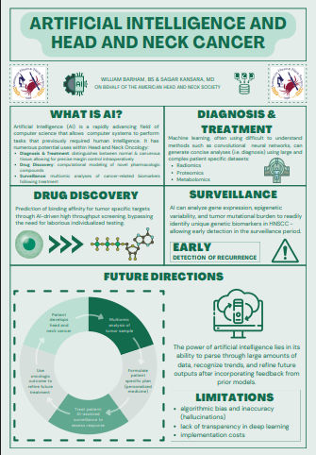
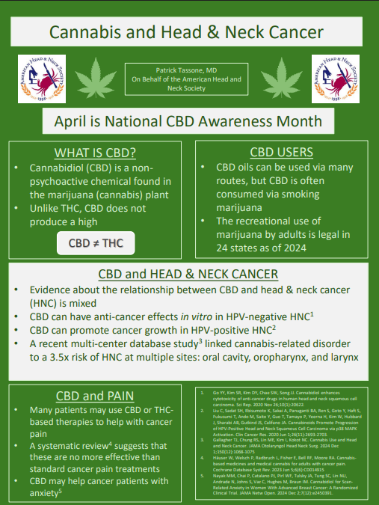
Population Health & Clinical Research Service
2025 AHNS Business Meeting
Infographics

Slide 65
Population Health & Clinical Research Service
2025 AHNS Business Meeting
Papers
  Published:
  Collaborative Neoadjuvant Therapy for Mucosal HNSCC: JAMA Otolaryngology, April 24th
  Pending:
  Consensus on the Best Practices Regarding Circulating Tumor DNA
  Patient-Reported Outcomes (PROs) in Clinical Trials
Podcast
  Recurrent Respiratory Papillomatosis (RRP): Consensus statement on the use of systemic Avastin to treat RRP in Laryngoscope
Research Study
  Collaborative multidisciplinary study on impact of COVID in HNSCC
Grand Rounds / Invited Lecture Exchanges
  Kevin Contrera TJUH Grand rounds: Neoadjuvant Immunotherapy
  Carissa Thomas TJUH SCC working group: Microbiome in HNSCC
AHNS Survey:
Surgical Margin Practices among HN surgeons
Service Communication:
Established an Clin Pop Slack channel for communcaiton: Puram
Meeting Program Proposals:
Pre-meeting Research and Grant Writing course:
  Proposal submitted for consideration for upcoming meeting

Slide 66
Grants Service
2025 AHNS Business Meeting
Presidential Grants
  Novel Therapeutic Targets and Combinations in Head and Neck Cancer
  Understanding Treatment Resistance in Head and Neck Cancer
  Defining and Implementing Value-Based Care in Head and Neck Cancer
New Presidential Grant Topic will be presented for the upcoming cycle
Innovation and Entrepreneurship Symposium planned for 2025 AHNS meeting, incorporating other COSM societies
Submission for grant-writing panel at 2026 AACR-AHNS meeting
Potential Webinar Proposal: "Paths to AHNS Funding: Tips and Tricks"

Slide 67
2025 CORE Study Section:
AHNS Grant Award Recommendations
Thank you to the AHNS reviewers for CORE!
Theresa Guo
Natalie Silver
Matthew Spector
Andrey Finegersh
Marisa Buchakijan
Farshad Chowdhury
Kevin Contrera
Janice Farlow
Thomas Ow
Apoorva Ramaswamy
Nicole Schmitt
Travis Schrank
Baran Devrim Sumer
Carissa Thomas
Michael Topf

Slide 68
Grants Service
2025 AHNS Business Meeting
Status of 2025 Submissions
All AHNS-sponsored grants received applications.
Head & Neck Subcommittee reviewers have completed assignments and made recommendations.
Membership Verification
Membership status cross-checked with AHNS roster.
Next Steps
FOAs for 2025 cycle shared with leadership for approval.
Feedback due to AAO-HNSF by Thursday, May 15.
Announcement of recipients expected in Early June 2025.

Slide 69
Survey Task Force
2025 AHNS Business Meeting
John De Almeida
Jeffrey Liu
Staff: Betty Mulugeta
Survey Progress and Challenges: Increase member involvement and support, address survey fatigue, and establish formal reporting structure for better organization and communication.
Streamlining Process: Recognize the importance of streamlining survey development process and shift focus to both research and operational purposes.
Reviewer Expansion: Plan to expand the reviewer base to manage the growing volume of surveys and mitigate survey fatigue by recruiting representatives from more service and section groups.
Formalization : Formalize task force as service of the research division, pending approval from the Executive Committee and Bylaw service.

Slide 70
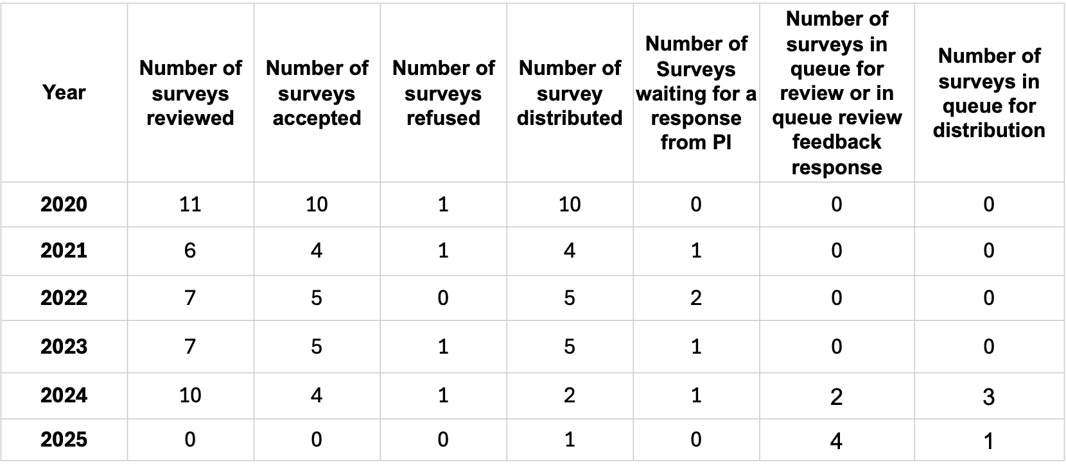
Survey Task Force/Service
2025 AHNS Business Meeting

Slide 71
HNCIG/AHNS SALIVARY CONSORTIUM
2025 AHNS Business Meeting
HNCIG Call for Database Proposals
Proposal submitted for global salivary duct carcinoma database (Chinn, Schmitt, Lai)- selected by HNCIG but advised to include all high-grade salivary cancers
AHNS Salivary Research Committee
Was already working on similar database in parallel
Next Steps
Merged efforts- leadership from AHNS Salivary Research Committee (Holcomb/Sajisevi), with international Steering Committee to include HNCIG members
Database fields decided, data use agreements pending

Slide 72
SECTIONS
2025 AHNS Business Meeting

Slide 73
Cutaneous Cancer Section
2025 AHNS Business Meeting
-
Section Engagement/Membership
Section Newsletter/Townhall (Jan 2025)
https://www.ahns.info/sections/cutaneous-cancer/cutaneous-section-news-reports/
Plan follow up in (July 2025)
Encourage new AHNS members to sign up!
Mentorship
Kelly Malloy/Anne Kane – Young Members PODCAST
Brittny Tillman, Kevin Emerick – building a skin cancer practice
https://www.ahns.info/ahns-ymcp-episode-10-anne-kane-md-kelly-malloy-md-brittny-tillman-md-kevin-emerick-md/
https://www.ahns.info/meetings/young-members-corner-podcast/
New Social Media Chair
Thank you Caitlin McMullen, Welcome Jobran Mansour!

Slide 74
May – Skin Cancer Awareness Month
Successful CDMS tumor board (Alice Lin)
Social media and prevention content (Mansour, Jessica Yesensky) - Mohs video, Lesion assessment video
Research (Joe Curry)
Tri-NetX / multi-institutional study of ICI among immune compromised patients
Surgical planning hands-on survey – post-neoadjuvant
Guidelines (David Neskey)
White paper – current state of adaptive surgery in response
to neoadjuvant therapy
AHNS COSM footprint
2 symposia
HN014 informational session

Slide 75

Endocrine Surgery Section
2025 AHNS Business Meeting
Strategic goal: To cement the role of the AHNS and head & neck surgeons as recognized leaders in the care of patients with thyroid & parathyroid diseases
  3-pronged approach
Clinical expertise
  Development of clinical reading list with key publications
  Support of Focused Practice Designation (FPD) applications
Outreach
  2 upcoming, co-sponsored webinars
    American Association of Clinical Endocrinology –
    “Multidisciplinary Graves’ Disease Care”
    American Association of Endocrine Surgeons –
    “Advanced Thyroid Ablation Techniques”
  Promotion of volunteering/engagement in American Thyroid Association
Research/Publications
  Recruitment of Thyca grant submissions
  Statement on Neoadjuvant Therapy for Advanced Thyroid Cancer – developed with International Thyroid Oncology Group (ITOG)
Clinical expertise cultivation
Organizational outreach
Research/publications

Slide 76
Mucosal section:
Miriam Lango MD and Ryan Jackson MD
2025 AHNS Business Meeting
Oral cavity clinical practice guideline
  First in-person meeting May 12-13; second in person meeting October 2025
  Development of COI Policy for CPG Members (c/o Baran Sumer)
TORS Course
Panel submissions
  AHNS 2025 & IFOS Istanbul 2026
Sponsored Webinars
  Early Onset Oral Cavity Cancer (planned)
  Minimally Invasive Larynx Cancer Treatment
  Multidisciplinary approach to Oropharyngeal Cancer
Narrative reviews (in process)
  Neck dissection classification & Review Early Onset Oral Cavity Cancer

Slide 77
2025 AHNS Business Meeting – COSM
12/18/2024
2/19/2025
4/16/2025
6/18/25
Reconstructive Section
Microvascular Fellowship Boot Camp: Oct 11-13, 2024; Columbus, OH (42 fellows, 25 faculty)
AHNS/COSM meeting, 3 panels
  Horror Stories in Head and Neck Reconstruction: Is It a Thing of the Past?
  Outcomes of ERAS and Perioperative Protocols for H&N Reconstruction
  Reconstruction Debates: Can AI Do It All? AI and Its Impact in Head and Neck Reconstruction and Rehabilitation
Recon ‘Round the World Webinars
12/18/24, 2/19/25, 4/16/25, 6/18/25 (Southeast Asia, Korea, Africa, Central America)
IFOS 2026 Submissions – 3
Quality Committee:
-Patient Recon Handouts: 16 hand-outs completed – will be on-line soon.
-ERAS handouts completed
-Systematic review of quality measures literature for head and neck reconstruction
-Narrative Review/position paper: Head and Neck Recon ERAS protocol
Mentorship Committee:
-Grant proposal to AHNS for URM med – pending approval
-Manuscript on text-group based mentorship to be published
-Mentorship award nomination pending
Education Committee:
- Microvascular Fellowship Boot Camp: Oct 17-19; Registration open in July – look for announcements.
- Patient educational pamphlets now on-line: - 6 downloadable pdfs
Research Committee:
    Standards for research for multi-d studies in recon
    Position Papers – ORN, ERAS
    Publication - Microvascular Reconstruction of Medication Related Osteonecrosis of the Hand and Neck.
    Publication - Flow-Through Flaps as a Robust Method for Advanced Free Flap Reconstruction in the Head and Neck: A Multi-Institutional Experience
    Publication - Microvascular Free Flap Outcomes in Maxillectomy Defects from Invasive Fungal

Slide 78
Salivary Section
2025 AHNS Business Meeting
Chair, Kiran Kakarala; Vice Chair, William Ryan
Research (Mirabelle Sajisevi and Andrew Holcomb)
  Follow up studies utilizing low grade salivary cancer database
  Initiating multi center high grade salivary cancer database
    Increasing international participation/engagement: Canada, South America, Europe, Asia
  Participating in neck dissection classification update (Robbins) and AJCC staging update (Lydiatt and Ganly)
Education (Trevor Hackman and Ameya Asarkar)
  Fellows tumor board co-developed with CDMS: Jan 8, 2025
  4 panels submitted for Annual Meeting at COSM 2025, 3 accepted
  2 AHNS webinars for 2025 submitted in collaboration with Multidisciplinary Salivary Gland Society
Outreach (Christopher Rassekh)
  Initiated research and education collaboration with Multidisciplinary Salivary Gland Society

Slide 79
Skull Base Surgery Section
Shirley Y. Su and Marilene B. Wang
2025 AHNS Business Meeting
Educational Endeavors
  Skull Base Oncology Case Series - 15 cases uploaded
    February 2025 “HPV-Associated Sinonasal Squamous Cell Carcinoma “
    March 2025 “Circulating Tumor DNA for Surveillance of HPV-Associated Sinonasal Carcinoma”
    April 2025 “Ca. Ex-pleomorphic of lacrimal gland with intracranial extension”
  Themed Journal Club – June 2025
  Sinonasal Cancer Virtual Tumor Board (with ARS) – March 19th, 2025
  COSM 2025 Panels, involving ARS members.
    “Skull base survivorship considerations every surgeon should know”
    “Advances in the management of NPC”
Tri-Society collaboration (AHNS, ARS and NASBS) - Sinonasal Tumor Alliance
  September 17th, 2024: “Virtual Tumor Board”, 500 registrants, 83 attended.
  March 11th, 2025 “Pediatric Tumor Board”, 275 registrants, 81 attendees
Expert Practice Guidelines - with NASBS
  “Initial Radiographic Work Up in Skull Base Surgery - Expert Practice Statement”

Slide 80
Call For New Business
2025 AHNS Business Meeting

Slide 81
Council Members Rotating Off Council:
Bert O’Malley, MD – Past President
Greg Farwell, MD – Patient Care Division Chair
2025 AHNS Business Meeting - May

Slide 82
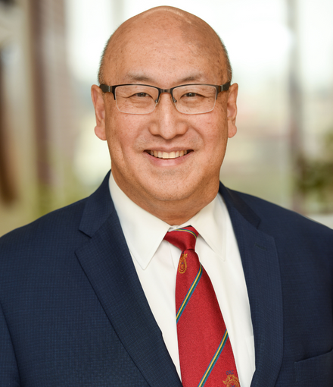
Bevan Yueh, MD
2025-2026 AHNS President
Chief Executive Officer for the University of Minnesota Physicians and Vice Dean of Clinical Affairs for the University of Minnesota Medical School. AJCC Staging Committee Chair
Led numerous services and leadership positions for the AHNS, including Treasurer, 2014 Meeting Program Chair, Development, Patient and Public Education, Program, Journal, ATC, Ethics & Professionalism, Publications, Archives chair, Quality of Care, Guidelines, RUC, Finance Service, Research

