Slide 1


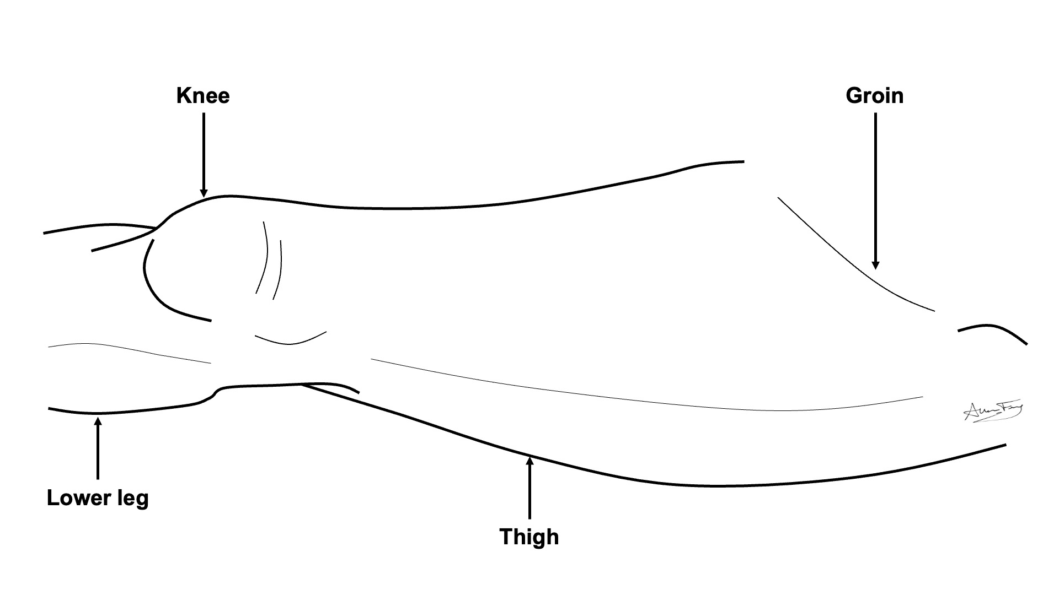
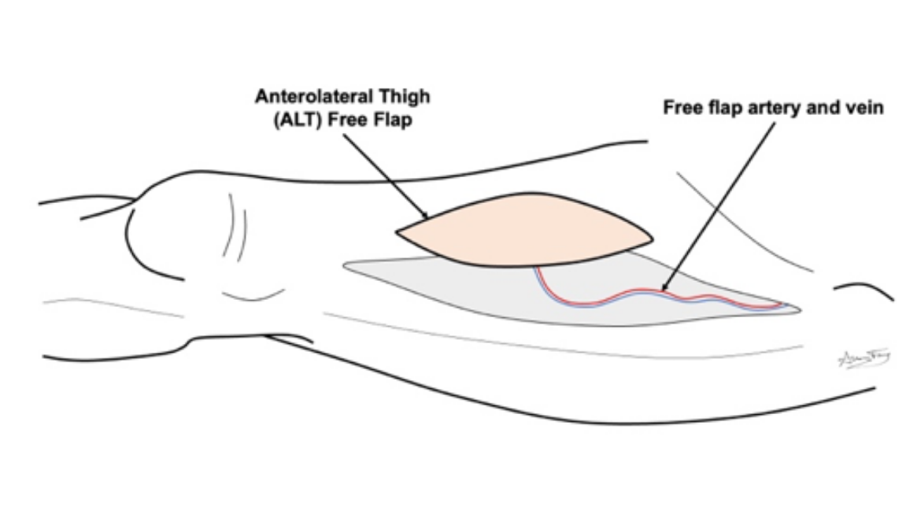
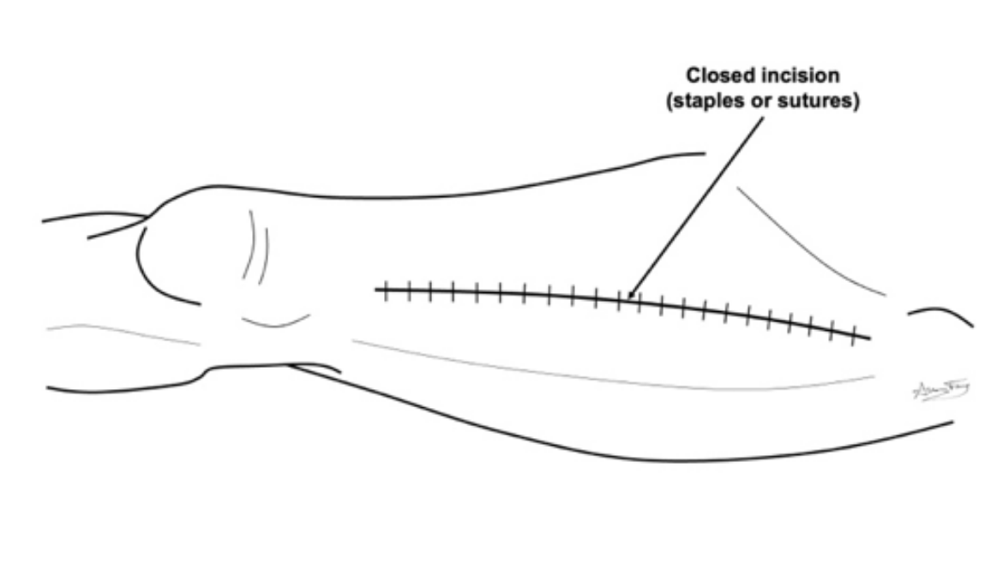
Anterolateral Thigh Free Flap (ALT)
What is a “free flap”?
A transplant of flesh/bone from one part of your body to another
It is used to rebuild the body part that was removed
How does it work?
The flesh/bone is removed from its original part of the body along with its artery and vein.
The free flap is used to rebuild the missing body part. The artery and vein are hooked up to a new artery and vein in the neck. This keeps the flap alive.
Anterolateral Thigh Free Flap (ALT)
This flap comes from the muscle and skin of the thigh (upper leg).
The wound is closed as a long incision.
You will have a long scar on your thigh.
What to expect?
Short term:
  You will have 1-2 drains for 1-2 weeks
  Stitches or staples are removed in 1-2 weeks.
  Your leg will feel tight and weak for several weeks.
  We want you to start walking 1-2 days after surgery.
  Long term:
    The wound / scar will heal over the course of several months.
    You may have temporary or permanent numbness, swelling and weakness in your thigh / leg.
    With proper physical therapy you should regain near normal movement and use of your thigh / leg.
    If you do not do the prescribed therapy, you may not recover.
How to take care of the wound
No lifting more than 10 lbs until your doctor clears you. But lots of walking is encouraged!
Go to your prescribed physical therapy / occupational therapy appointments
Dressing:
Step 1: Clean the wound with gentle soap and water or ½ strength hydrogen peroxide daily
Step 2: Apply Aquaphor or vaseline to the incision / scars and skin graft to prevent scabs or crusts
Step 3: Apply xeroform (yellow gauze) or adaptic to the incision.
Step 4: Wrap the leg in gauze (snug – but not too tight!)

