Slide 1


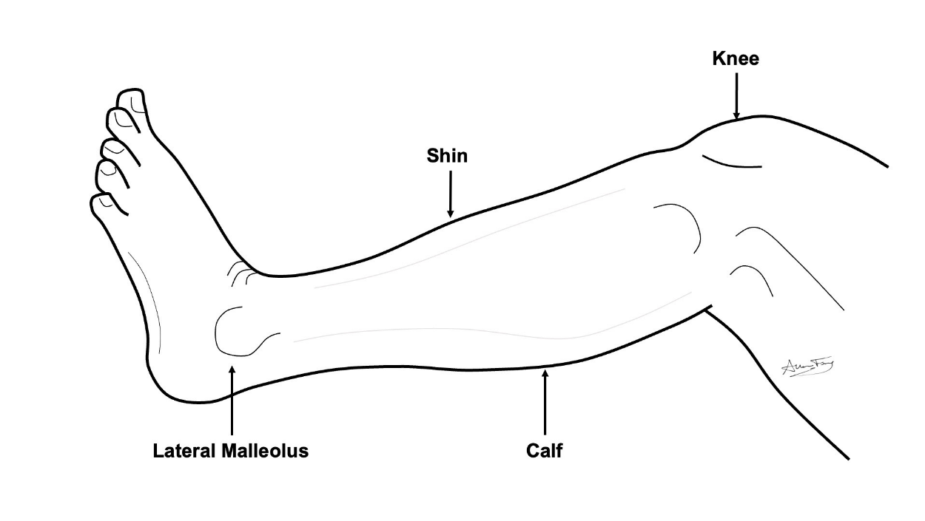
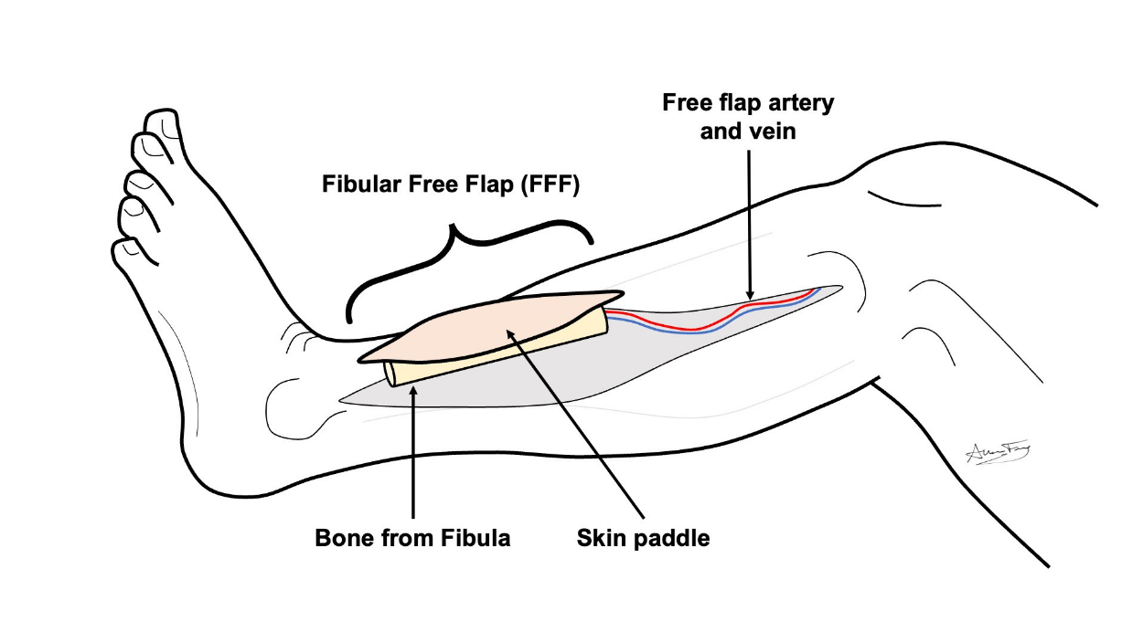
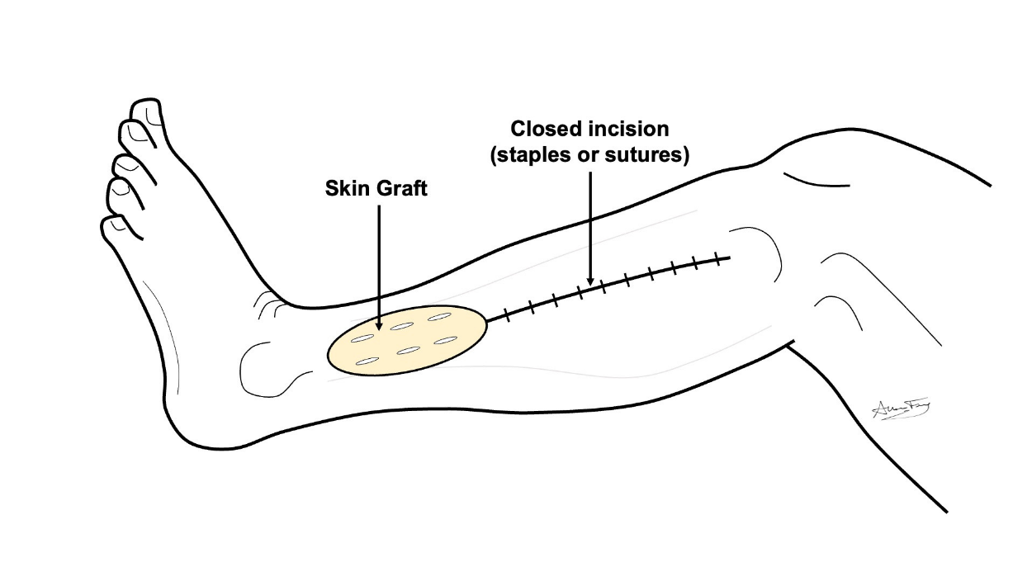
Fibula Free Flap (FFF)
What is a “free flap”?
A transplant of flesh/bone from one part of your body to another
It is used to rebuild the body part that was removed
How does it work?
The flesh/bone is removed from its original part of the body along with its artery and vein.
The free flap is used to rebuild the missing body part. The artery and vein are hooked up to a new artery and vein in the neck. This keeps the flap alive.
Fibula Free Flap (FFF)
This flap comes from the skin, muscle and bone of your lower leg.
It is used to rebuild your jaw/face bone.
The missing skin from your leg is replaced by a shaving of skin from your thigh (aka skin graft).
The missing bone does not need to be replaced.
What to expect?
Short term:
  You may have 1-2 drains and/or wound vacuum (VAC) for 5-7 days
  Stitches or staples are removed in 5-7 days
  Your leg will be in a splint/boot for a month.
  We want you to start walking 1-2 days after surgery.
  Long term:
    The skin graft will take weeks-months to fully heal and may break down and re-heal during that time
    You may have temporary or permanent numbness, swelling and weakness in your leg and foot
    With proper physical therapy you should regain near normal movement and use of your leg.
    If you do not do the prescribed therapy, you may not recover.
How to take care of the wound
No lifting more than 10 lbs until your doctor clears you. But lots of walking is encouraged!
Go to your prescribed physical therapy / occupational therapy appointments
Dressing:
Step 1: Clean the wound with gentle soap and water or ½ strength hydrogen peroxide daily
Step 2: Apply Aquaphor or vaseline to the incision / scars and skin graft to prevent scabs or crusts
Step 3: Apply xeroform (yellow gauze) or adaptic to the incision and skin graft
Step 4: Wrap the leg in gauze (snug – but not too tight!)
Step 5: Wear the leg splint/boot for 1 month and then stop.

