Slide 1


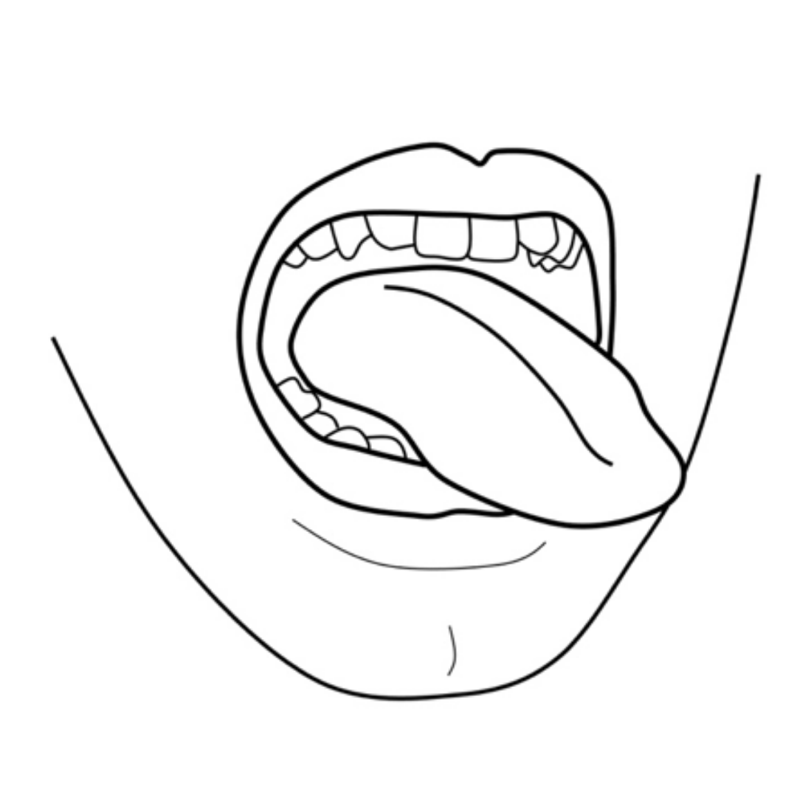
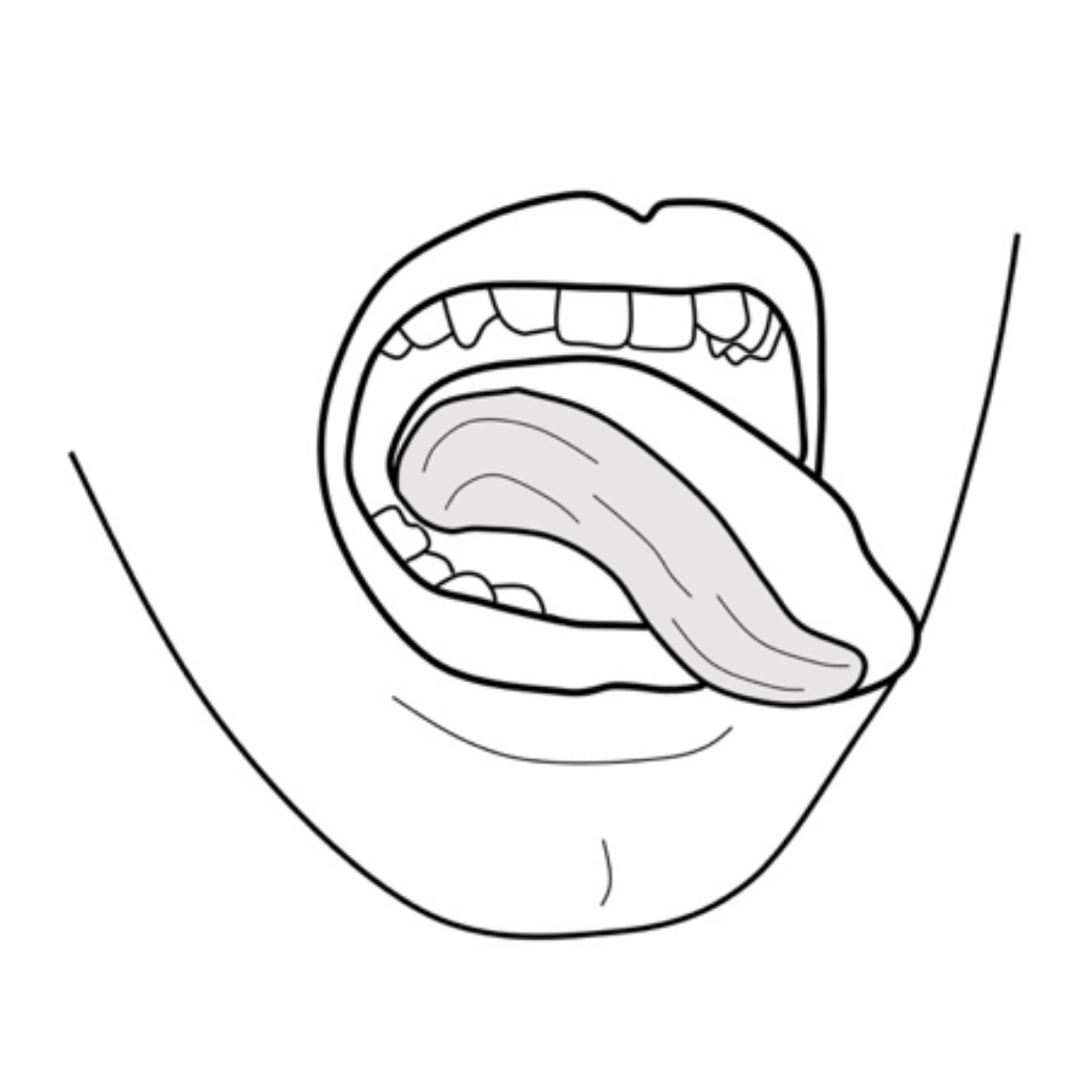
Hemi-Glossectomy
(Half Tongue Removal)
What is a “hemi-glossectomy”?
About half the tongue is taken out to get rid of the cancer.
Why do I need a hemi-glossectomy?
To get rid of your mouth cancer, your surgeon needs to remove all parts that look or feel like cancer as well as a safety “margin” (1-2cm) beyond this.
Cancers have “roots” that go beyond what we can see and feel. That is why more than just what looks like cancer must be removed.
Once the cancer is removed and extra margins are sent for an immediate analysis (frozen section), you will have about half of your tongue left.
What to expect?
Short term:
Your tongue will be rebuilt with tissue from another part of your body (graft/flap). This helps you talk and swallow better.
Your tongue and the graft/flap will swell up after surgery, and your tongue may hang out of your mouth for a few weeks.
You may need a trach-tube (tr-ake) temporarily because of the swelling.
Long term:
The swelling will go down and the graft/flap will shrink over time.
You will need speech and swallowing therapy/rehab for a year to recover as much as you can. If you do not start therapy early after surgery, you may not recover.
How to take care of your mouth
No lifting more than 10 lbs until your doctor clears you. But lots of walking is encouraged!
Go to therapy: speech/swallowing therapy appointments with your SLP (Speech Language Pathologist).
Use your mouth cleaning medications (saline or baking soda rinses, Peridex) as instructed.
Brush and floss your teeth normally once your doctor says it is ok.
Increase your diet by mouth as instructed by your SLP

