Slide 1


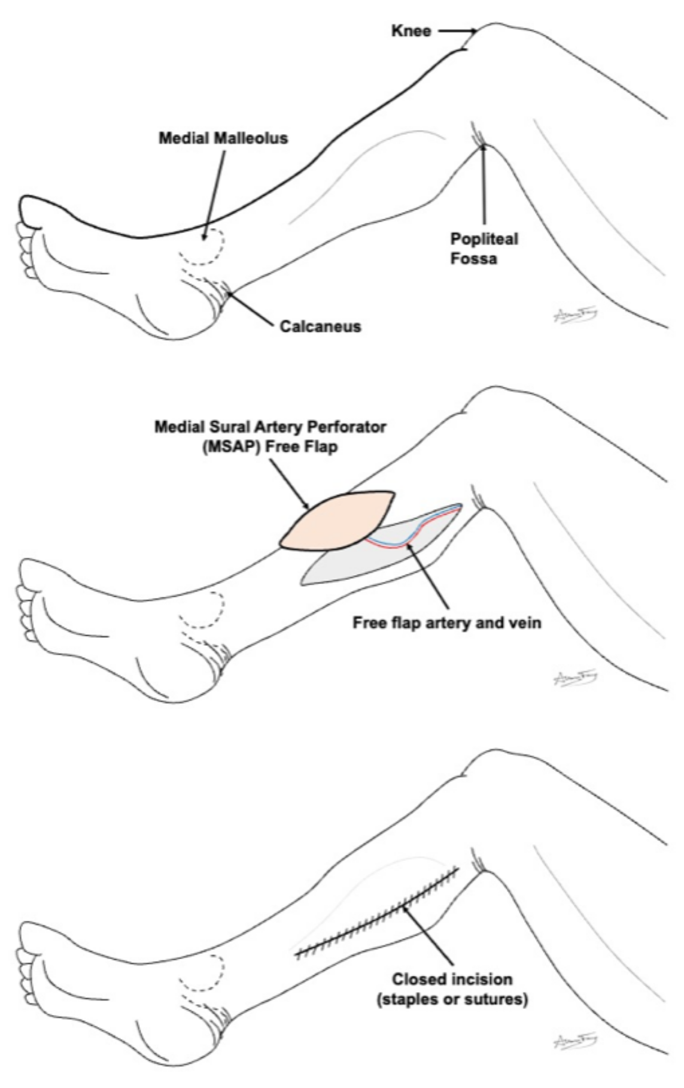
Medial Sural Artery Perforator Free Flap (MSAP)
What is a “free flap”?
A transplant of flesh/bone from one part of your body to another
It is used to rebuild the body part that was removed
How does it work?
The flesh/bone is removed from its original part of the body along with its artery and vein.
The free flap is used to rebuild the missing body part. The artery and vein are hooked up to a new artery and vein in the neck. This keeps the flap alive.
MSAP
This flap comes from the skin and fatty tissue of your calf (lower leg).
The wound is closed with an incision.
What to expect?
Short term:
You may have a drain in your leg for 1-2 weeks.
Stitches or staples are removed in 1-2 weeks after surgery.
Your calf and leg will feel tight and sore for several weeks.
You should be able to walk the first day after surgery.
Long term:
The tightness will loosen the more you walk
You will have a scar
With proper physical therapy, you should regain strength and full movement in your leg within a few months
If you do not do the prescribed therapy, you may not recover.
How to take care of the wound
No lifting more than 10 lbs until your doctor clears you
Go to your prescribed physical therapy / occupational therapy appointments Dressing:
Step 1: Clean the wound with gentle soap and water or ½ strength hydrogen peroxide daily
Step 2: Apply Aquaphor or vaseline to the incision / scars and skin graft to prevent scabs or crusts
Step 3: You do not need to cover or wrap the leg in gauze, unless you find it more comfortable.

