Slide 1


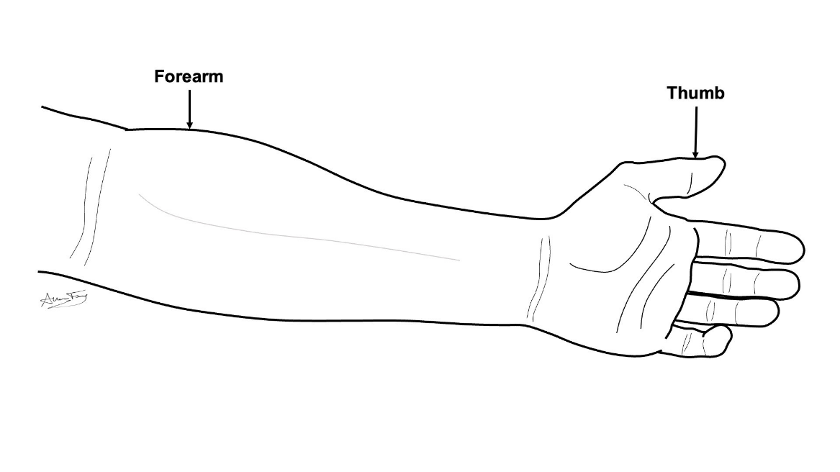
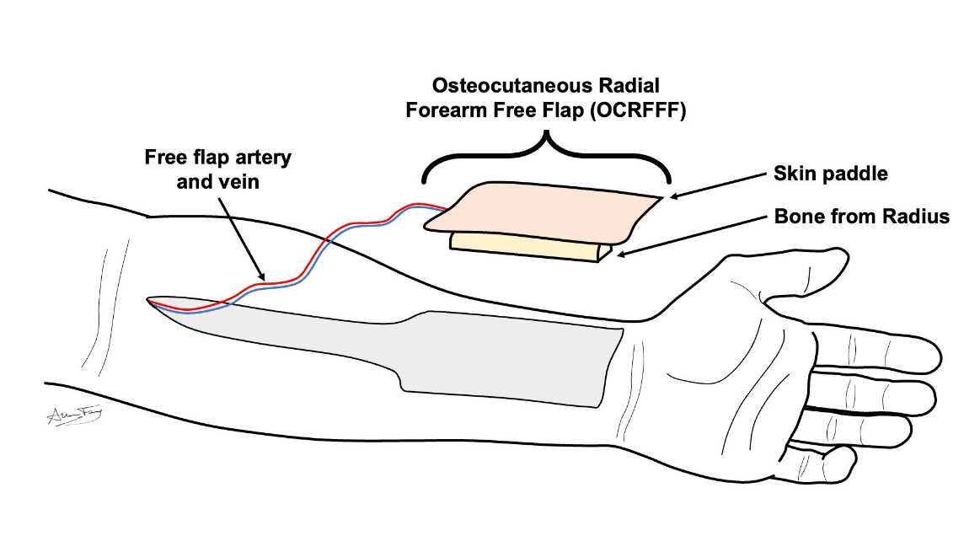
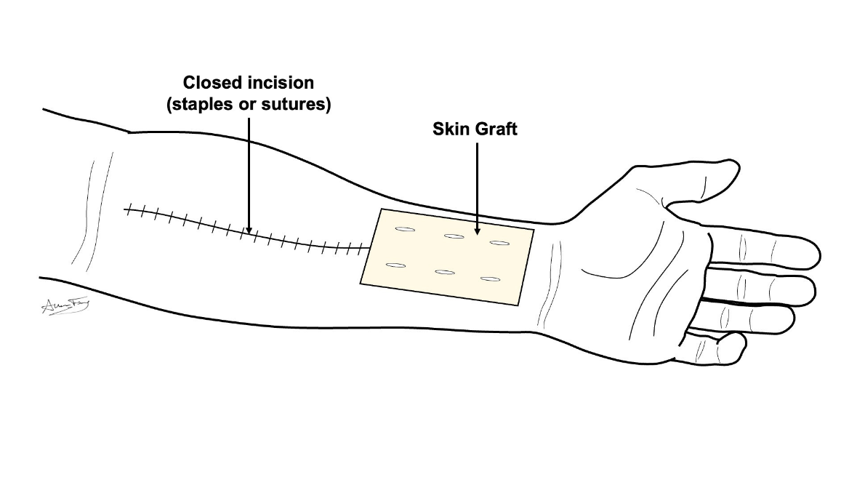
Osteocutaneous Radial Forearm Free Flap (OCRFFF) [aka “Bony Forearm Free Flap”]
What is a “free flap”?
A transplant of flesh/bone from one part of your body to another
It is used to rebuild the body part that was removed
How does it work?
The flesh/bone is removed from its original part of the body along with its artery and vein.
The free flap is used to rebuild the missing body part. The artery and vein are hooked up to a new artery and vein in the neck. This keeps the flap alive.
Bony Forearm Free Flap
This flap comes from the skin and bone of your forearm and wrist.
It is used to rebuild your jaw/face bone.
The missing skin from your forearm is replaced by a shaving of skin from your thigh (aka skin graft).
Them missing bone is replaced by a metal bar.
What to expect?
Short term:
You may have a drain and/or wound vacuum (VAC) for 5-7 days
Stitches or staples are removed in 5-7 days
Your arm will be in a splint to keep it still
Long term:
The skin graft will take weeks-months to fully heal and may break down and re-heal during that time
You may have temporary or permanent numbness around the wound and thumb
With proper physical therapy you should regain near normal movement and use of your wrist and hand.
If you do not do the prescribed therapy, you may not recover.
How to take care of the wound
No lifting more than 10 lbs until your doctor clears you
Go to your prescribed physical therapy / occupational therapy appointments Dressing:
Step 1: Clean the wound with gentle soap and water or ½ strength hydrogen peroxide daily
Step 2: Apply Aquaphor or vaseline to the incision / scars and skin graft to prevent scabs or crusts
Step 3: Apply xeroform (yellow gauze) or adaptic to the incision and skin graft
Step 4: Wrap the arm in gauze (snug – but not too tight!)
Step 5: Wear the wrist splint for 1 month

