Slide 1


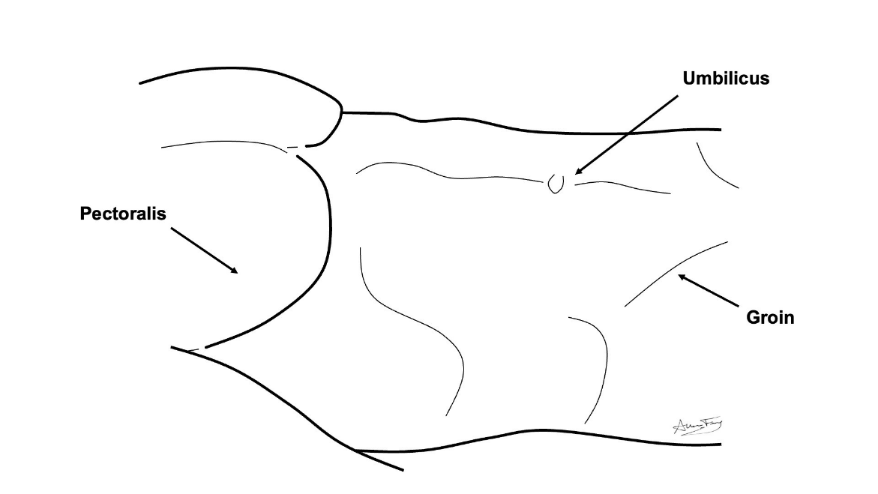
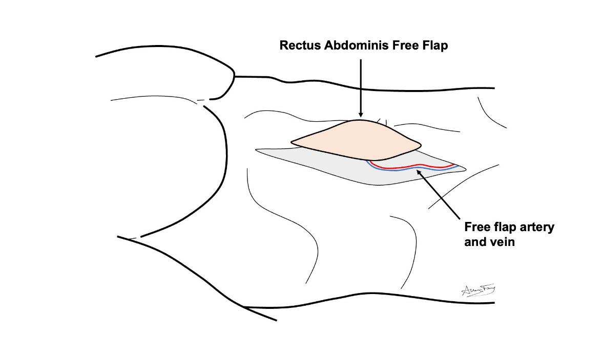
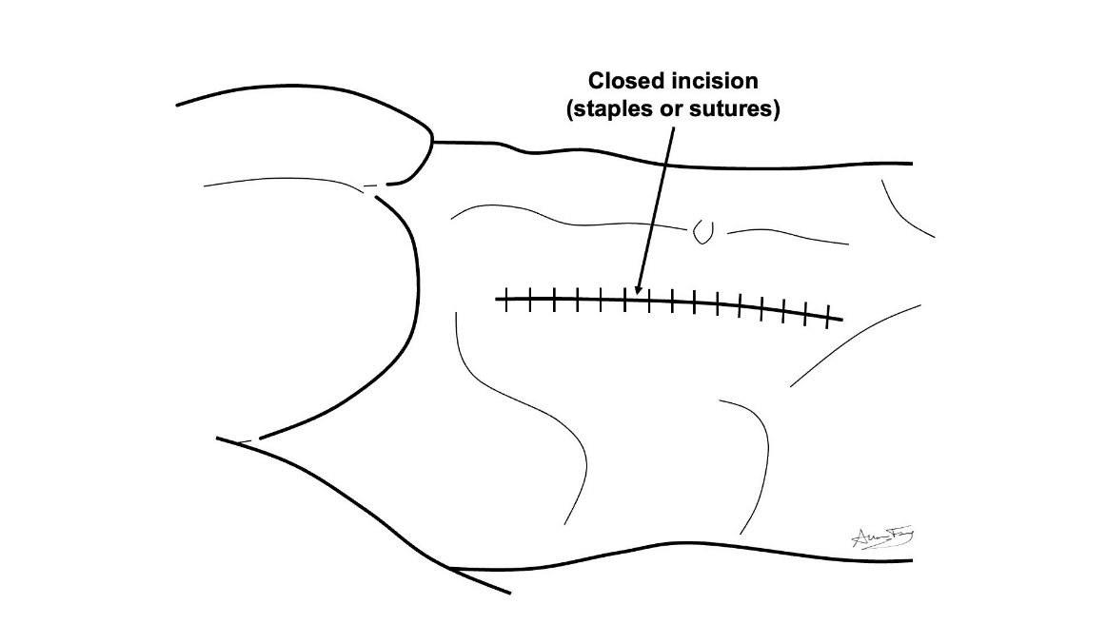
Rectus Abdominus Free Flap
(Belly Flap)
What is a “free flap”?
A transplant of flesh/bone from one part of your body to another
It is used to rebuild the body part that was removed
How does it work?
The flesh/bone is removed from its original part of the body along with its artery and vein.
The free flap is used to rebuild the missing body part. The artery and vein are hooked up to a new artery and vein in the neck. This keeps the flap alive.
Belly Flap
This flap comes from the skin, muscle and fatty tissue of your belly (abdomen).
The belly is closed as a long incision.
What to expect?
Short term:
You will have 1-2 drains for 5-7 days.
Stitches or staples are removed in 1-2 weeks.
Your belly will feel tight and for several weeks.
Your belly will feel stiff and tender at first, but should improve over a few weeks.
Long term:
The wound / scar will heal over the course of several months.
You may have temporary or permanent numbness, swelling and weakness in your belly.
With proper physical therapy you should regain near normal movement and use of your belly.
If you do not do the prescribed therapy, you may not recover.
How to take care of the wound
No lifting more than 10 lbs until your doctor clears you
Go to your prescribed physical therapy / occupational therapy appointments Dressing:
Step 1: Clean the wound with gentle soap and water or ½ strength hydrogen peroxide daily
Step 2: Apply Aquaphor or vaseline to the incision / scars and skin graft to prevent scabs or crusts
Step 3: Apply xeroform (yellow gauze) or adaptic to the incision
Step 4: Apply gauze and tape over top.

