Slide 1


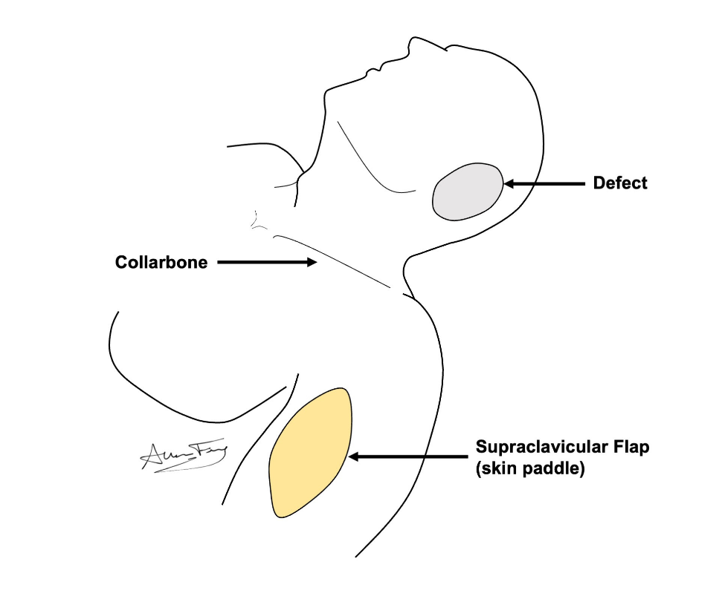
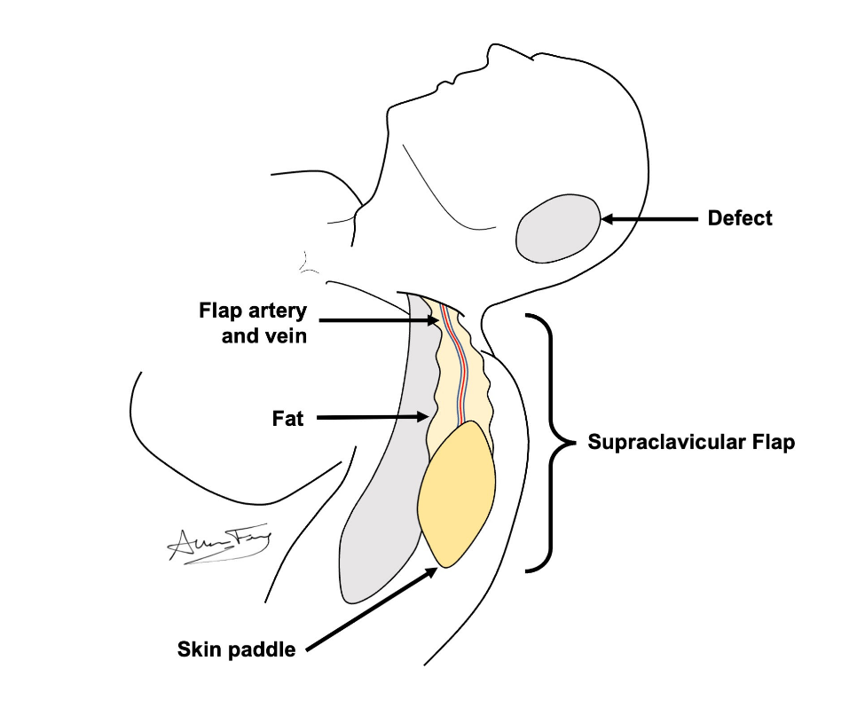
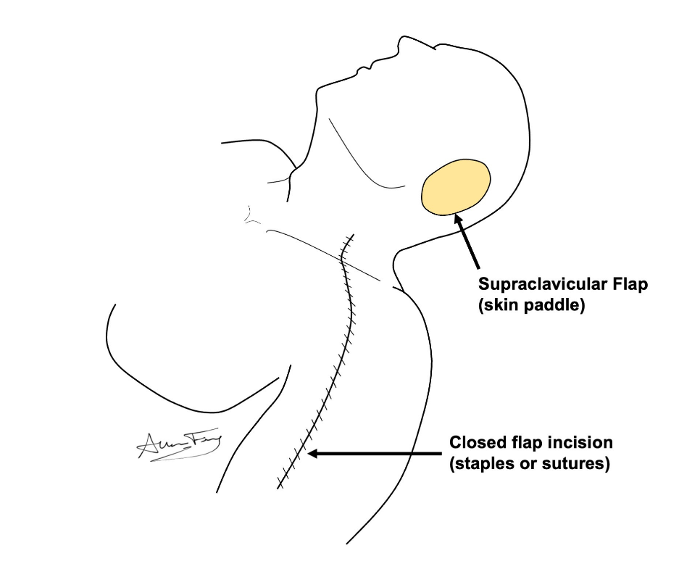
Supraclavicular Artery Island Flap
(SCAIF)
What is a “regional flap”?
Flesh is moved from one part of the body to another, while leaving it connected to its original blood supply.
It is used to rebuild the body part that was removed.
How does it work?
The flesh is separated from its original part of the body but is left attached to its artery / vein.
The flap is used to rebuild the missing body part by rotating/moving it into place.
Supraclavicular Flap (SCAIF)
This flap comes from the skin and fatty tissue of the neck and shoulder.
The flap is moved into neck, face, mouth or throat.
The wound is closed as a long incision.
You will have a long scar on your shoulder.
What to expect?
Short term:
You will have 2 or more drains for 1-2 weeks
Stitches or staples are removed in 1-2 weeks.
Your shoulder will feel tight and weak for several weeks.
Your shoulder will feel stiff at first, but should improve over a few weeks.
Long term:
The wound / scar will heal over the course of several months.
You may have temporary or permanent numbness, swelling and weakness in your back or shoulder.
With proper physical therapy you should regain near normal movement and use of your shoulder / back.
If you do not do the prescribed therapy, you may not recover.
How to take care of the wound
No lifting more than 10 lbs until your doctor clears you. But lots of walking is encouraged!
Go to your prescribed physical therapy / occupational therapy appointments Dressing:
Step 1: Clean the wound with gentle soap and water or ½ strength hydrogen peroxide daily
Step 2: Apply Aquaphor or vaseline to the incision / scars and skin graft to prevent scabs or crusts
Step 3: Apply an island bandage dressing over top.

