Slide 1


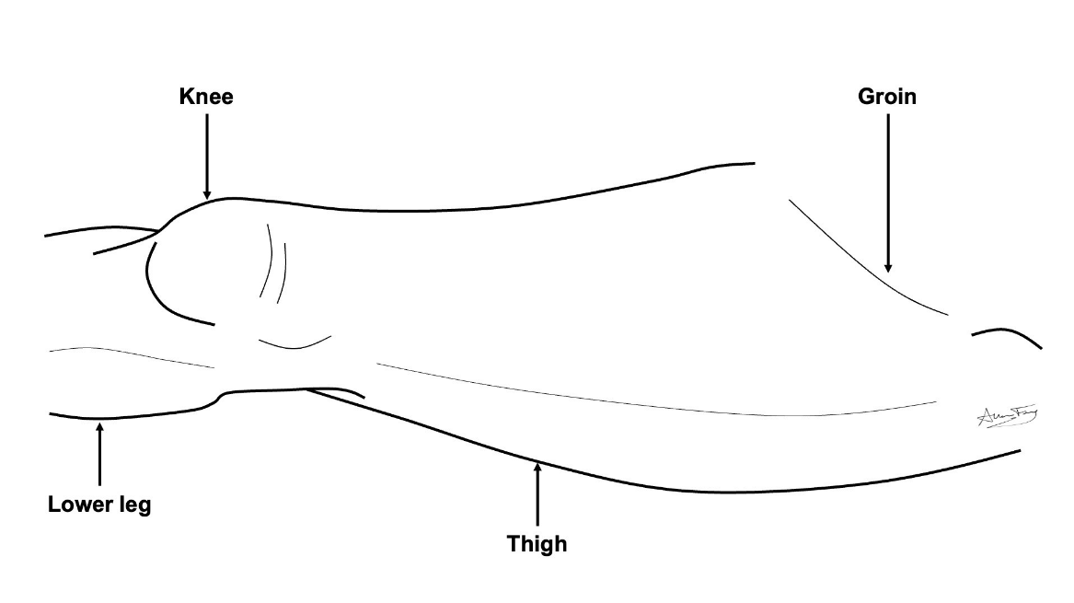
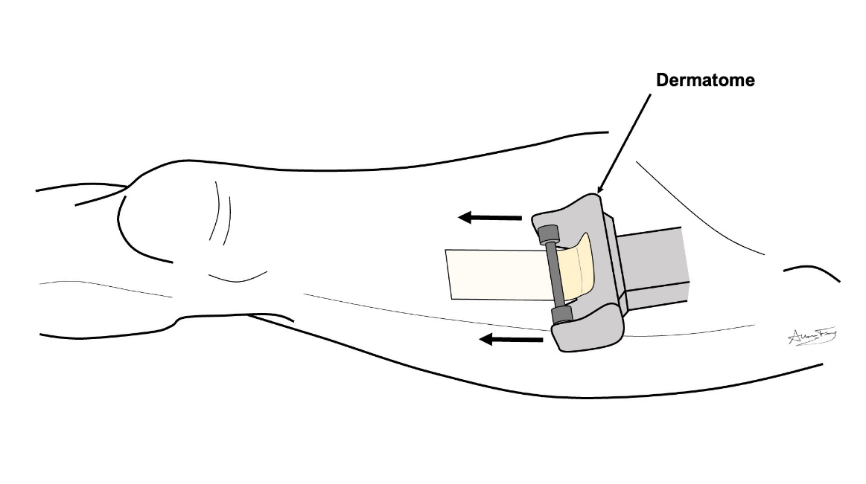
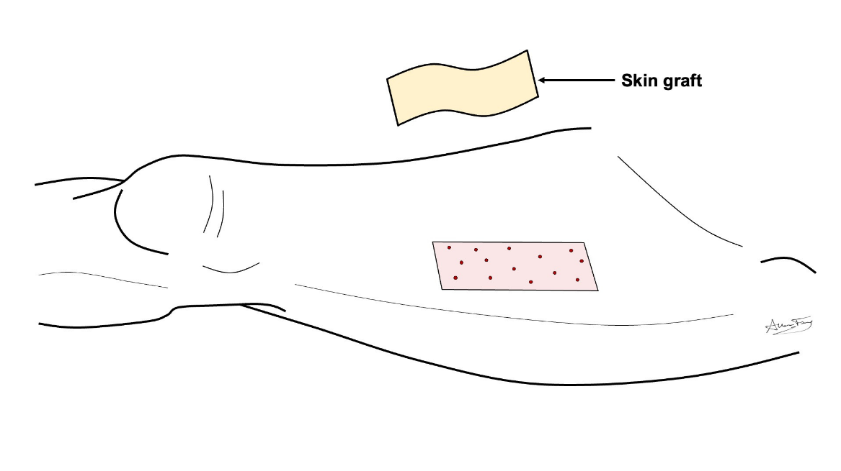
Split Thickness Skin Graft
(STSG)
What is a “skin graft”?
A shaving of skin moved from one part of the body to another.
It is used to cover a wound.
How does it work?
The skin is shaved off an area (e.g. the thigh) with an electric knife (dermatome).
The skin is sewn to a new area of the body and a pressure gauze (bolster) usually put over top to add pressure to it. This helps it heal.
The skin graft heals by getting blood from the area it is sewn to.
What to expect?
Short term:
You may have a yellow piece of gauze or similar tightly stapled or sewn over the skin graft.
This is removed in 1-2 wks.
You may have a wound vacuum (VAC) over the skin graft.
The body part where the skin graft came from will be sore, like road rash, for a few weeks.
Long term:
The wounds / scars will heal over the course of several months.
The body part where the skin graft came from will have a rectangle-shaped scar that will fade over time.
How to take care of the wound
No lifting more than 10 lbs until your doctor clears you. But lots of walking is encouraged!
Go to your prescribed physical therapy / occupational therapy appointments Dressing:
Step 1: Leave the dressing on until you see your doctor in follow-up. After your follow-up visit:
- Clean the wound with gentle soap and water
- Apply Aquaphor or vaseline to wound prevent scabs or crusts
- Apply gauze and an ace wrap over the wound to keep it from stinging or getting stuck to your clothes
Step 2. Once the wound starts to look and feel like normal skin, leave it open to air.

