Slide 1


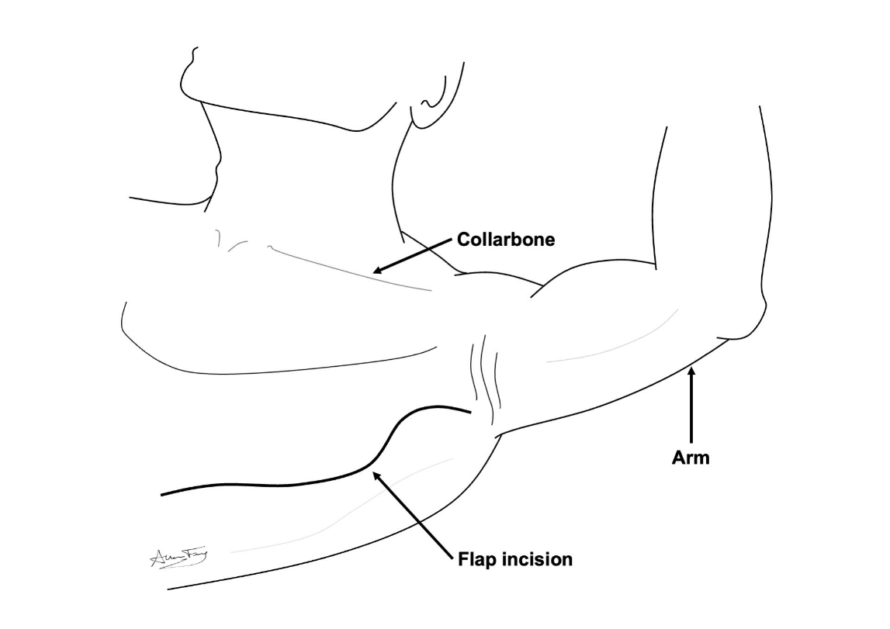
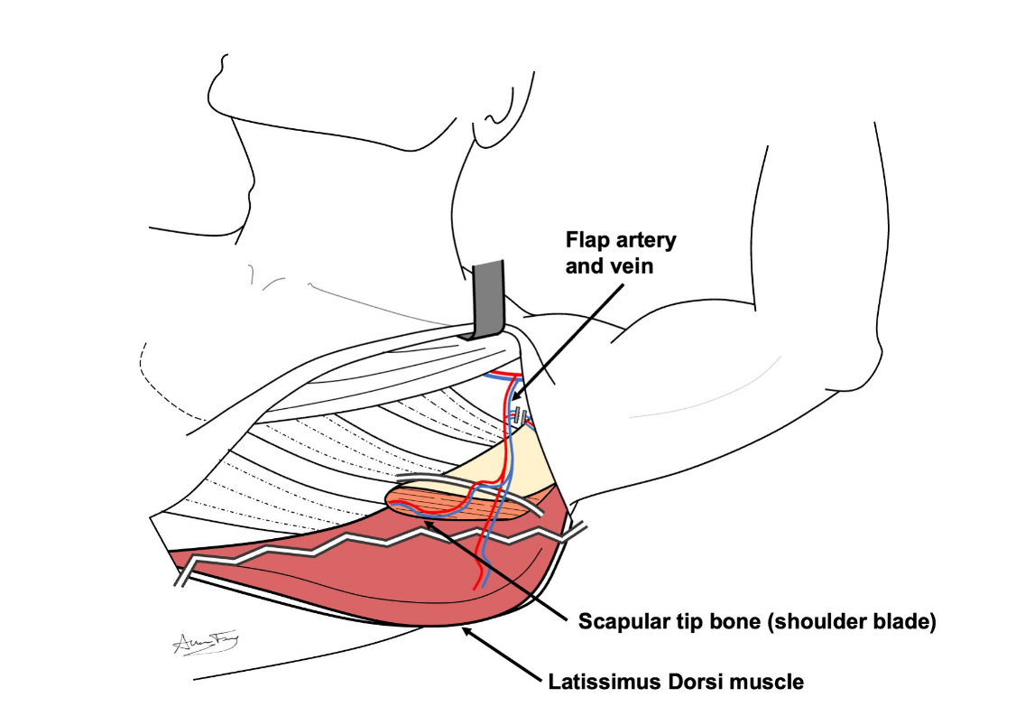
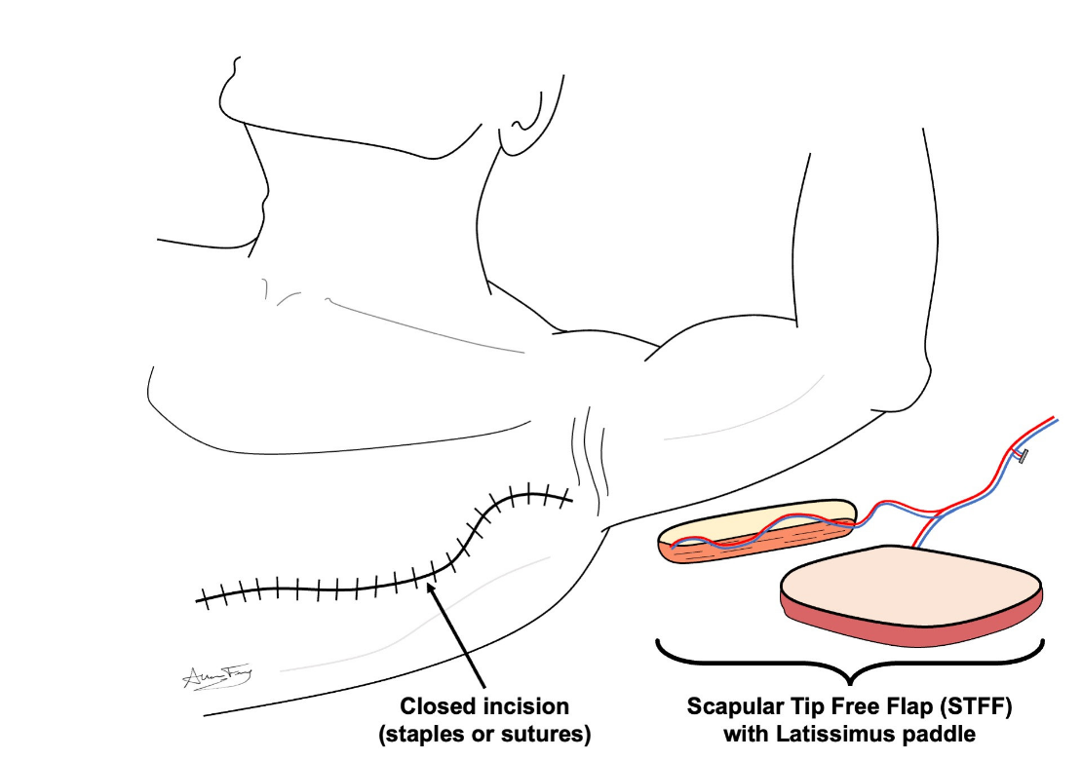
Scapula Free Flap
(Scap Flap)
What is a “free flap”?
A transplant of flesh/bone from one part of your body to another
It is used to rebuild the body part that was removed
How does it work?
The flesh/bone is removed from its original part of the body along with its artery and vein.
The free flap is used to rebuild the missing body part. The artery and vein are hooked up to a new artery and vein in the neck. This keeps the flap alive.
Scapula Free Flap (Scap Flap)
This flap comes from the muscle and bone +/- skin of the shoulder blade (back).
The bone and tissue are used to rebuild your jaw/face bones.
The wound is closed as a long incision.
You will have a long scar on your back.
What to expect?
Short term:
  You will have 2 or more drains for 1-2 weeks
  Stitches or staples are removed in 1-2 weeks.
  Your back will feel tight and weak for several weeks.
  Your shoulder will feel stiff at first, but should improve over a few weeks.
  Long term:
    The wound / scar will heal over the course of several months.
    You may have temporary or permanent numbness, swelling and weakness in your back or shoulder.
    With proper physical therapy you should regain near normal movement and use of your shoulder / back.
    If you do not do the prescribed therapy, you may not recover.
How to take care of the wound
No lifting more than 10 lbs until your doctor clears you. But lots of walking is encouraged!
Go to your prescribed physical therapy / occupational therapy appointments
Dressing:
Step 1: Clean the wound with gentle soap and water or ½ strength hydrogen peroxide daily
Step 2: Apply Aquaphor or vaseline to the incision / scars and skin graft to prevent scabs or crusts
Step 3: Apply an island bandage dressing over top.

