Slide 1


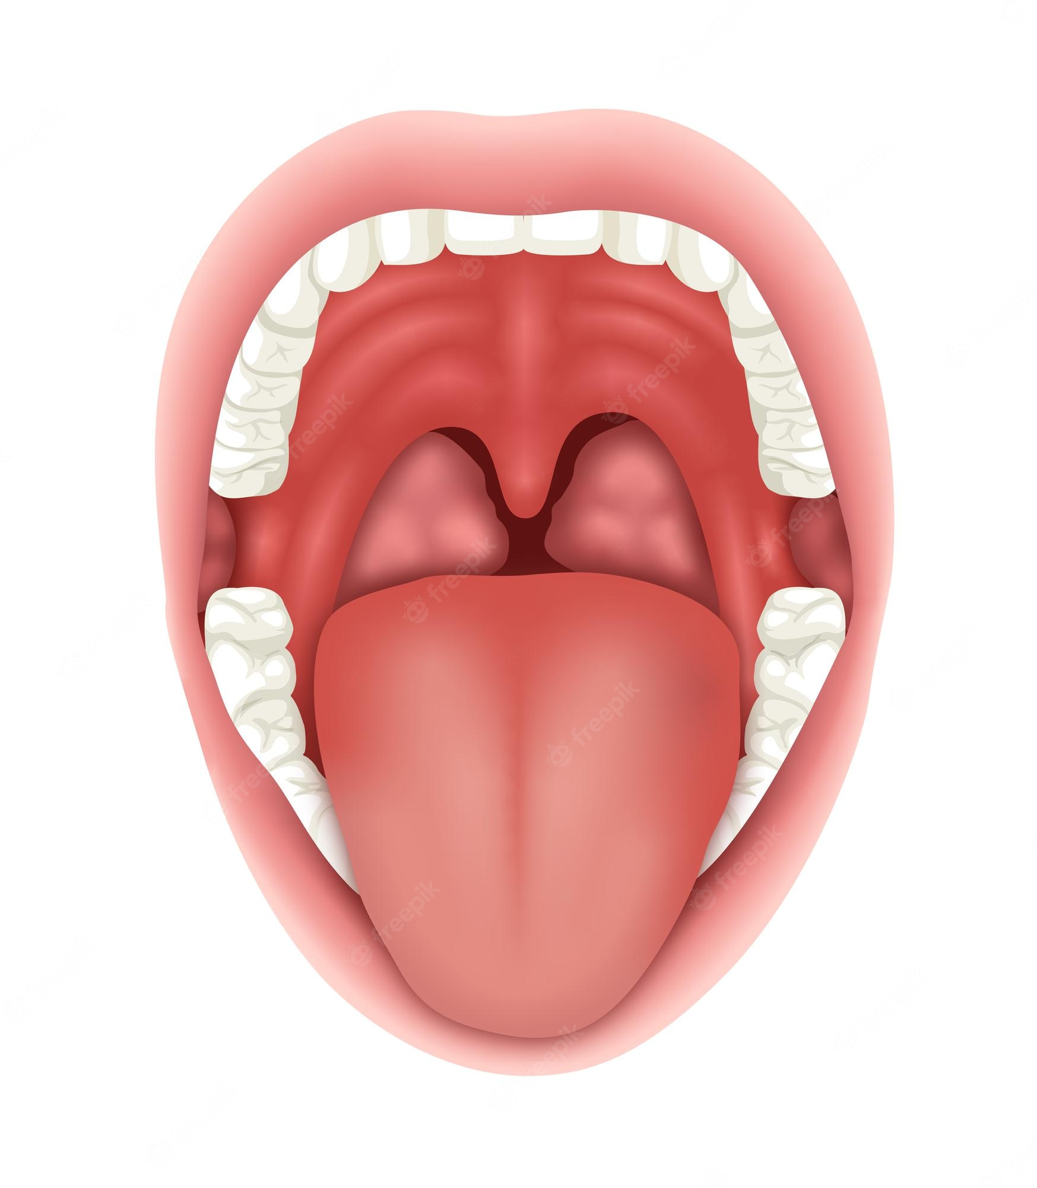
Treatment Plan
Cancer Type: ◻︎ Squamous Cell Carcinoma ◻︎ Other:__________________________
Cancer Location:
◻︎ Tongue ◻︎ Floor of the Mouth ◻︎ Roof of the Mouth
◻︎ Lower Jaw ◻︎ Upper Jaw ◻︎ Retromolar Trigone (RMT)
Estimated Cancer Stage: T ___ N ___ M ___ Overall Stage: ____________
Surgery Plan:
◻︎ Tracheostomy (Tr-ake) ◻︎ Removal of Cancer with 1-2cm Margin
◻︎ Feeding Tube ◻︎ Neck Dissection (Lymph Node Removal)
◻︎ Nasal ◻︎ Left
◻︎ Stomach ◻︎ Right
Reconstruction:
◻︎ _______________________________________________________________________
_______________________________________________________________________
Estimated Cancer Removal:

